Slide 1

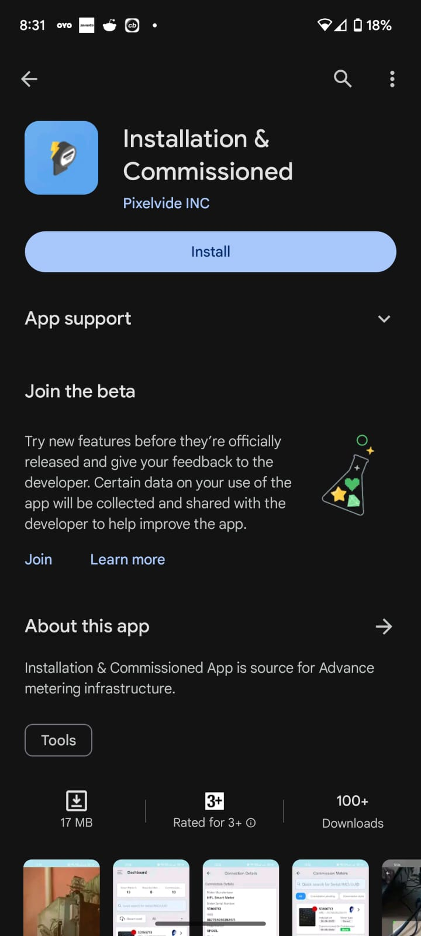


Installations and Commissioned APP Tutorial

Slide 2
How to download?
Go to the play stope app and search for installation & commisioned app, click install.
Allow permissions and you are all set.

Slide 3
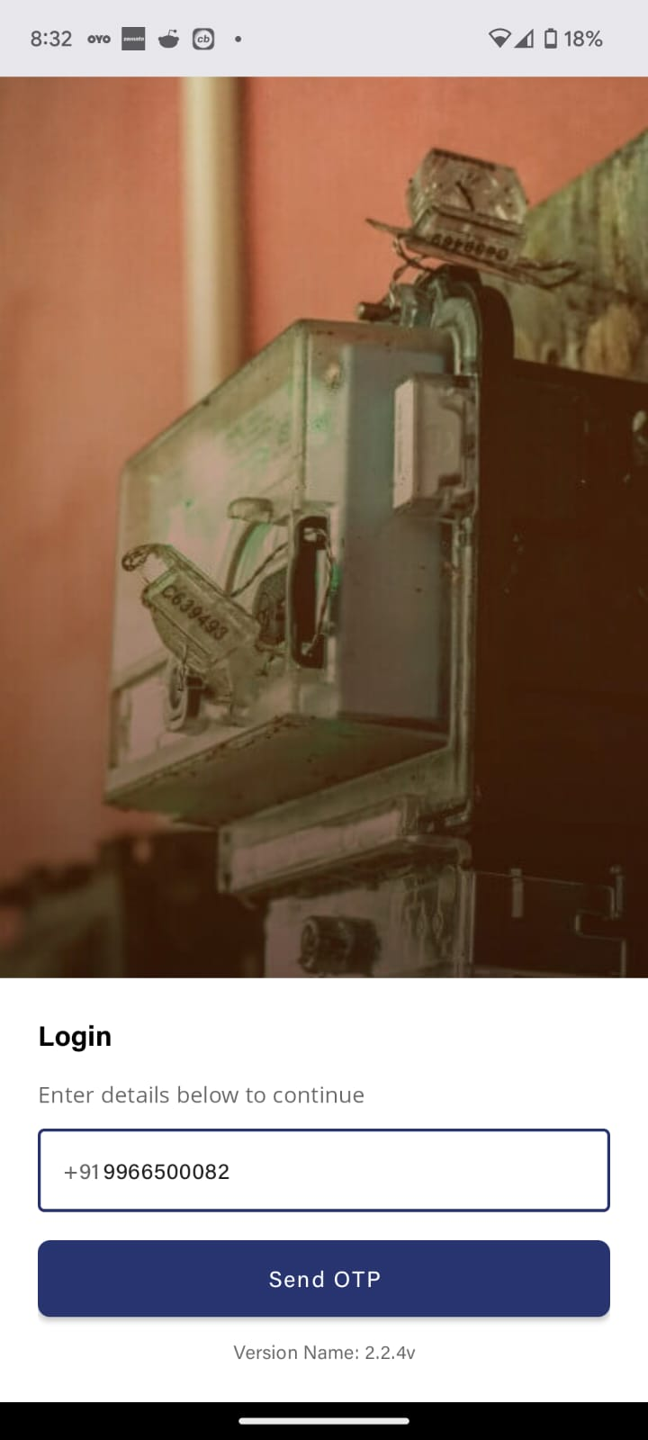
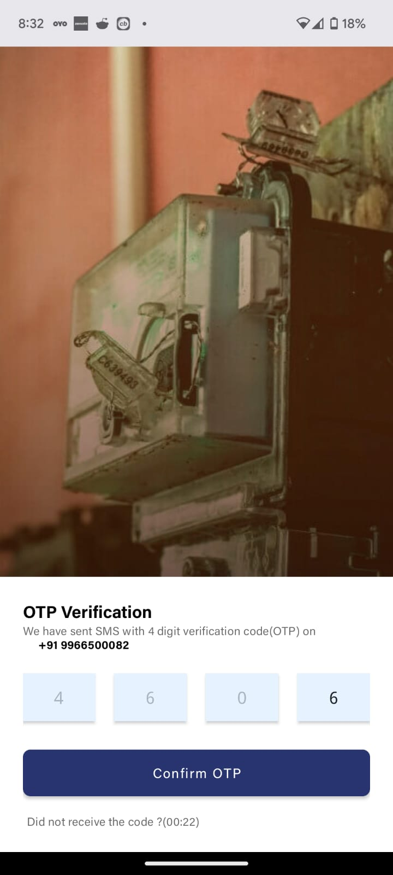
LOGGING IN
Enter the phone number with which a user ID is create.
Enter the 4-digit OTP generated and sent to the user's mobile.
Click "Confirm OTP"

Slide 4
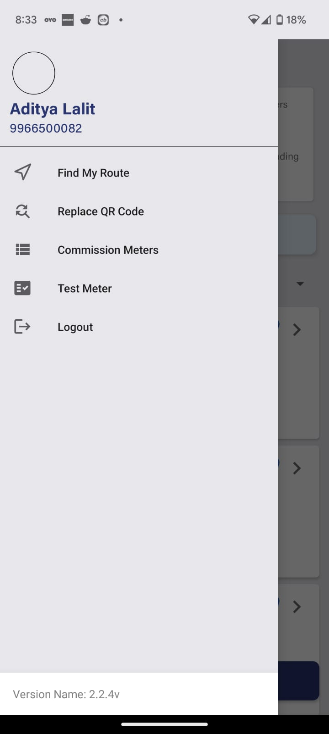
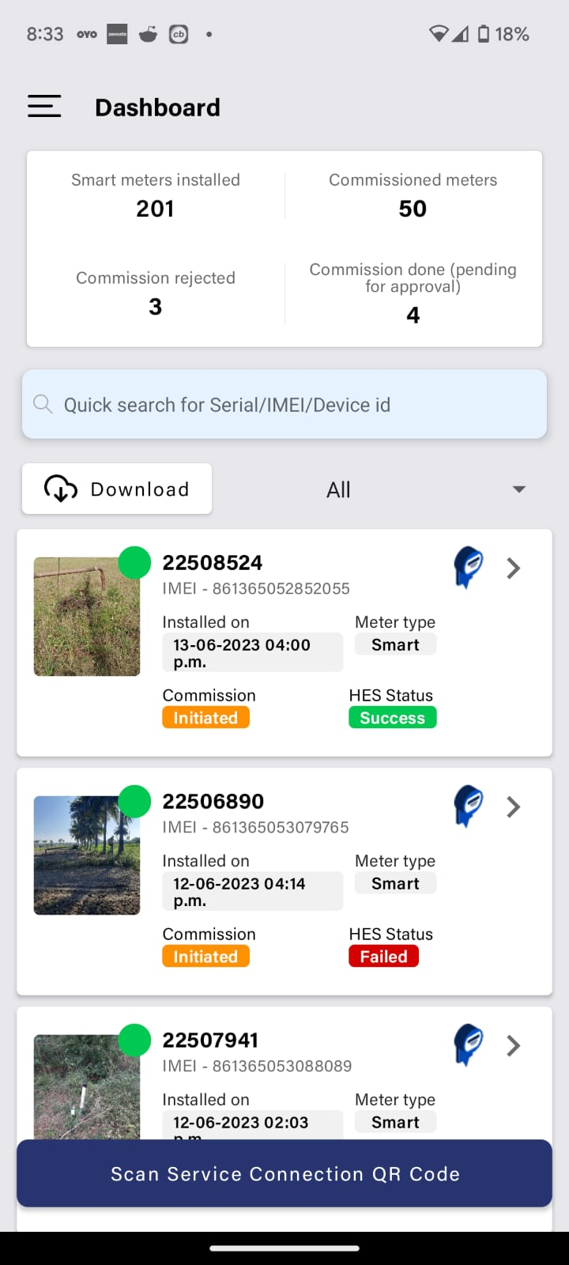
HOMESCREEN AND DASHBOARD
Upon logging in, the user will be displayed the home screen with all meters' count and each meter status (the status is null for a fresh user with counts being zero)
There is also a dashboard with the necessary modules as shown.

Slide 5
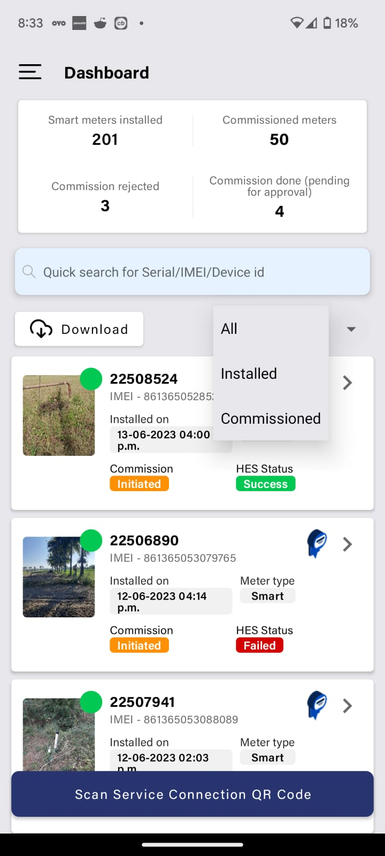
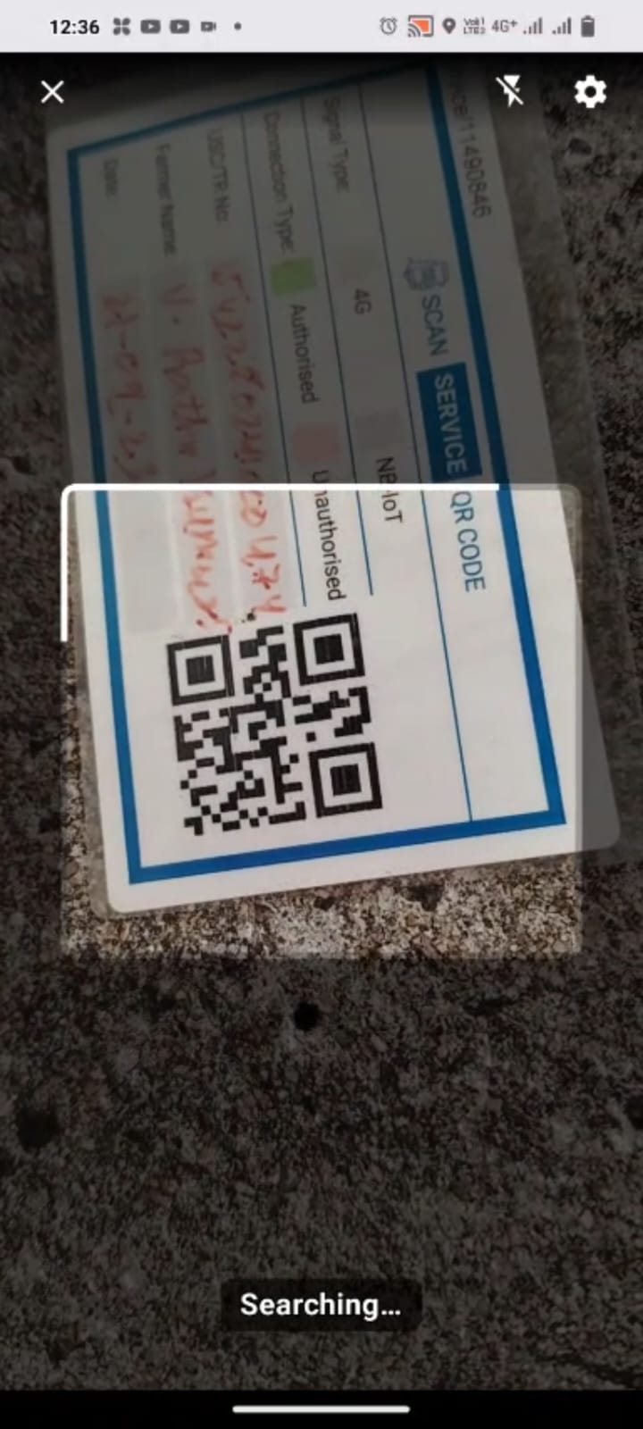
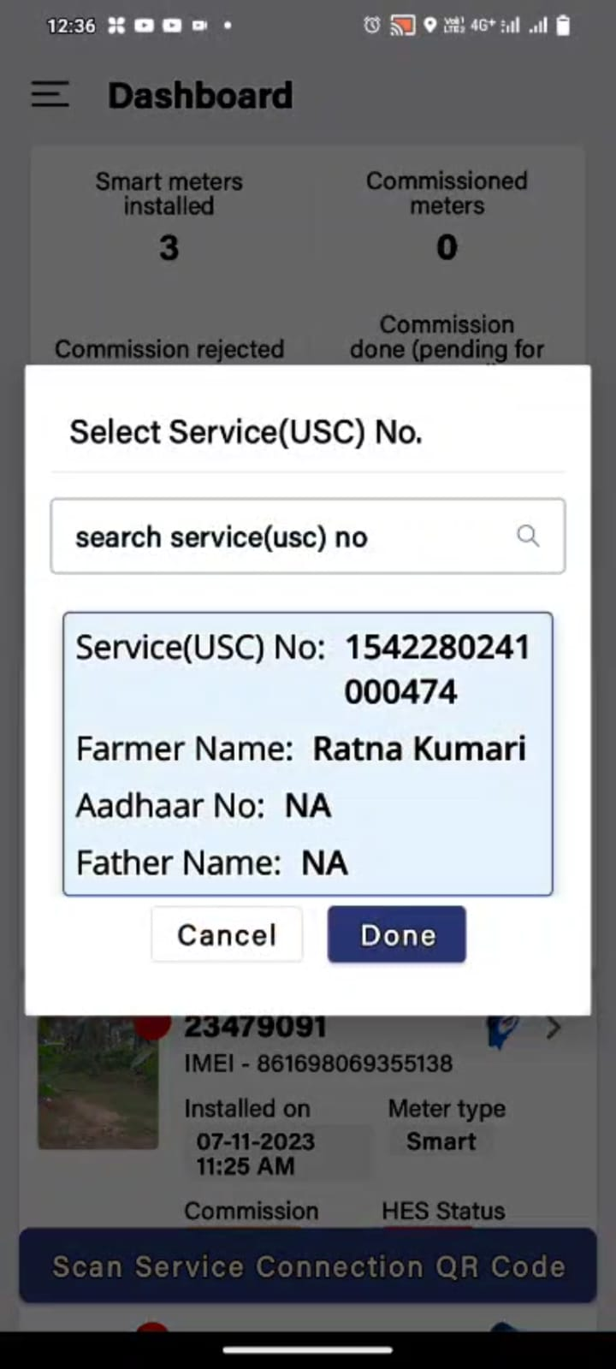
INSTALLATION OF A METER
To install a meter, click the scan SC QR code on the. Bottom of the home screen
Scan the QR code of the already surveyed SC point.
Confirm the details of the Service connection and select "Done"

Slide 6
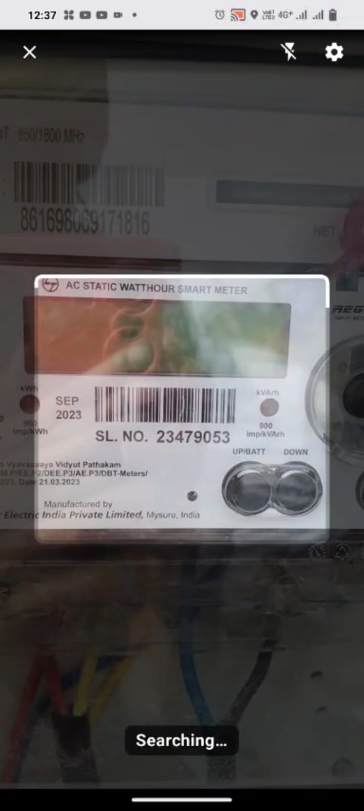
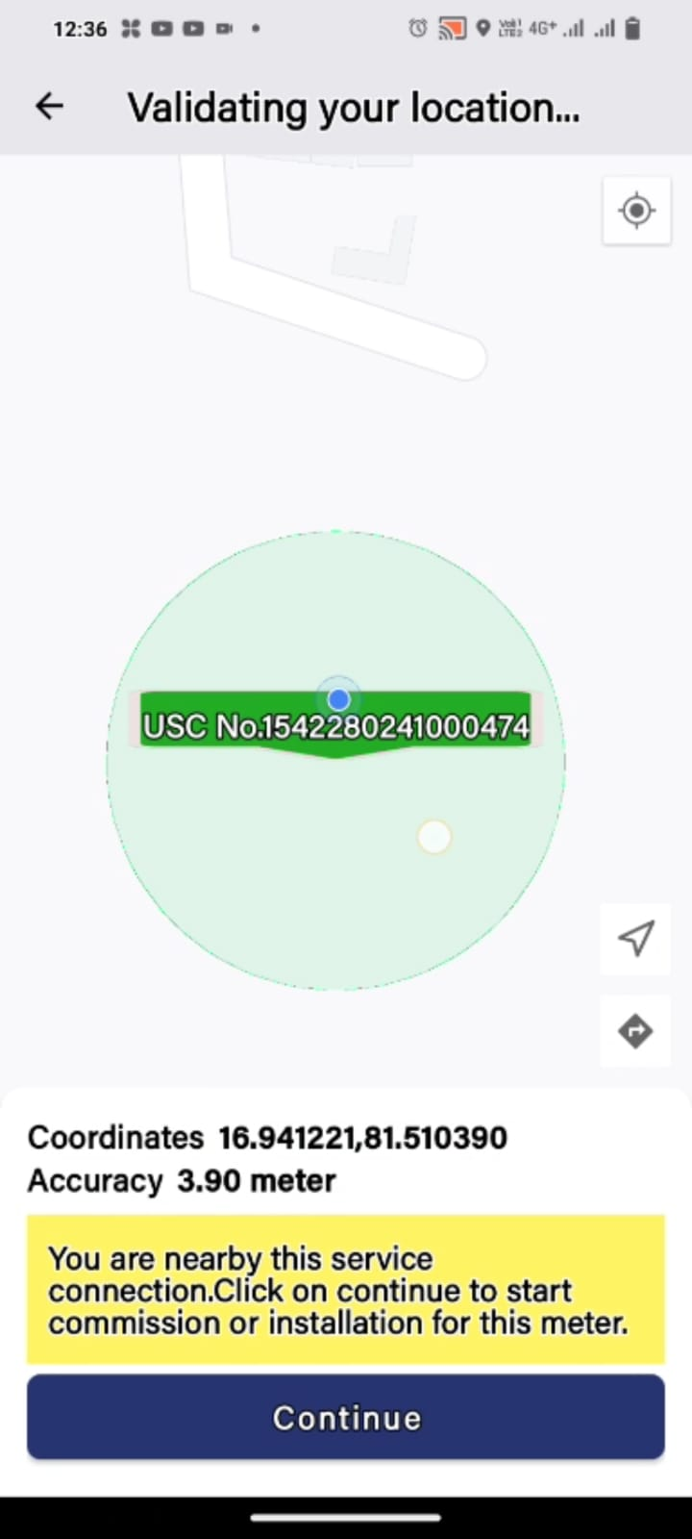
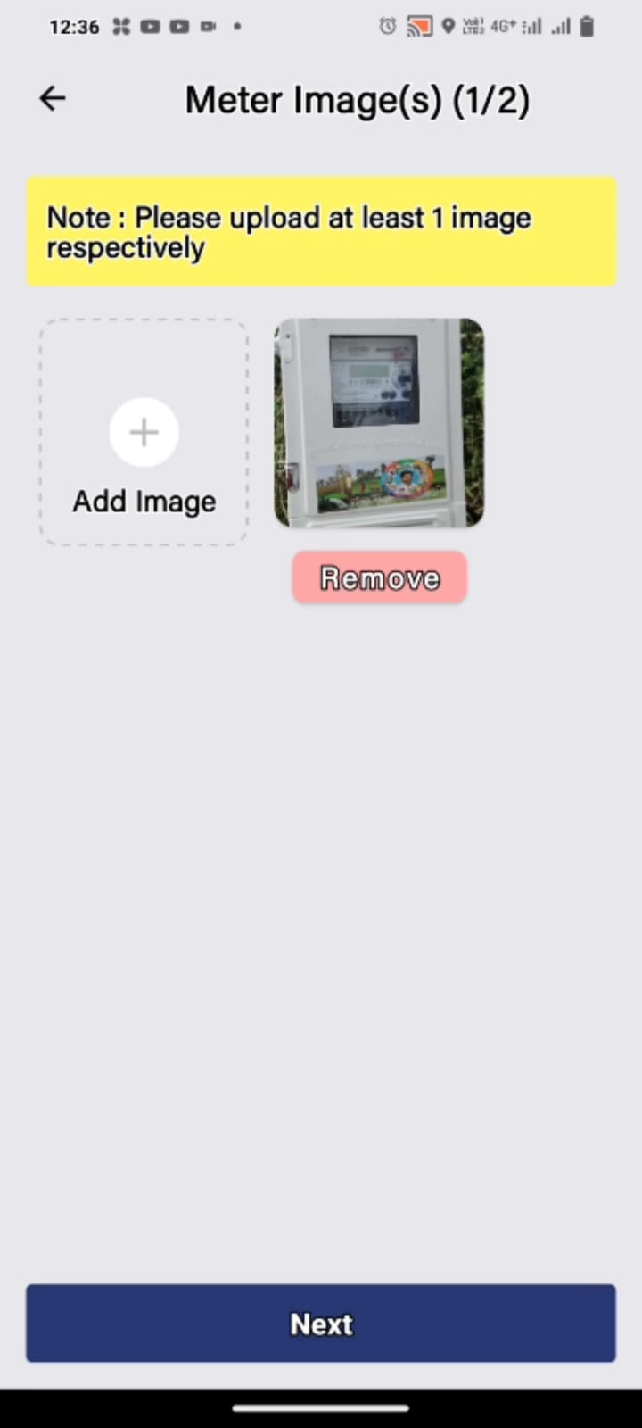
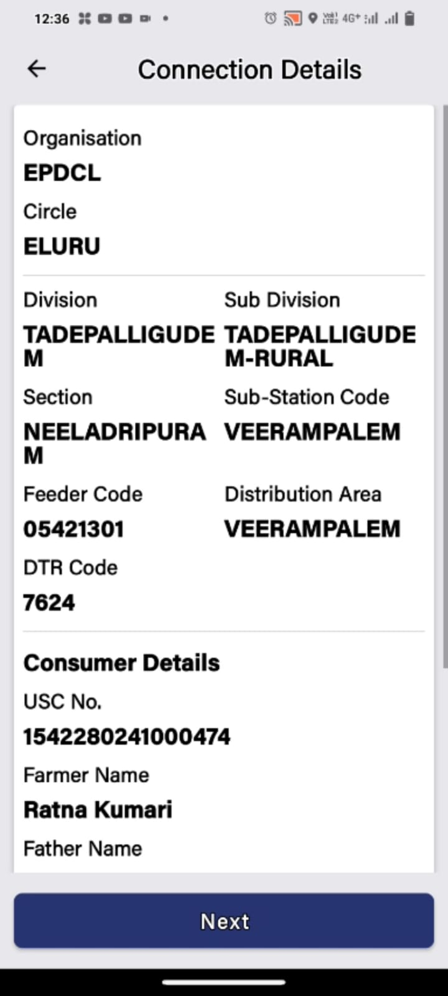
INSTALLATION PROCESS PT 2
Click "scan the barcode of the meter"
Scan the meter barcode.
Be within 30 meter range of the survey point without fail
Upload at least 2 images of the meter erected onto the pole.
Check all details and select "Next"

Slide 7
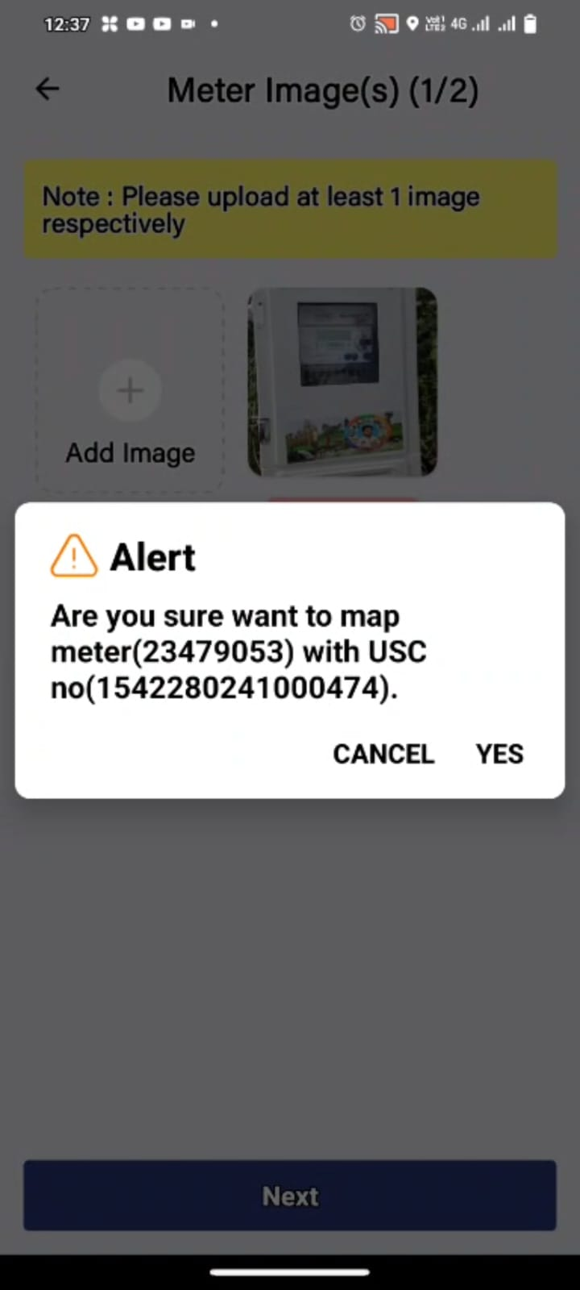
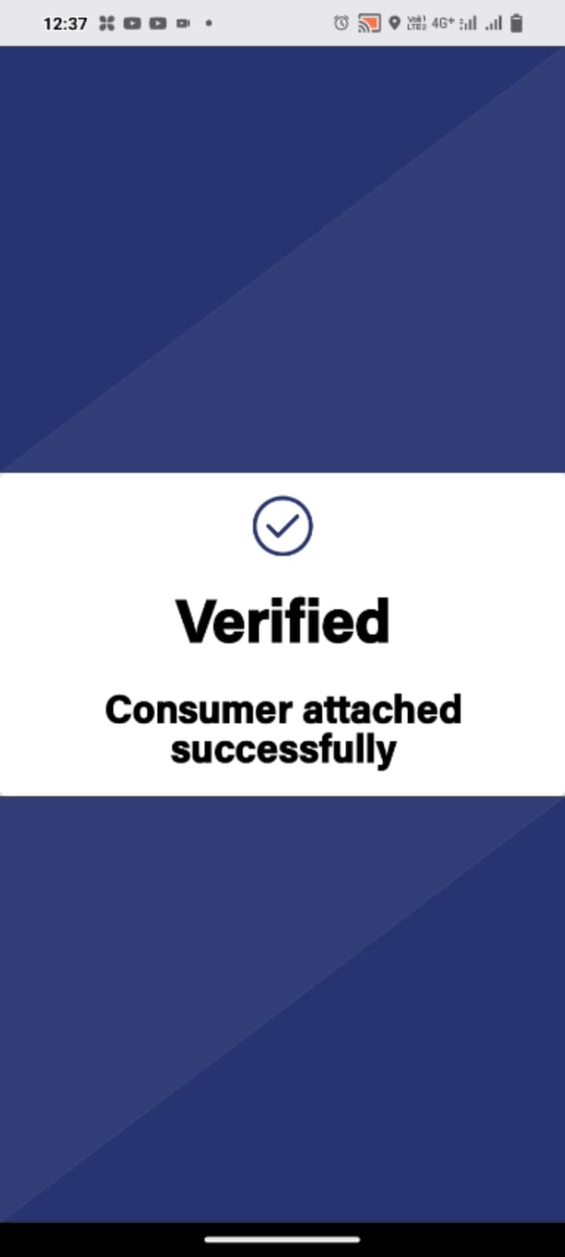
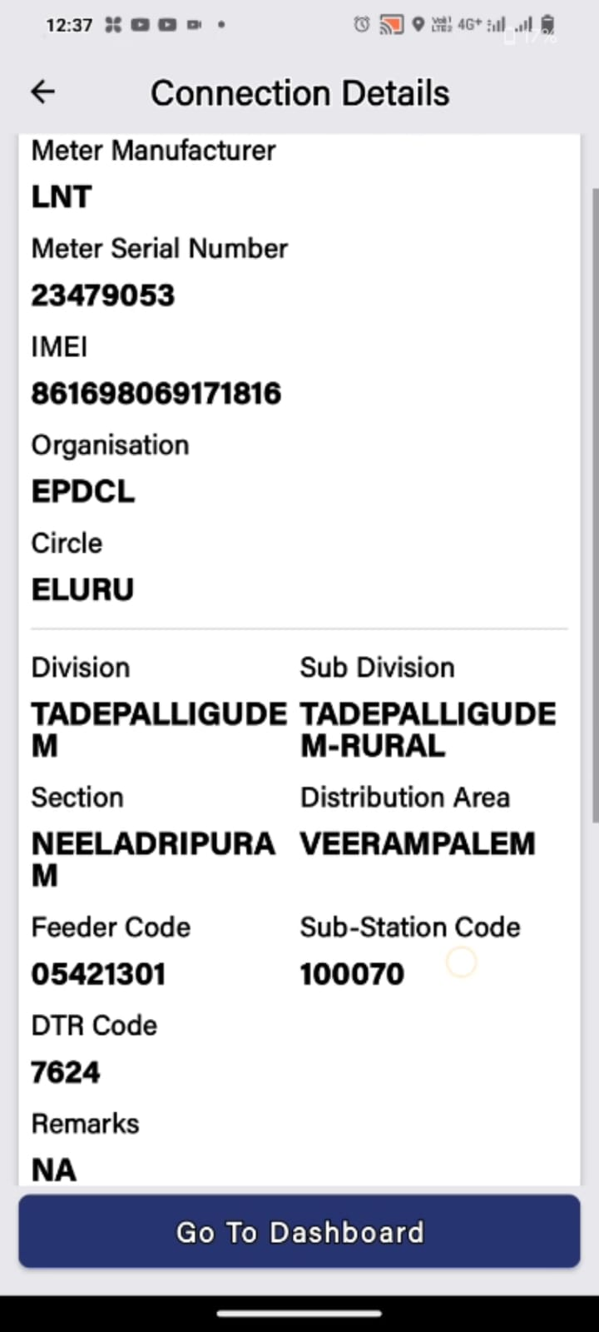
INSTALLATION PROCESS PT 3
Select yes to map the Meter to the service connection
Success! The meter is now verified
The user can view the details of the mapped device in the home screen

Slide 8
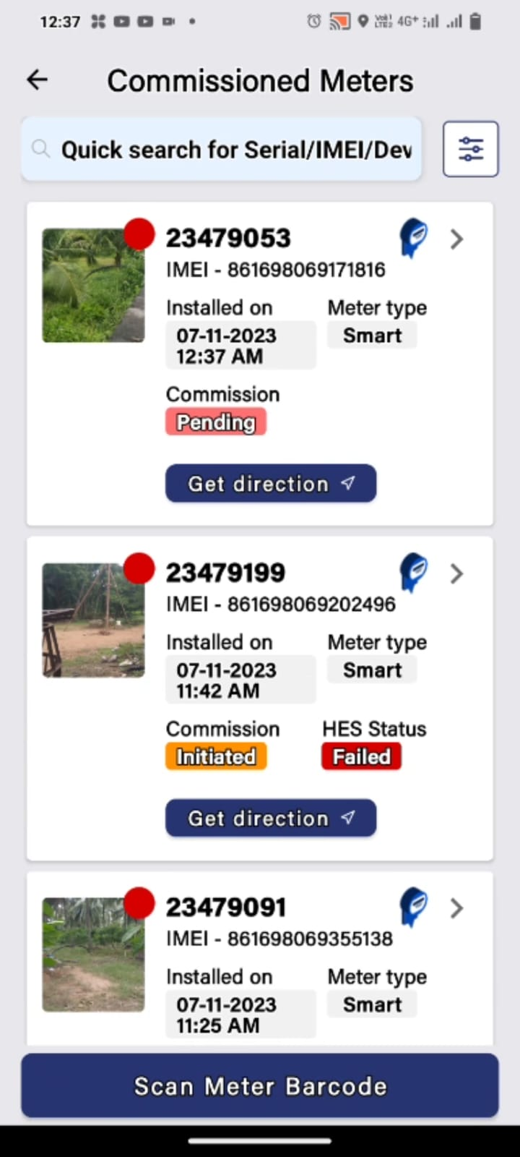
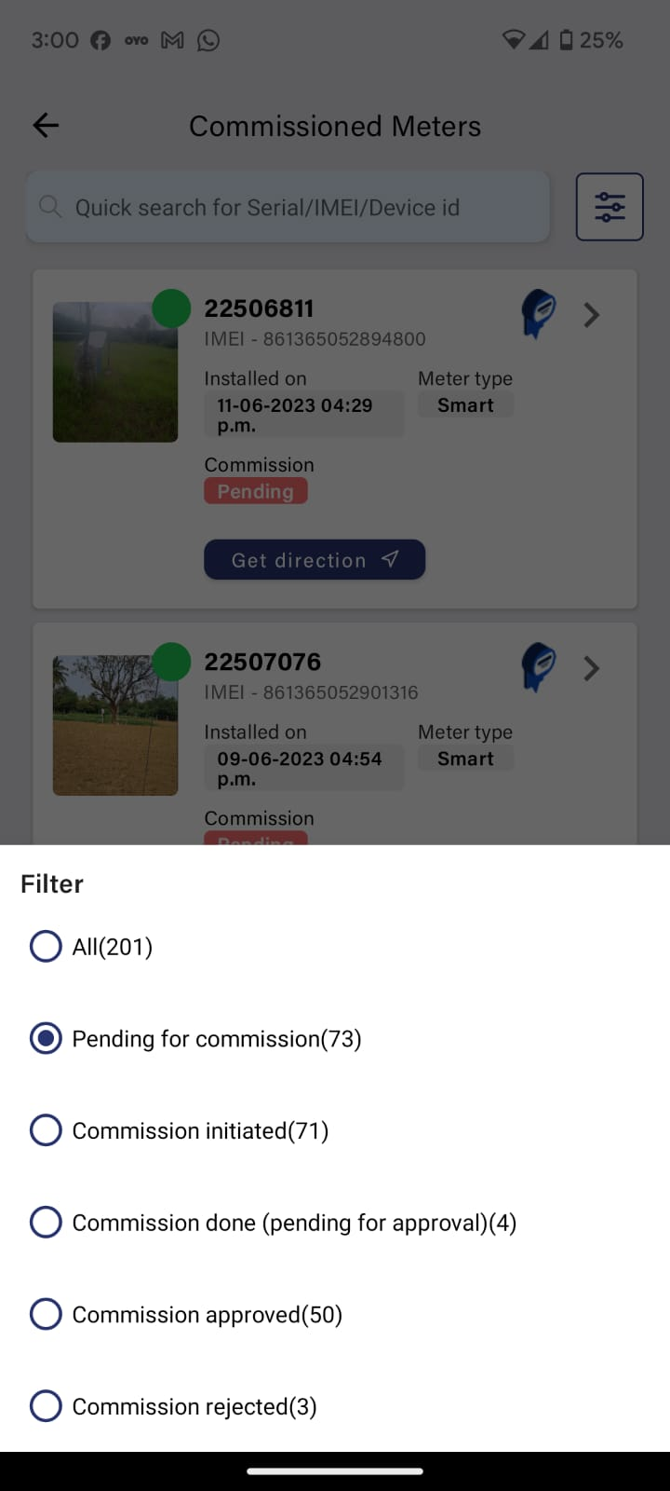
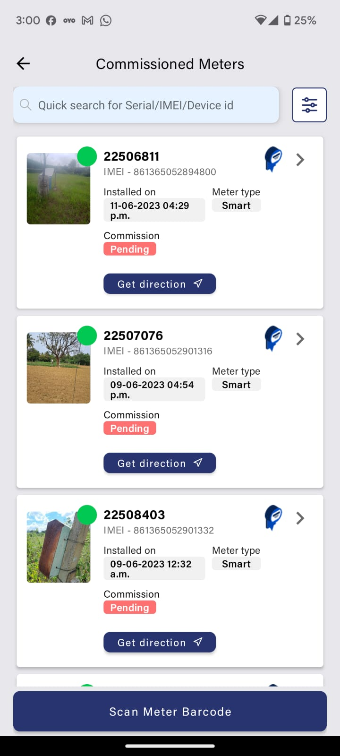
FILTERING METERS BY STATUS
There is a filter called commission Meters in the dashboard of meters with different status. (refer Commission status slide)
Selecting the status will filter out the results of the installed meters as shown above
By filtering out pending meters, the user can easily find out the meters that can me commissioned.

Slide 9
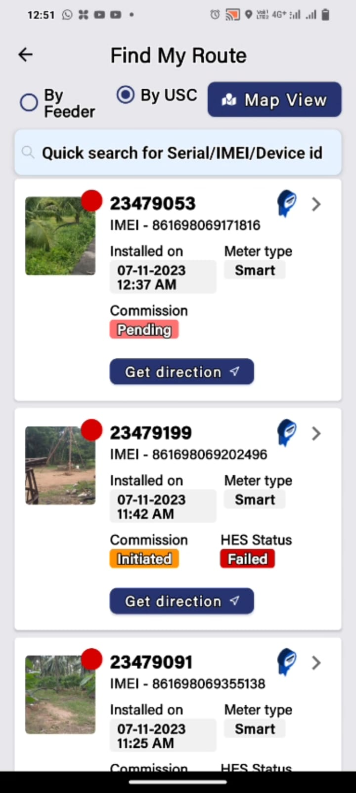
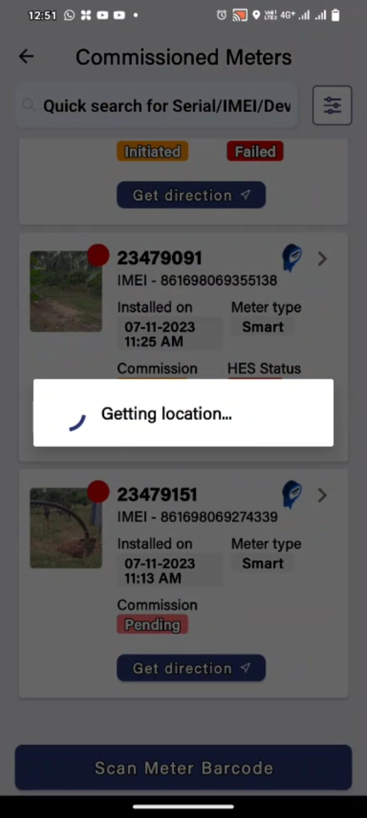
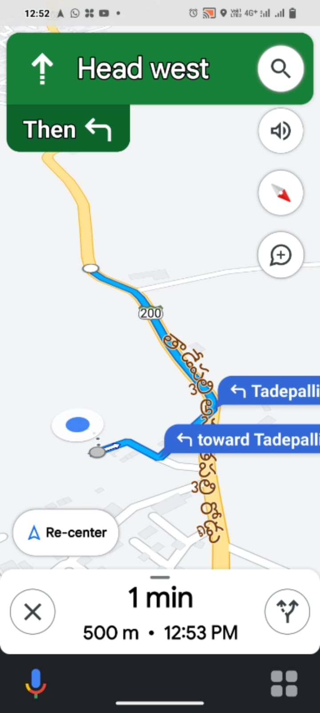
FIND MY ROUTE – GPS TRACKER
Find my route is a feature that allows an installer to find the exact meter location via maps.
Click on get directions under the meter that you want to visit.
Access the location of the installed meter and start the navigation.

Slide 10
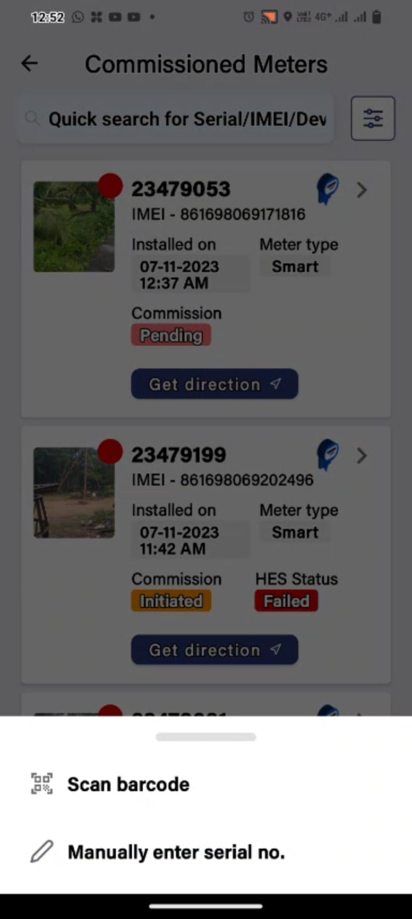
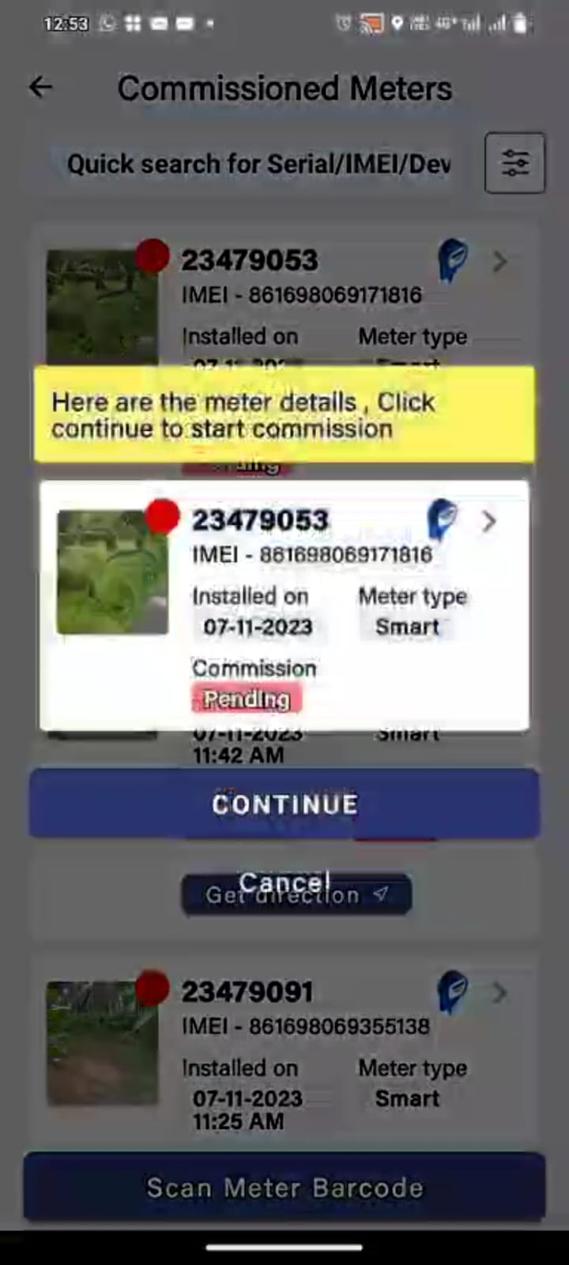
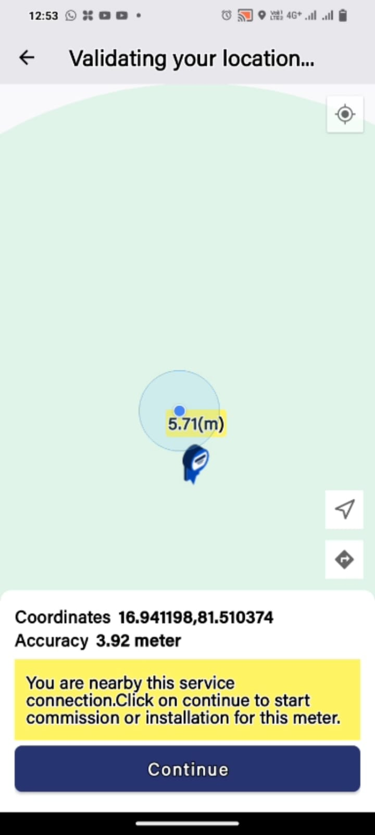
COMMISSIONING OF A METER
Click on the meter that needs to be commissioned.
Scan the Barcode or enter the meter s.no
Scan the barcode of the meter
Check the meter details and select continue
Make sure to be in range of the meter.

Slide 11
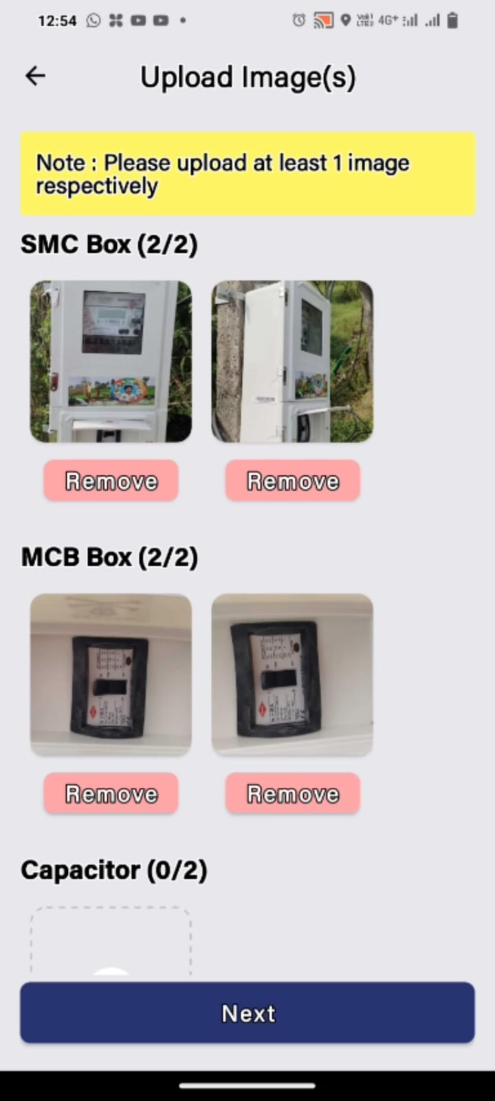
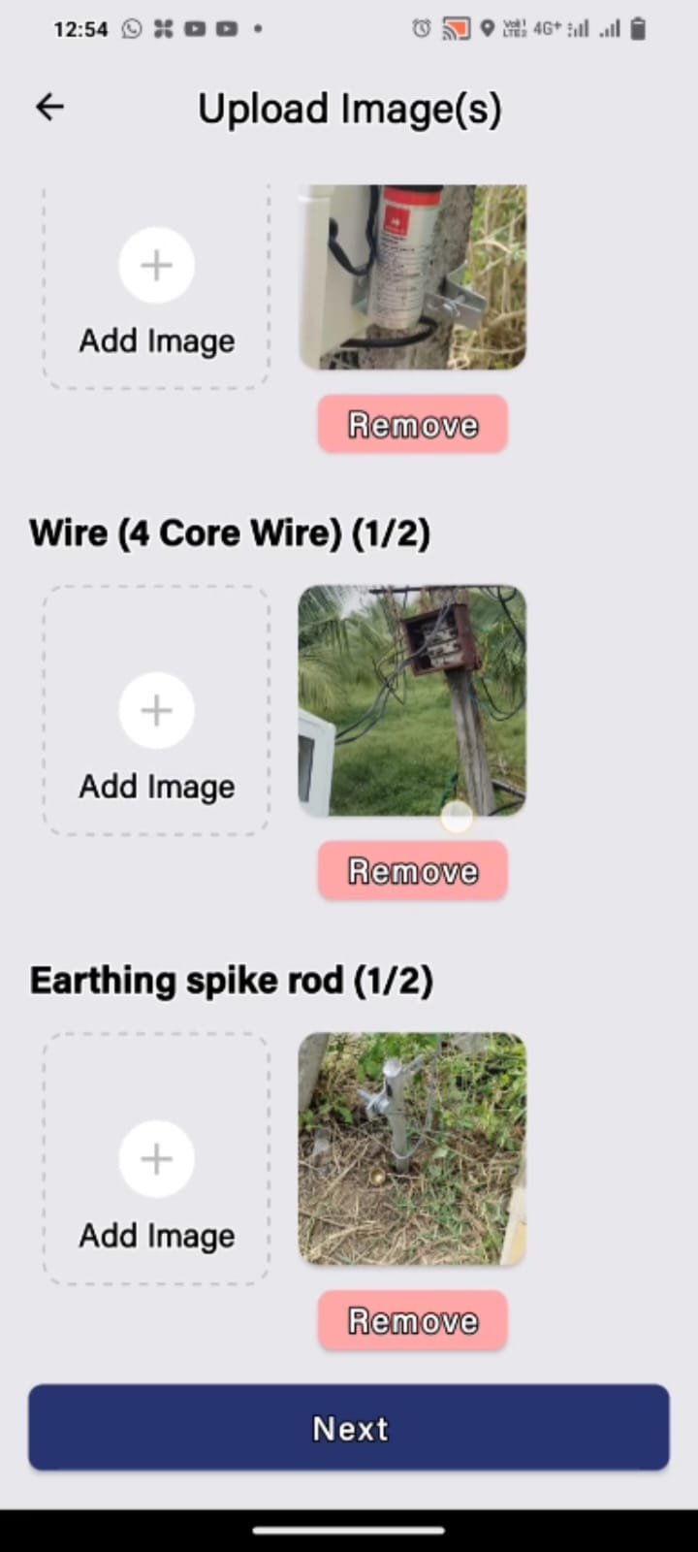
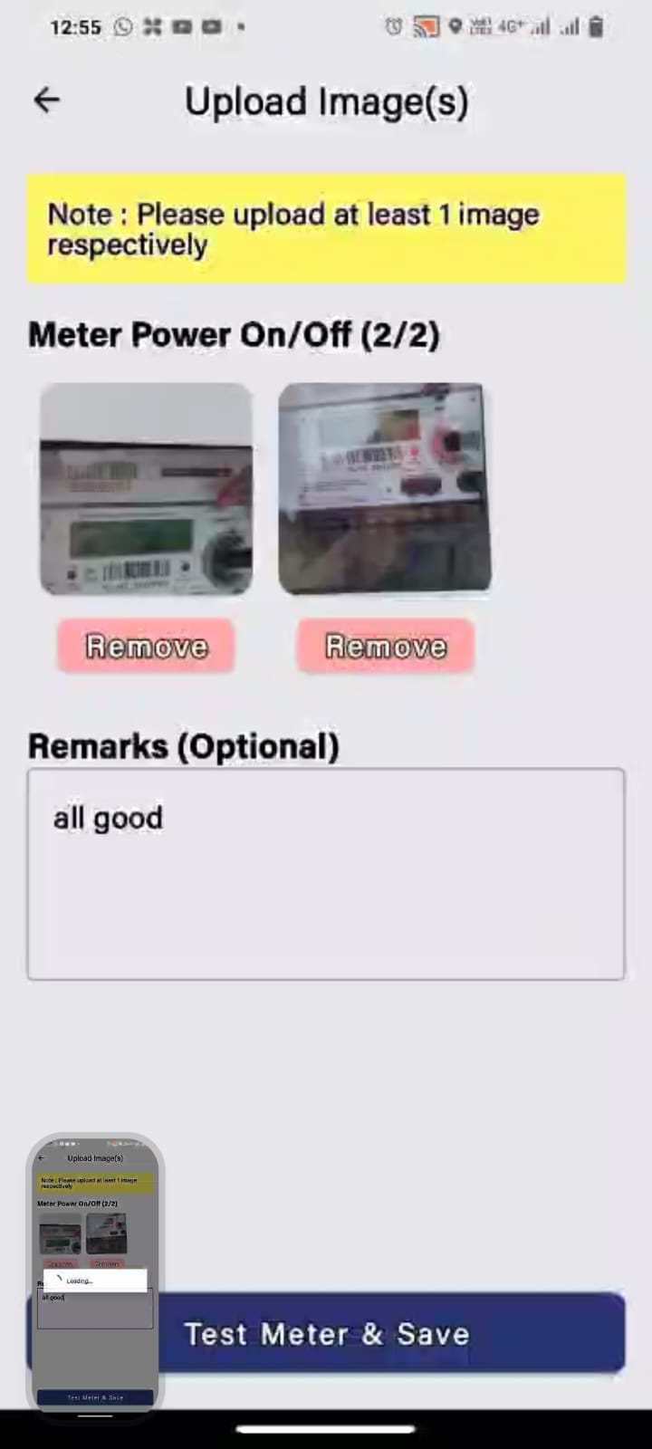
COMMISIONING OF A METER PT 2
Upload at least two images in each field.
Select Test Meter & Save
After uploading the images and entering the remarks, select "Test meter and save".

Slide 12
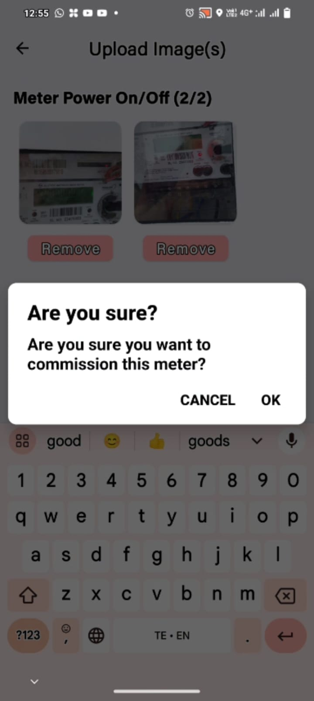
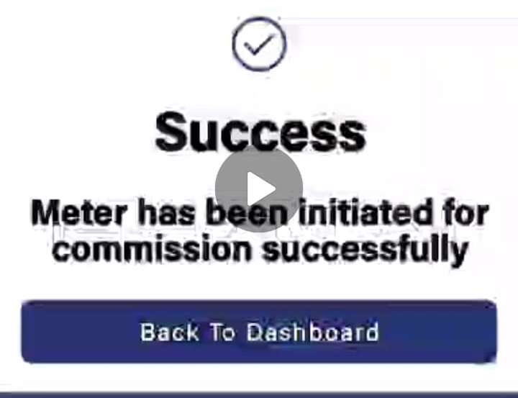
FINISHING STAGES OF COMMISSIONING
Select OK and finish the commission process

Slide 13
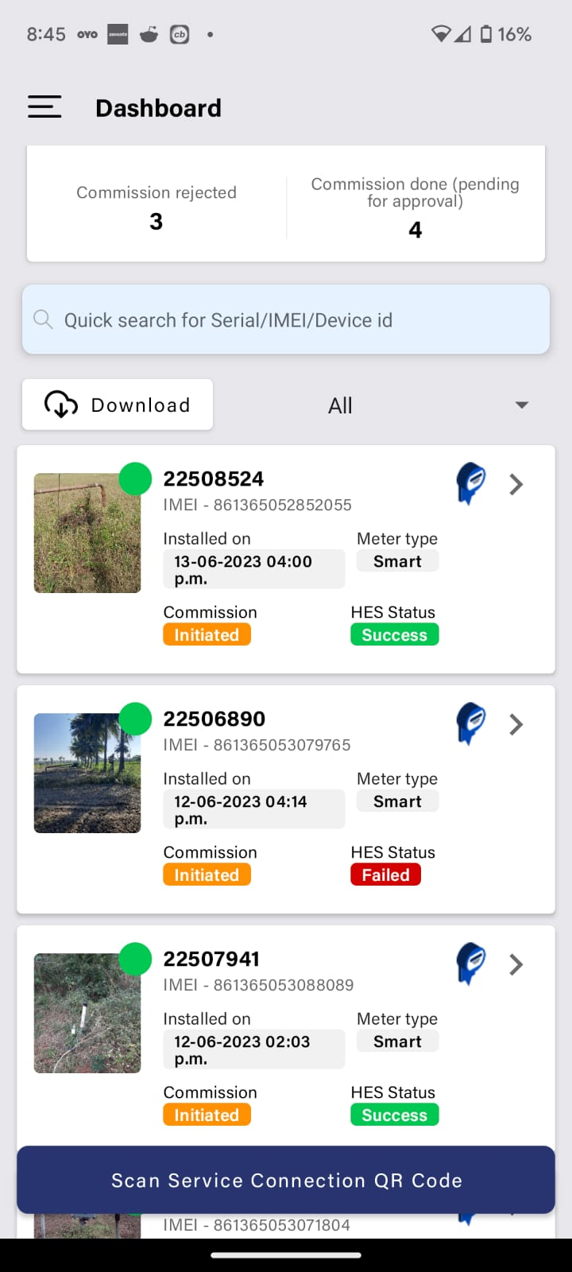
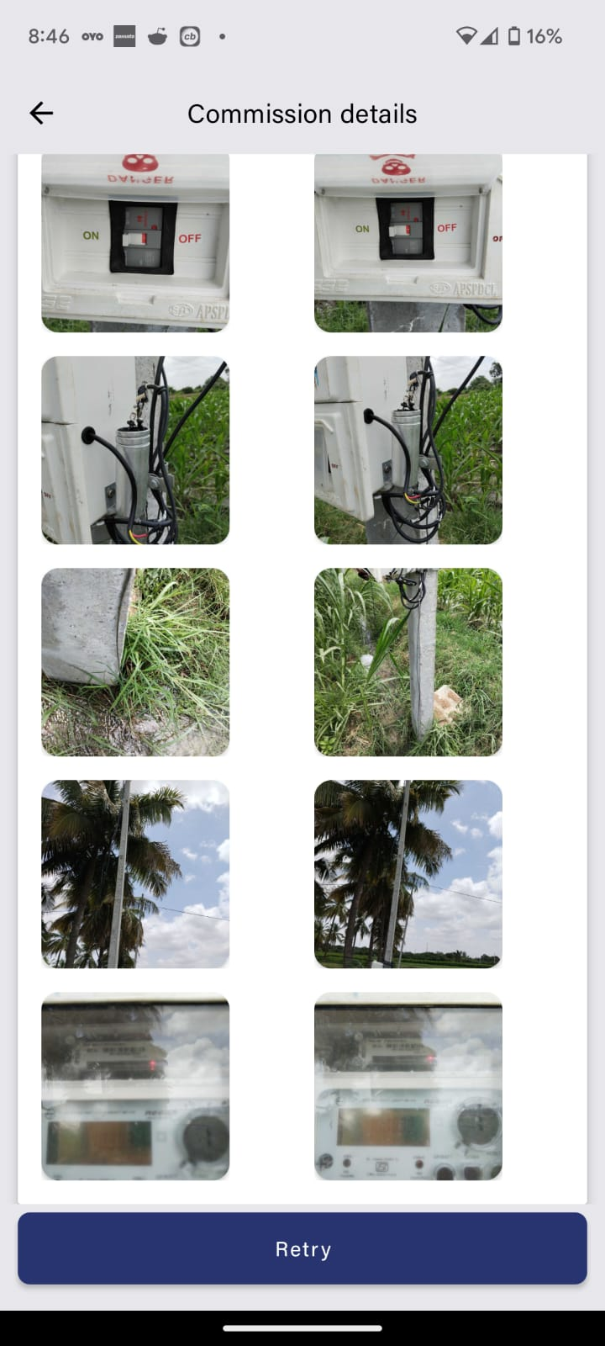
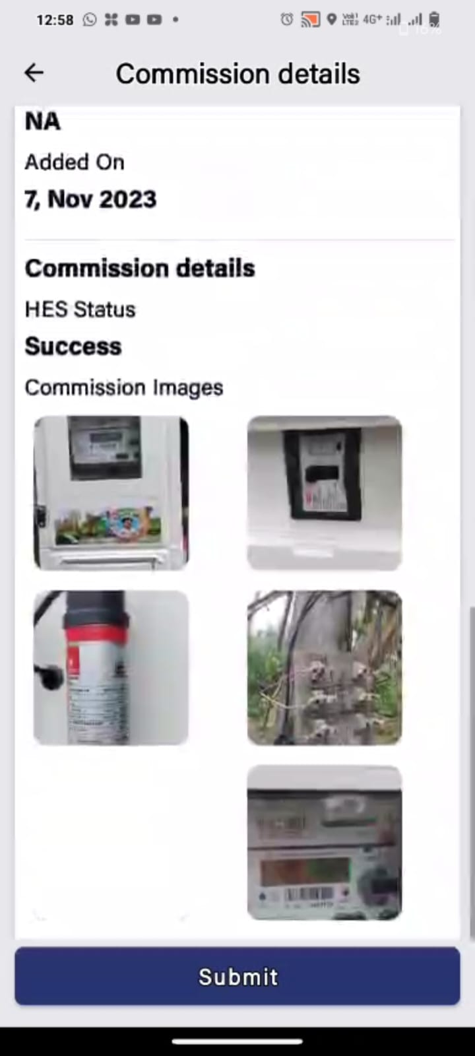
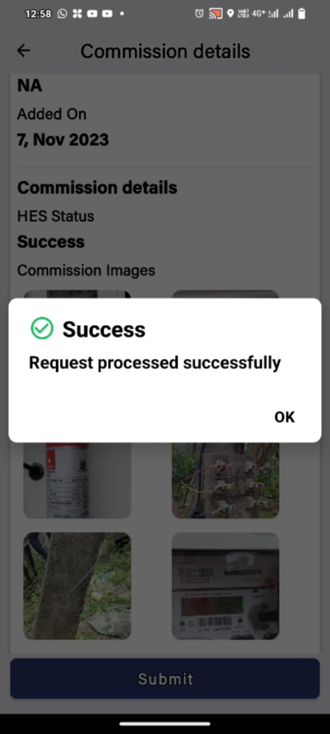
HES TEST
After the commission has been initiated, Submit the ones with the test result as success and retry the meters which have failed (Submit them if the test is successful on the second attempt).

Slide 14
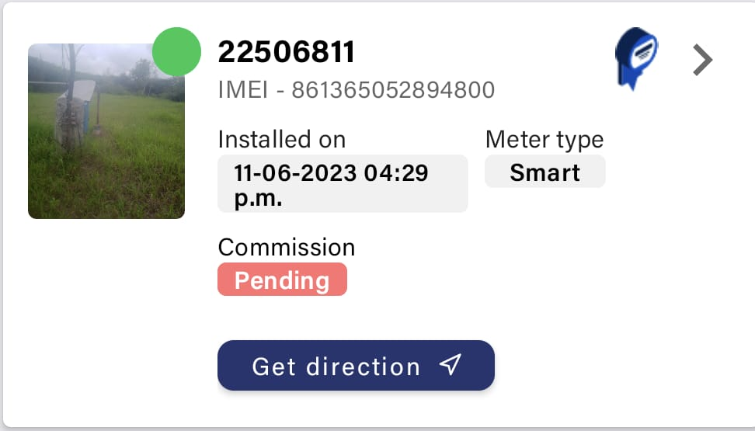
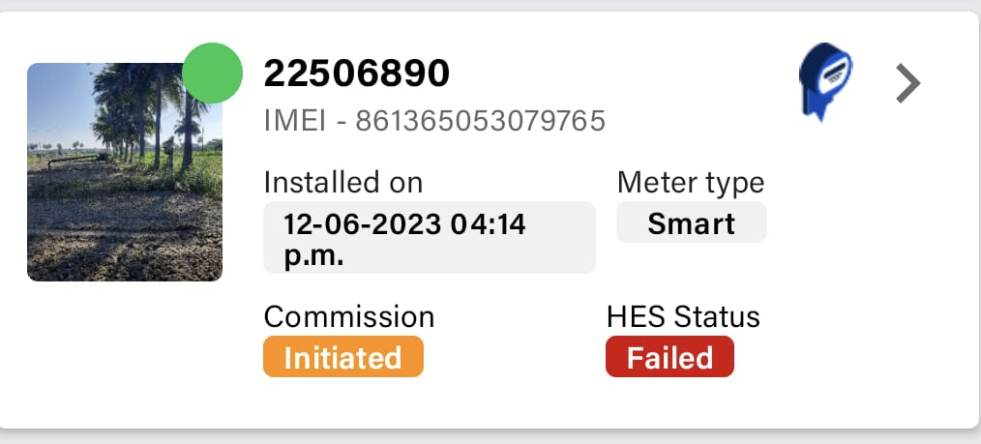
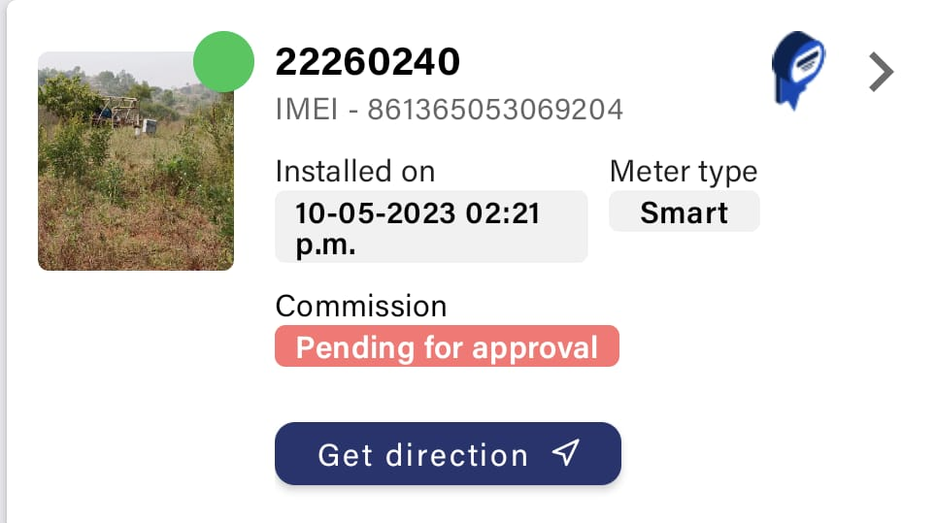
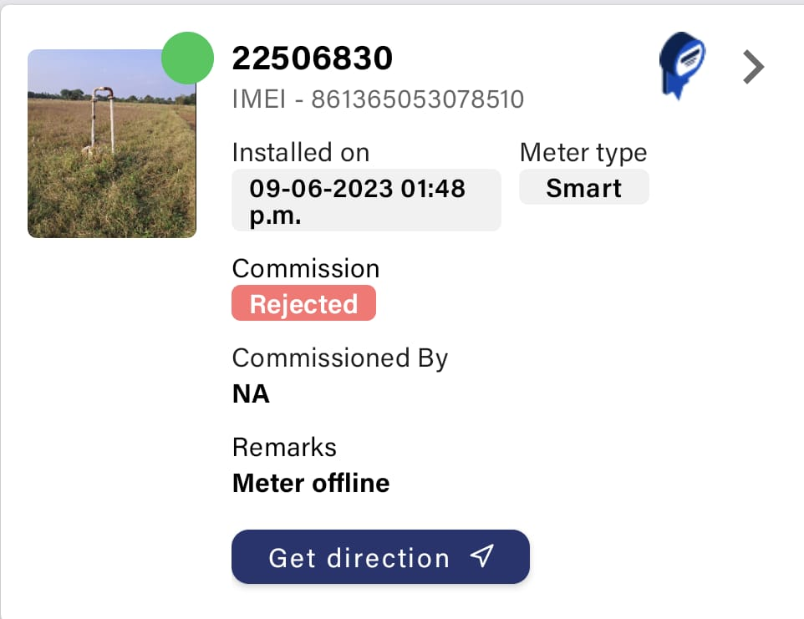
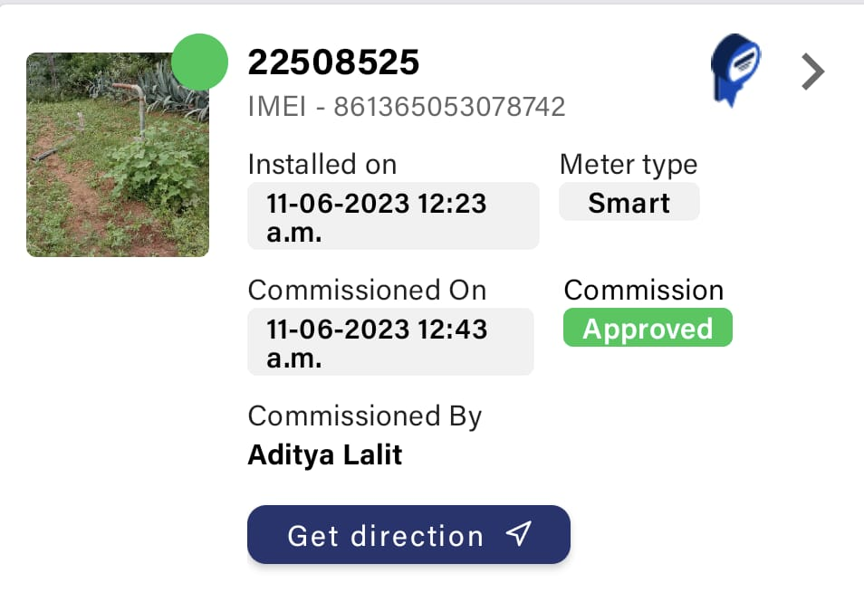
COMMISSION STATUS

Slide 15
COMMISSION STATUS EXPLAINED
Pending For Commission
Meter is installed but not commissioned.
Commission Initiated
Commission is initiated but it is not submitted for approval
Pending for Approval
Commission request is submitted and is pending for approval.
Commission Approved
Commission request is Approved
Commission Rejected
Commission request is rejected due to inaccuracy/insufficient data.

Slide 16
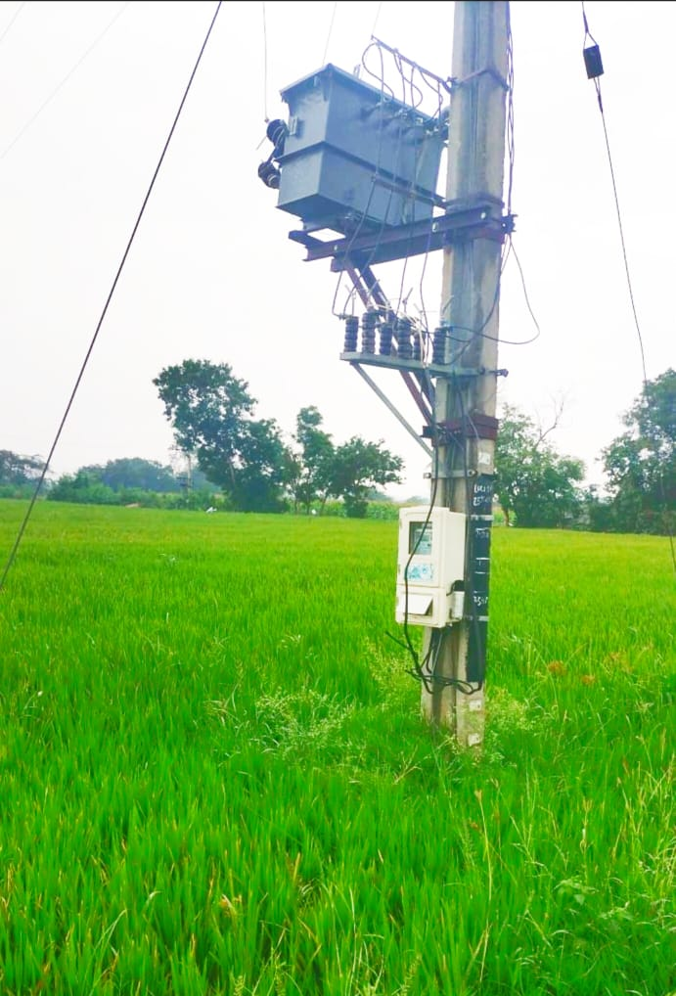
Thank You!!

