Slide 1


EPDCL Survey App Tutorial

Slide 2
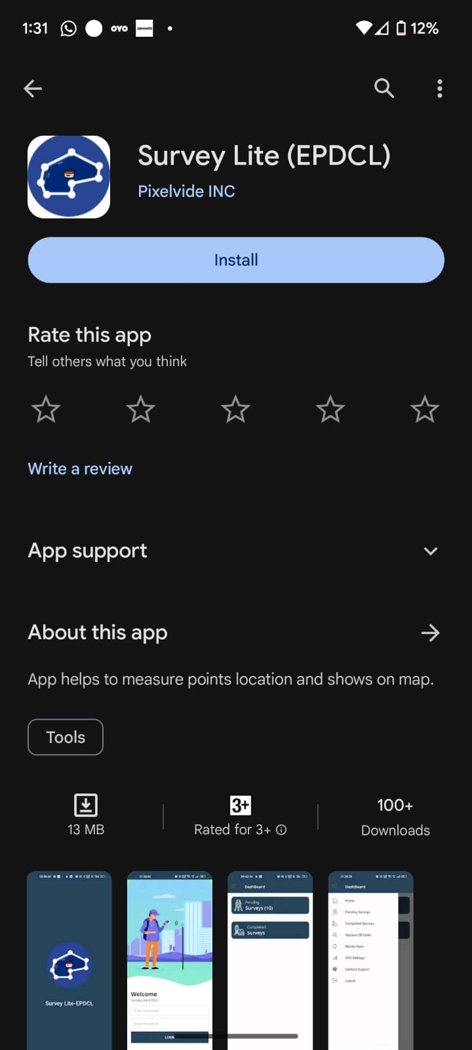
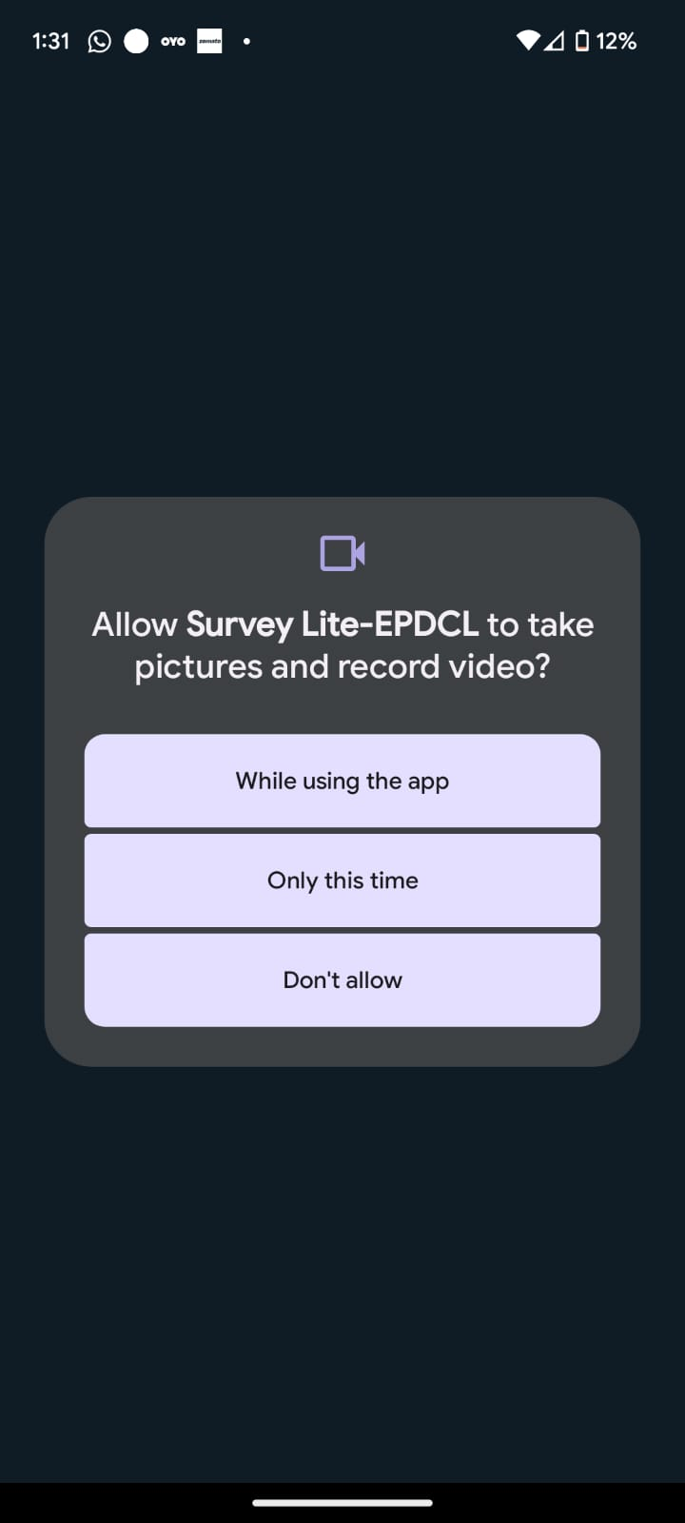
How to Download ?
Download Survey Lite (EPDCL) App
from Play store
Note : Allow all the Permissions while installing

Slide 3
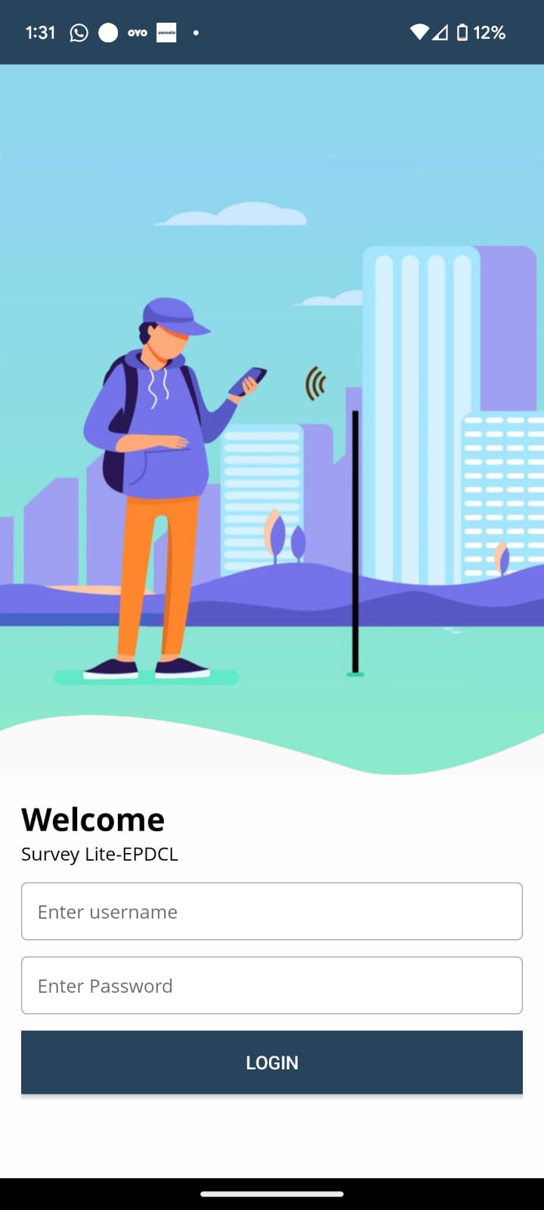

Survey Lite App Login Page
Enter the credentials provided to the user.

Slide 4
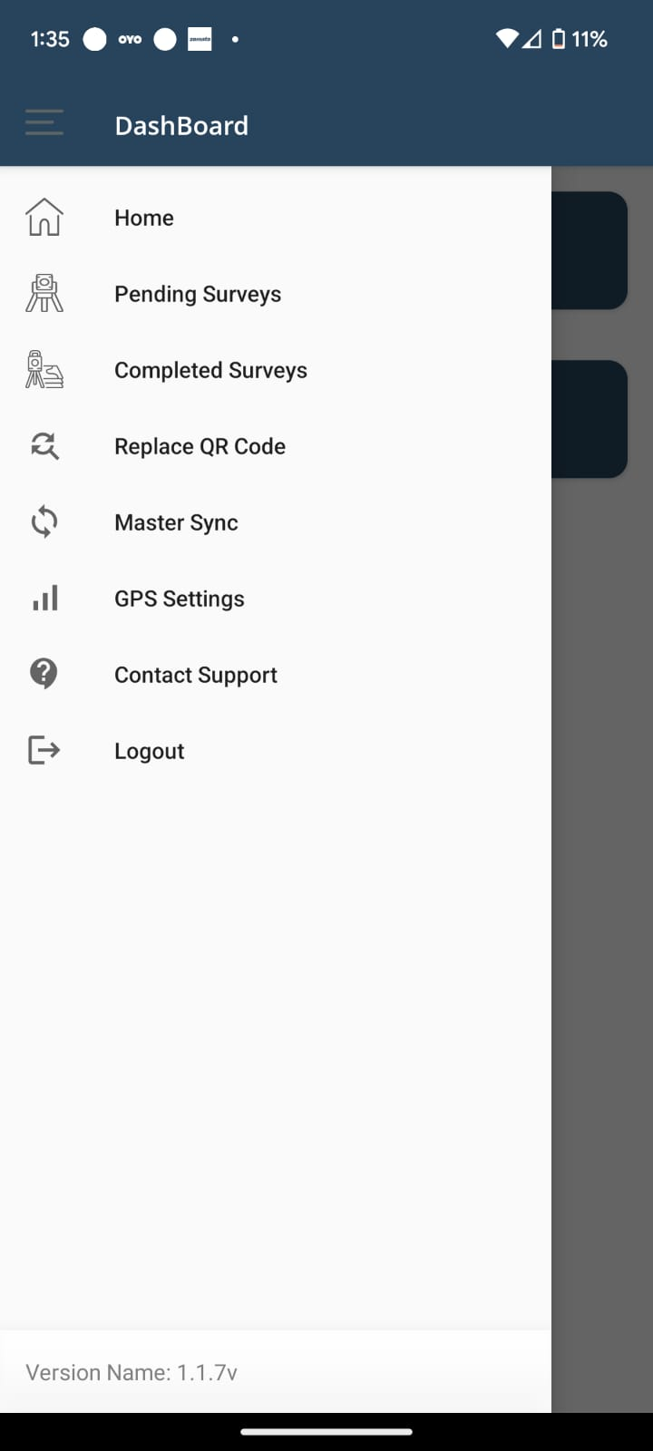
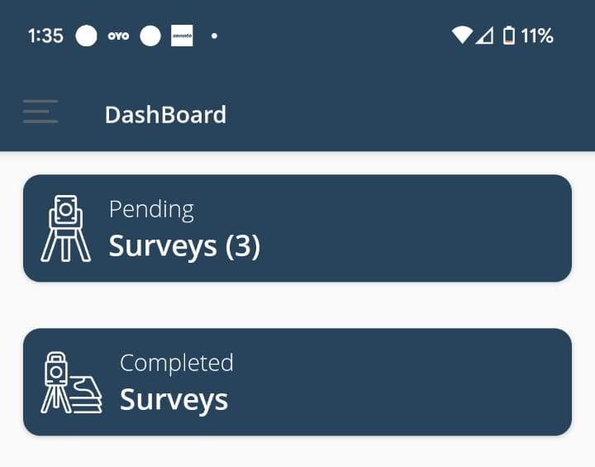
Dashboard Of Survey Lite App
After logging in, a dashboard and the assigned feeders will be visible.
Click on Pending Surveys to start uploading the points.

Slide 5
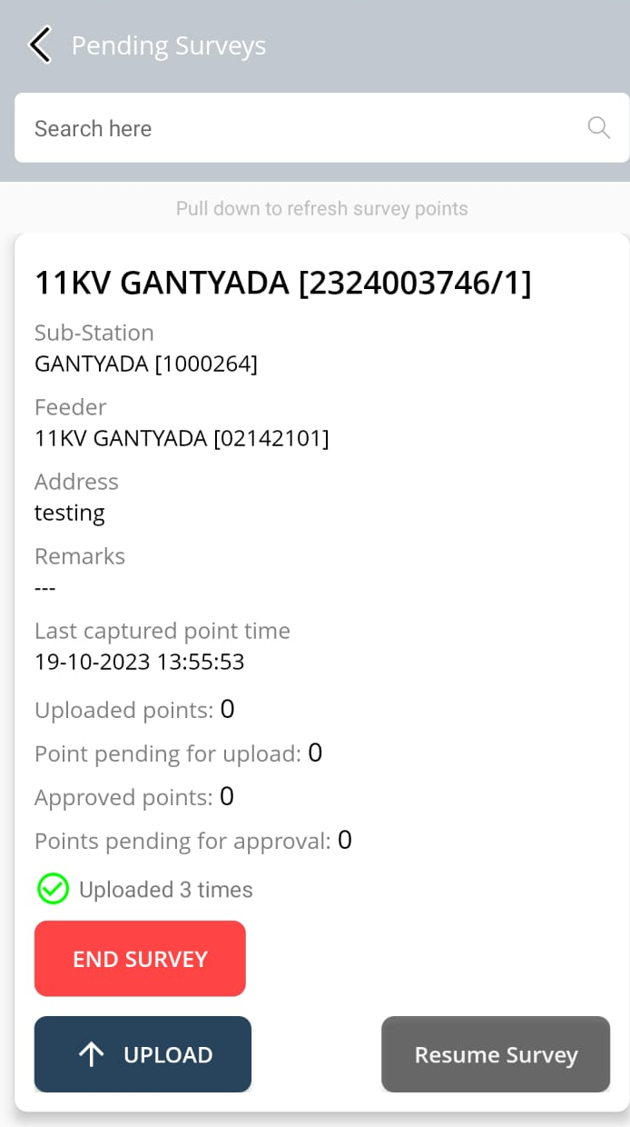
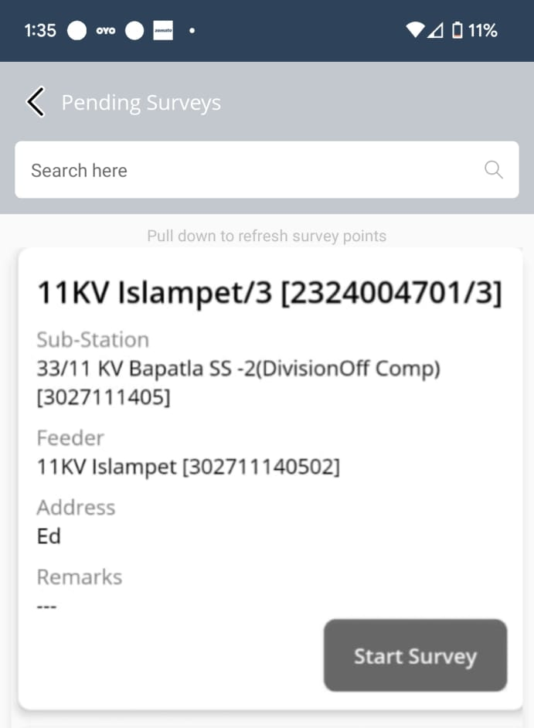
Pending surveys
In this page, you will find the list of feeders Assigned to Users Click on Start Survey to upload points on a newly assigned feeder.
Once a survey is started, user will get Resume Survey.
Once a feeder is complete, the end survey option moves the feeder from pending surveys onto the completed surveys.

Slide 6
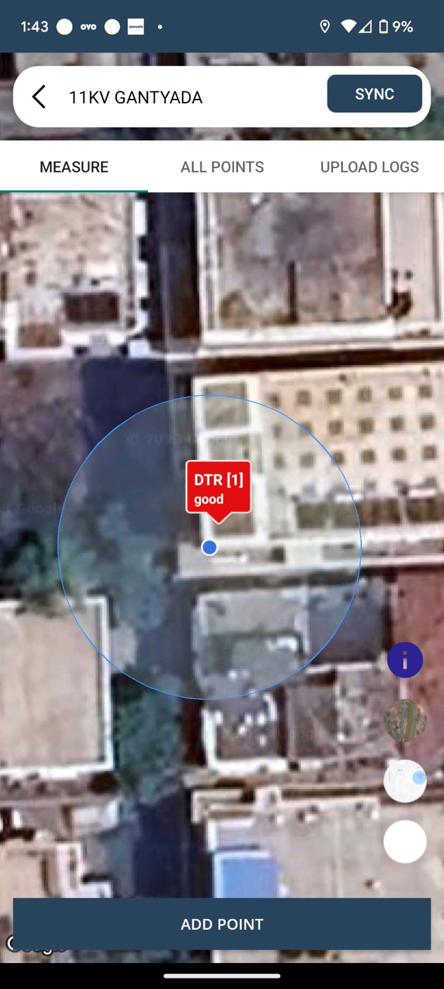
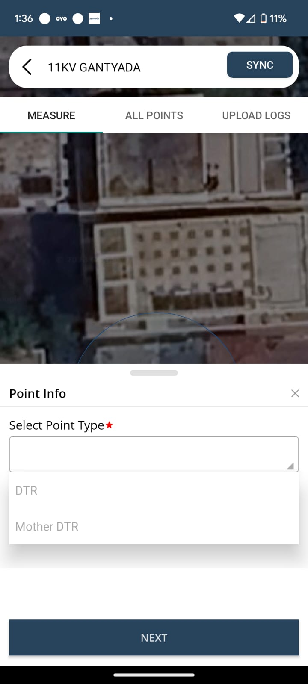
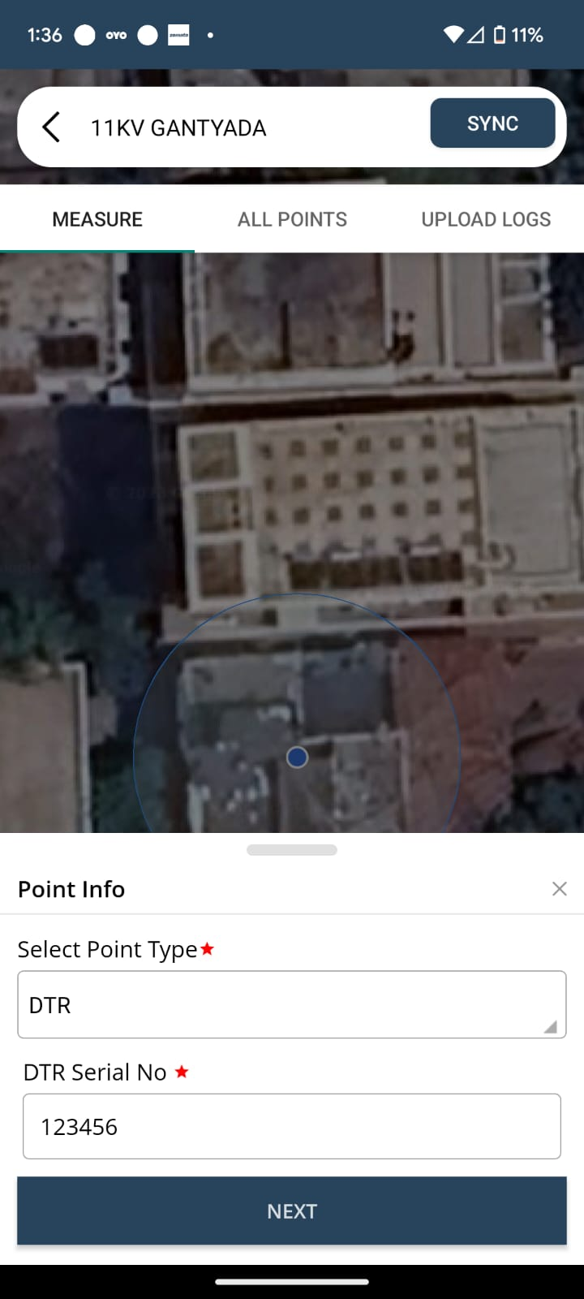
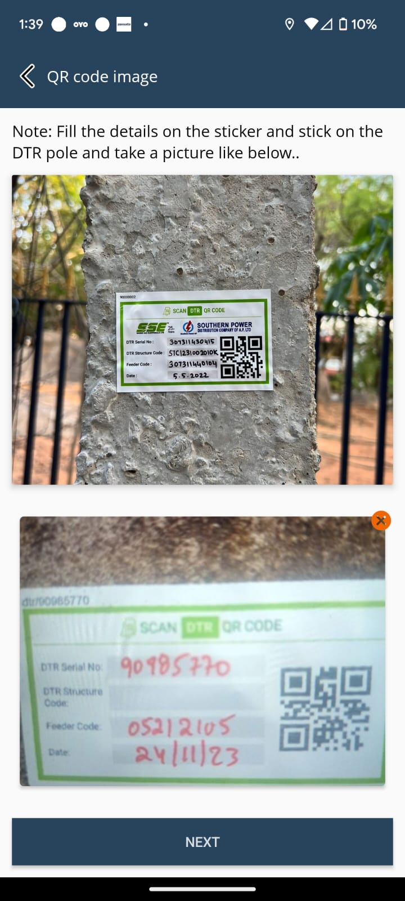
How to add DTR POINT
Click on +
Fill the Details on DTR Sticker and stick to the Pole & stick protective sticker above DTR sticker.
Capture Location of DTR in Map View
Select the Point type as DTR
Enter DTR Serial Number
Upload the Image of DTR Sticker

Slide 7
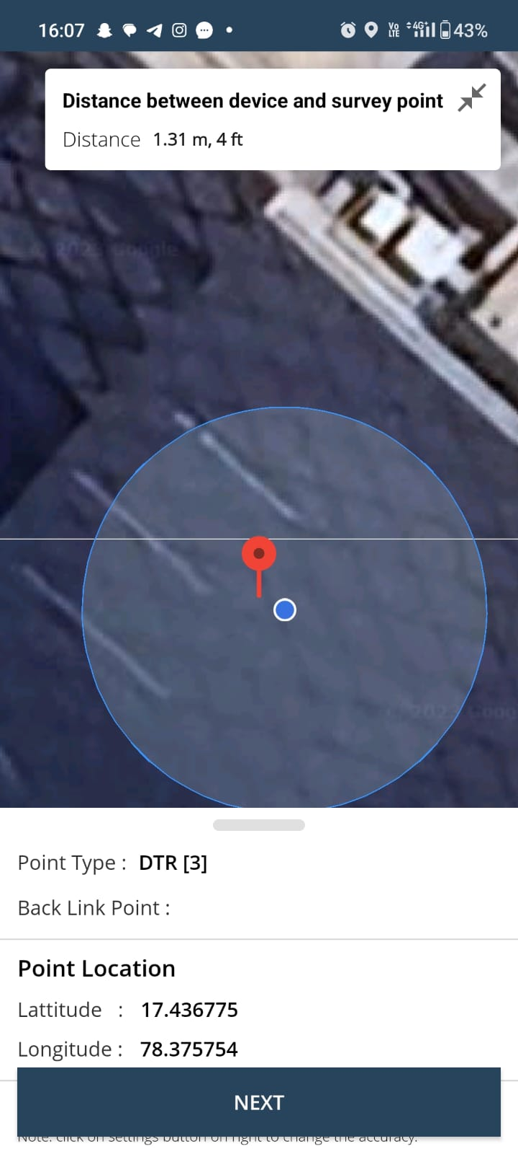
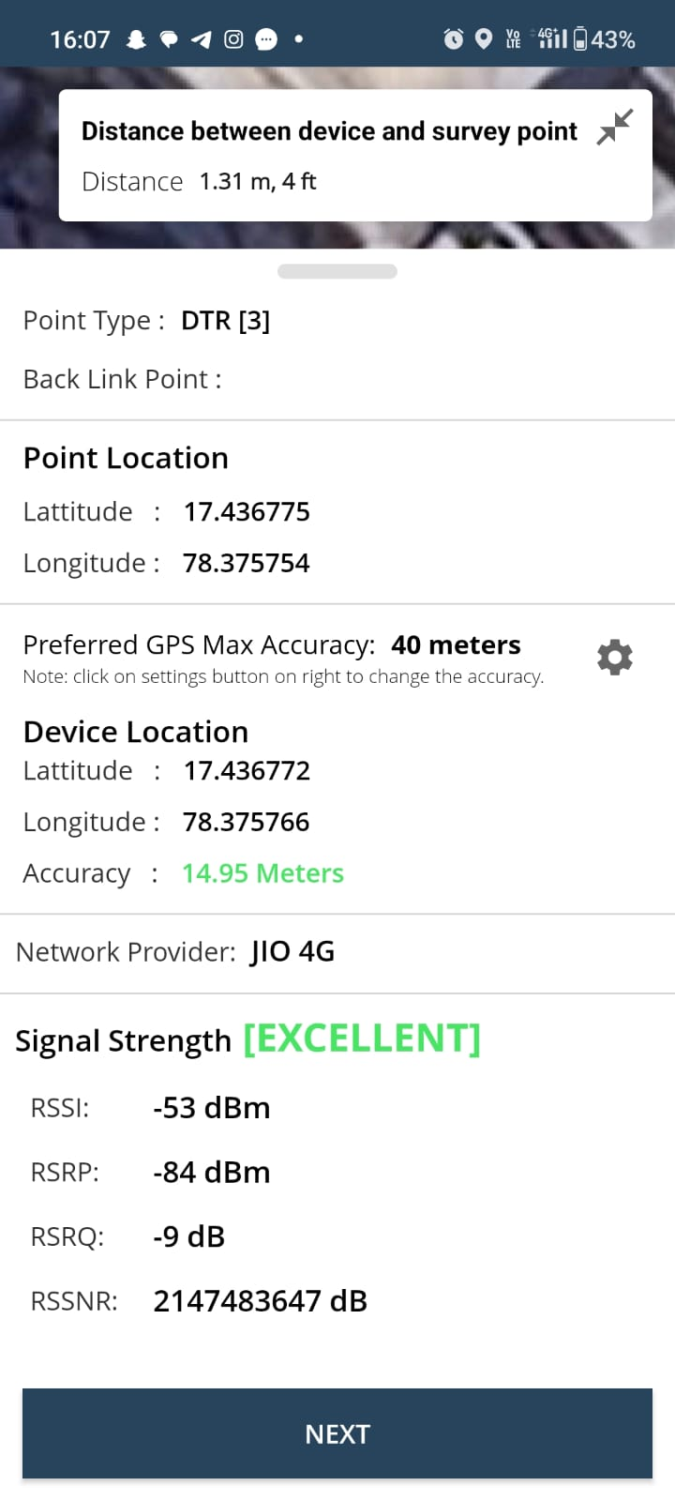
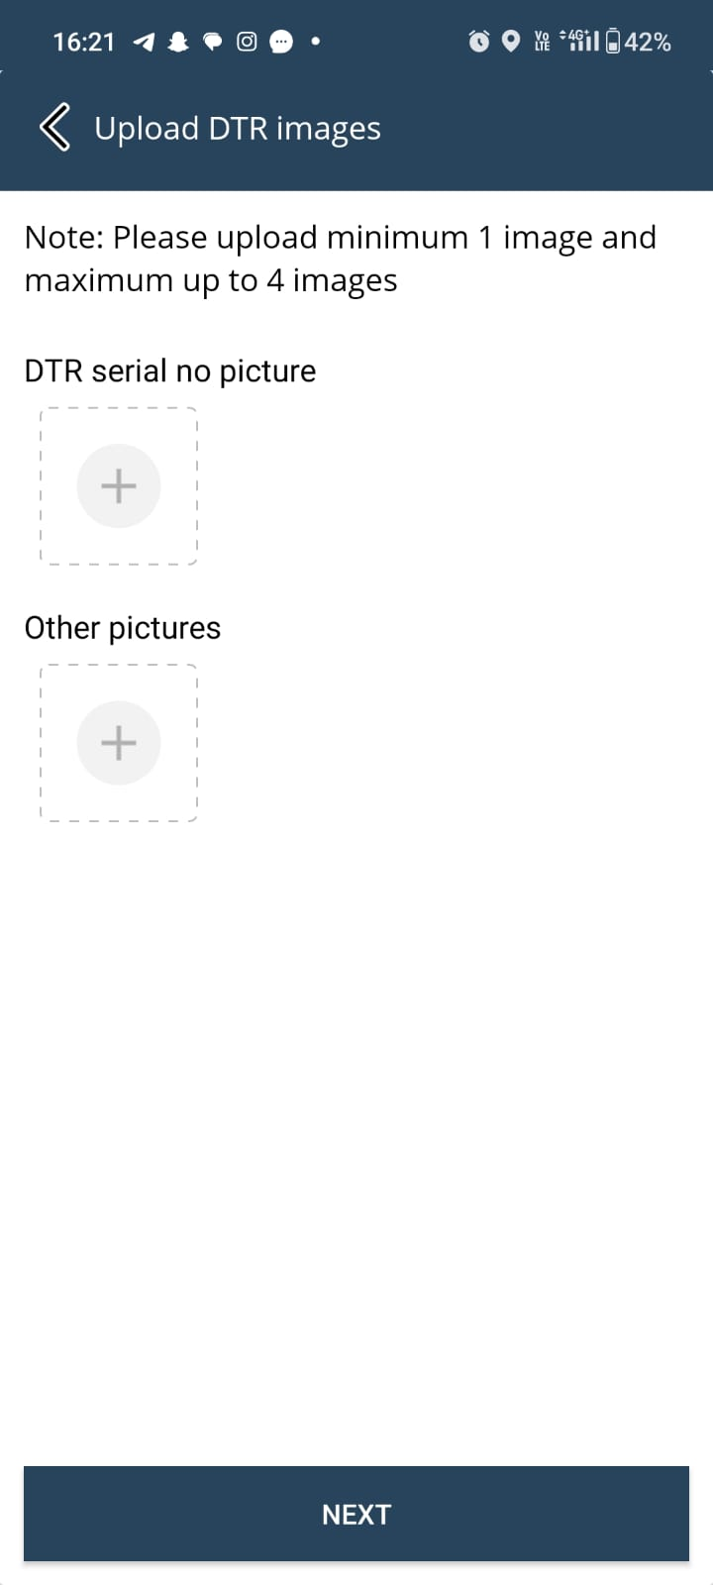
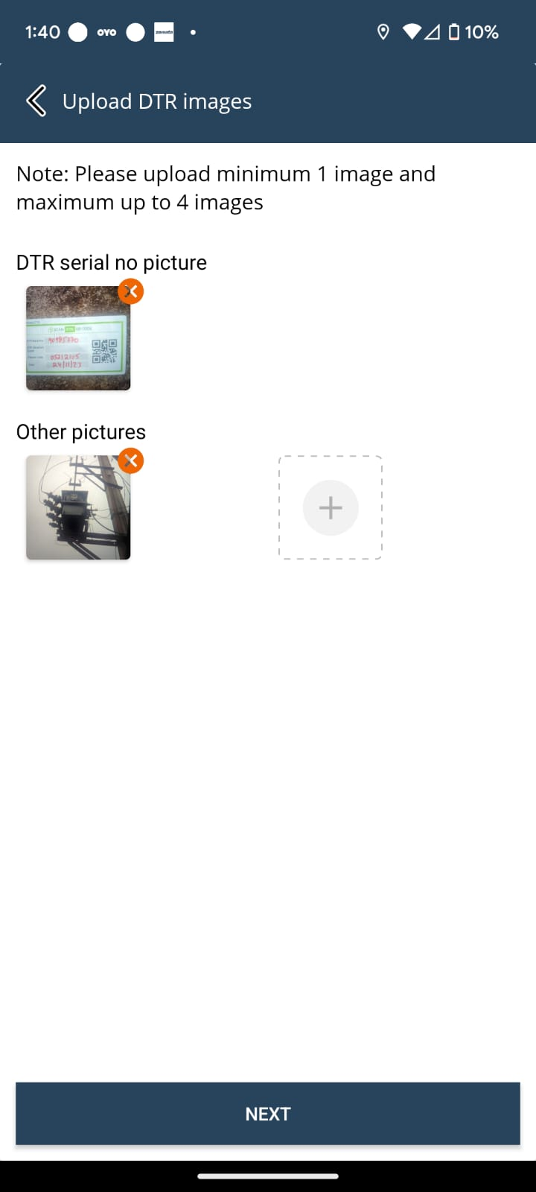
DTR Mapping and Images
Check the Captured location of DTR
Check the Signal Strength
Upload the DTR Serial no and images up to 4 Images

Slide 8
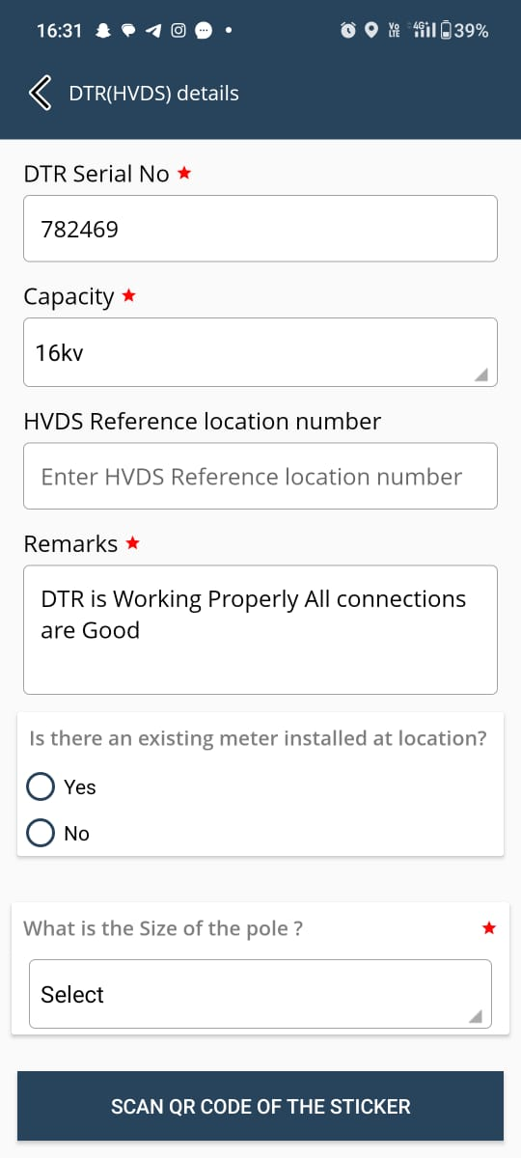
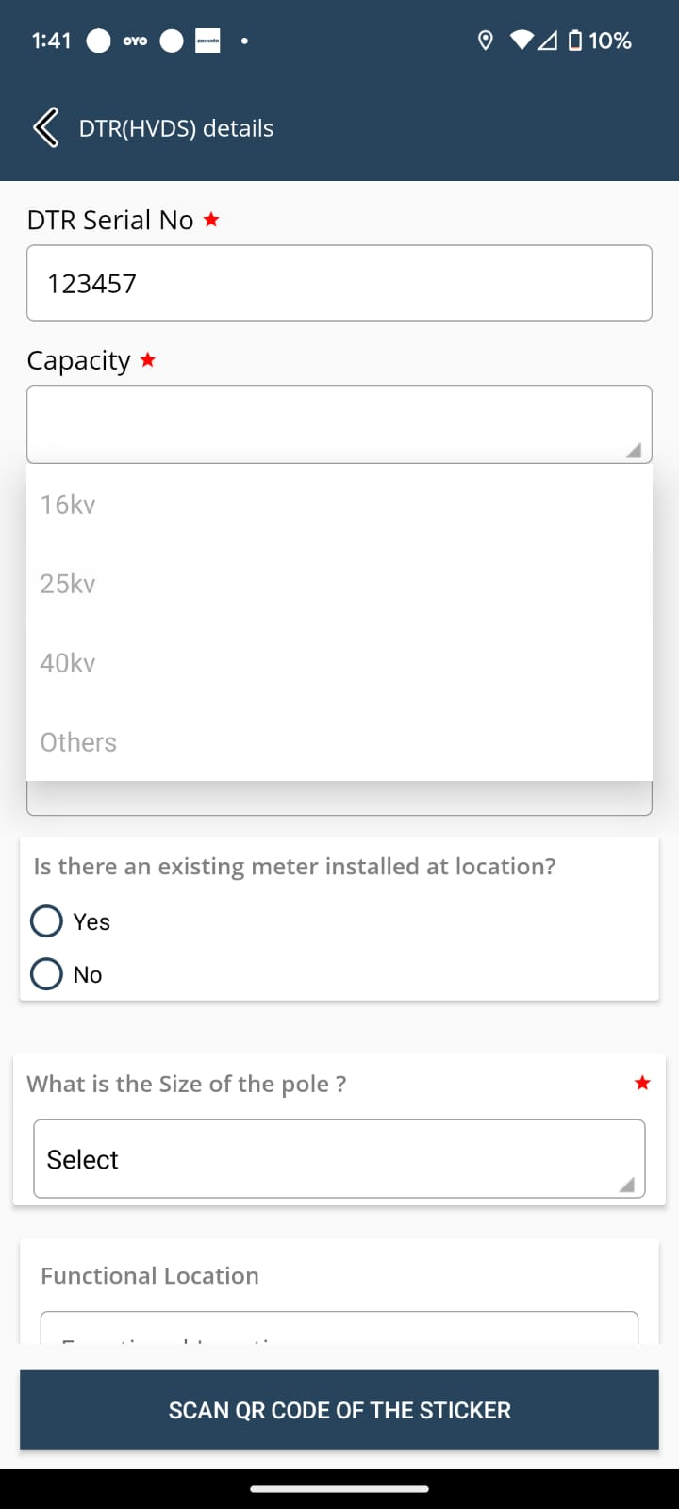
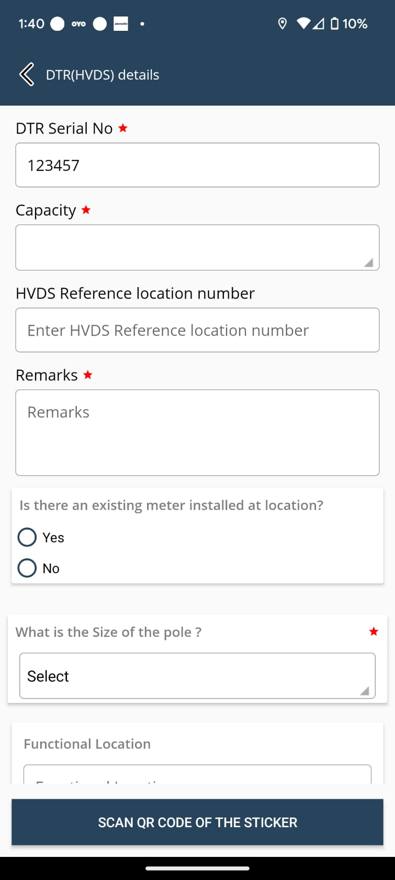
DTR Questionnaire
Select Capacity of DTR from the dropdown list
Write the Remarks of DTR Condition

Slide 9
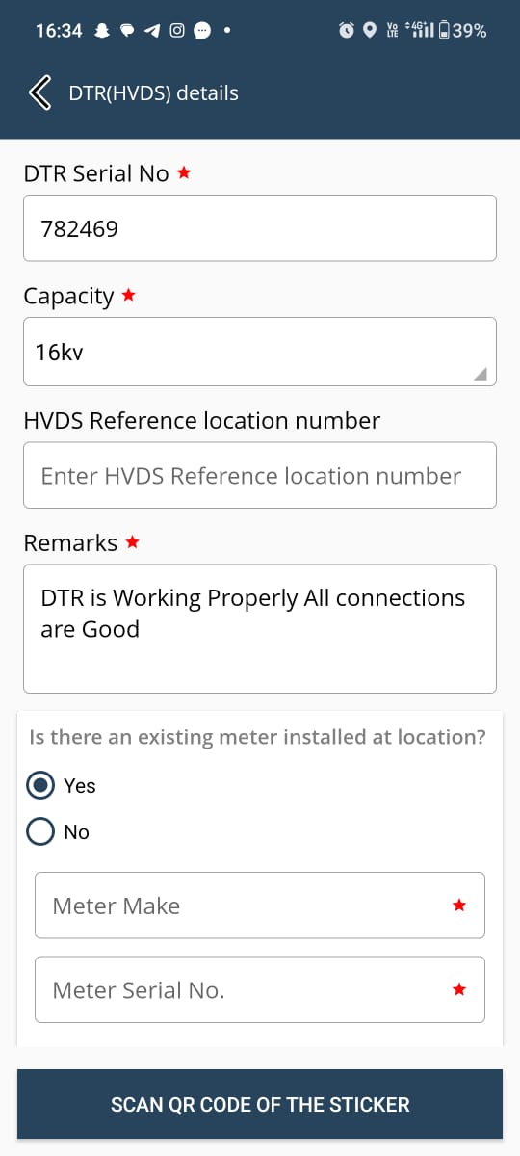
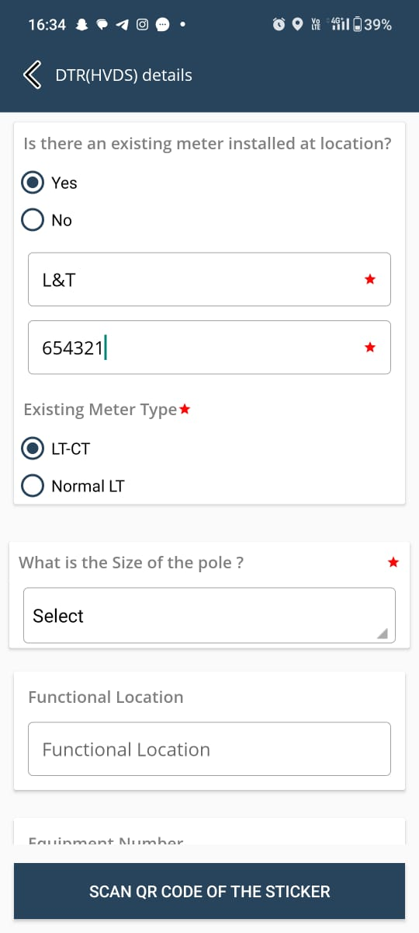
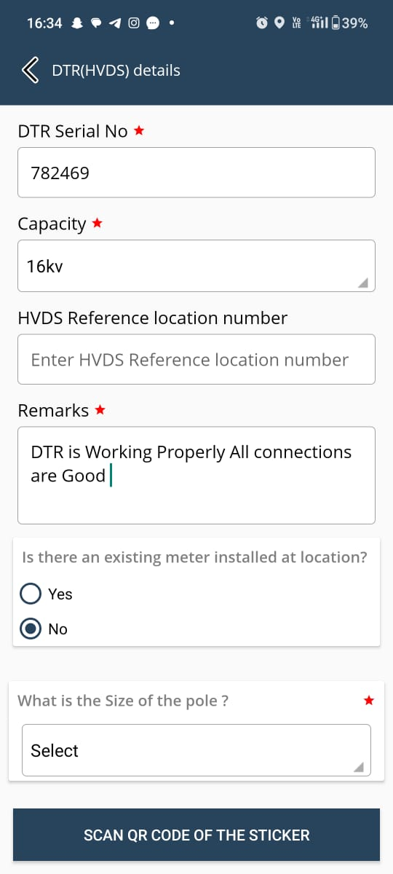
DTR Questionnaire
Is there an Existing meter installed at location please Click on Yes/No
If you click on ‘Yes’
Enter the DTR Make and Serial No
Click on Existing Meter type
If you click on ‘No’
Select the size of the pole

Slide 10
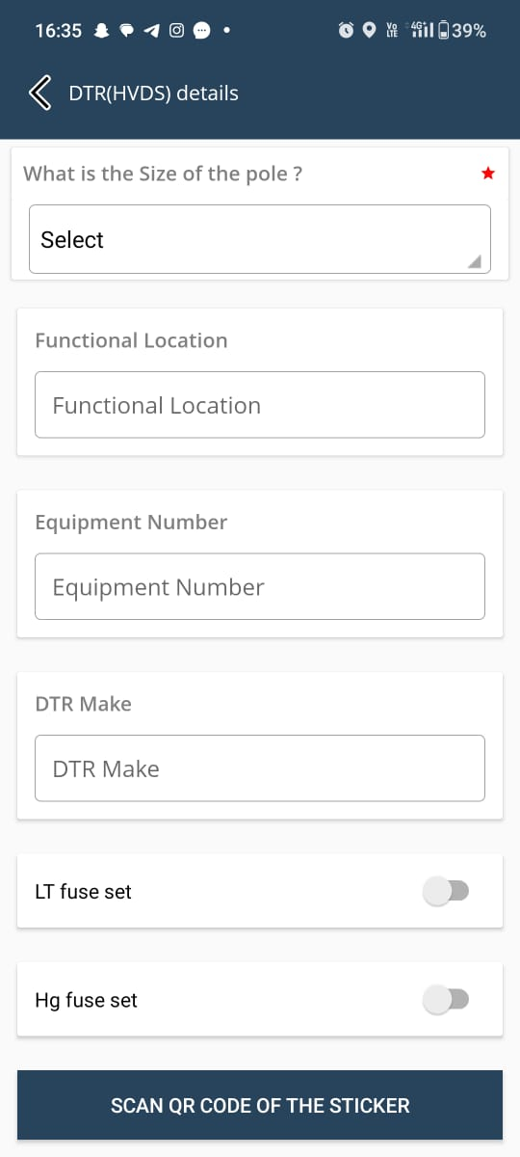
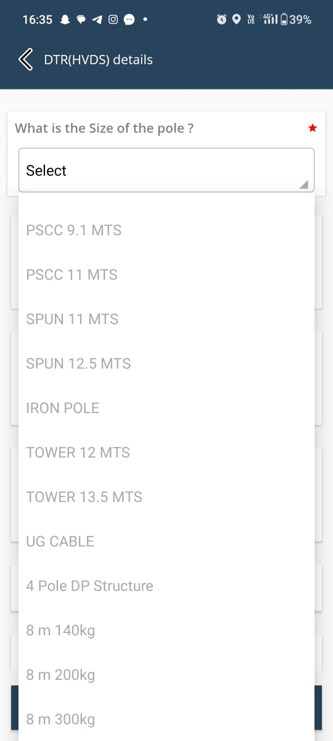
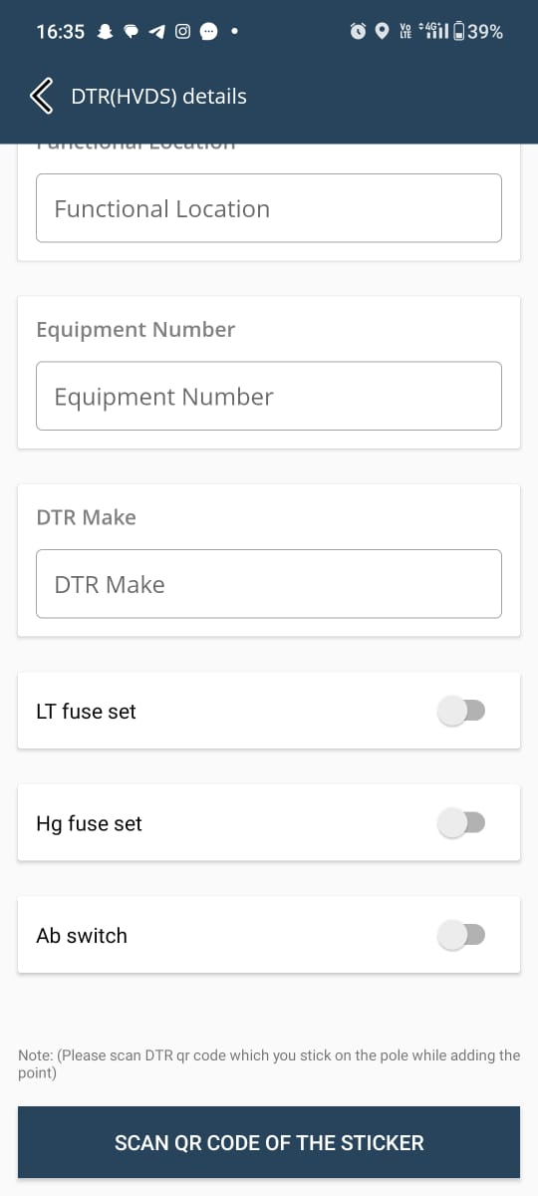
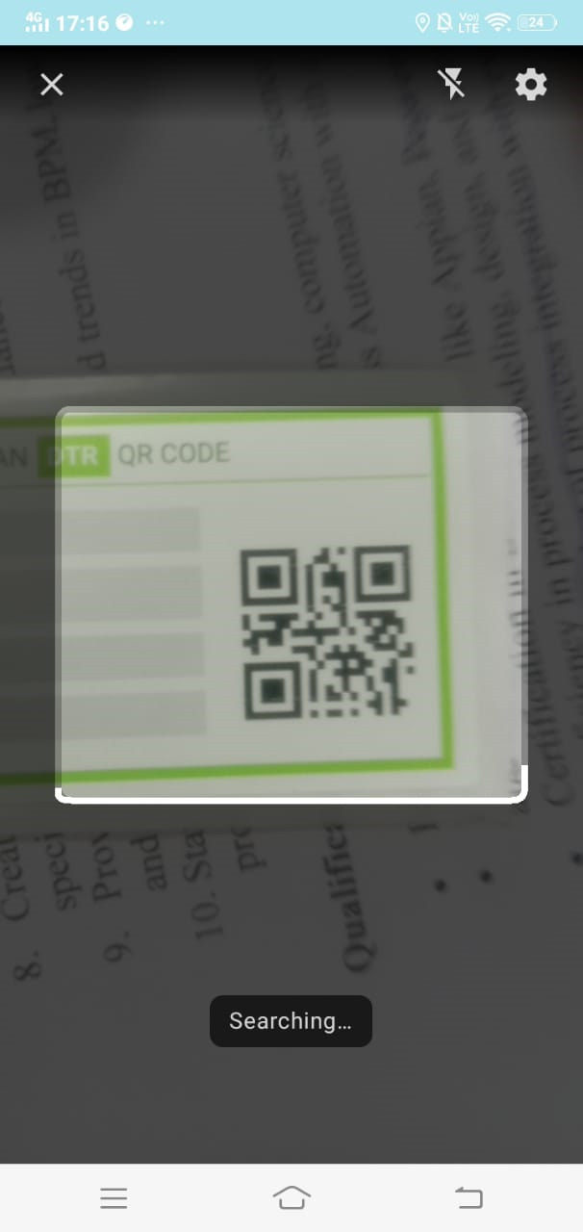
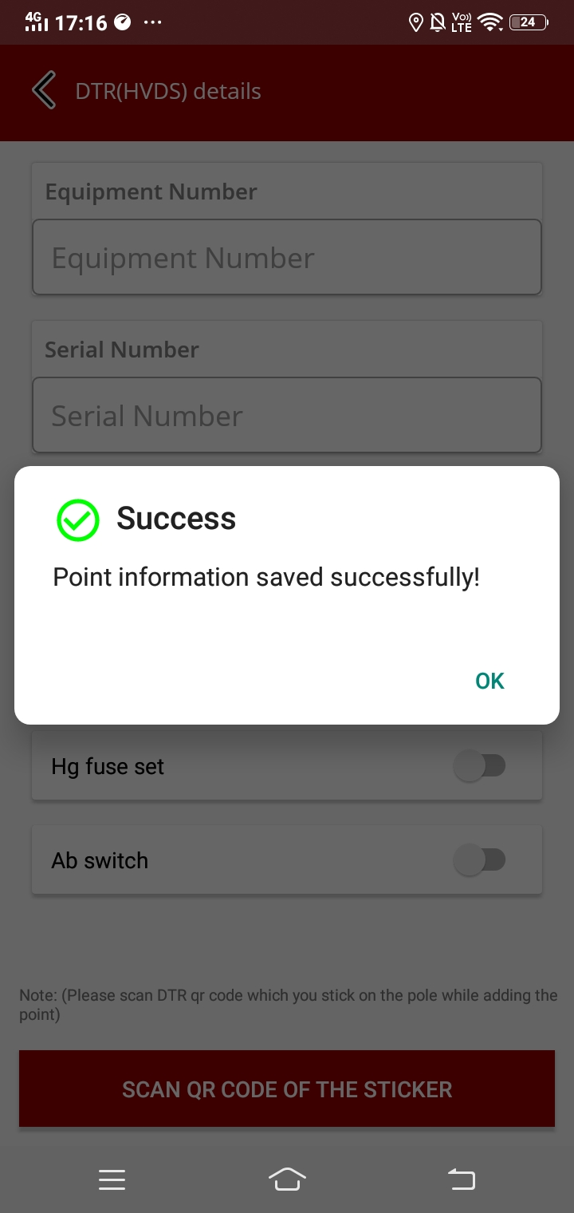
DTR Questionnire
Enter the Equipment Number & DTR Make
Enter Serial no of the DTR
Click on Toggle button LT,HT & AB switch
Scan the QR Code of DTR sticker which filled with DTR information
Once the DTR QR is scanned the DTR point information is saved successfully.
Select the Pole size from the dropdown list

Slide 11
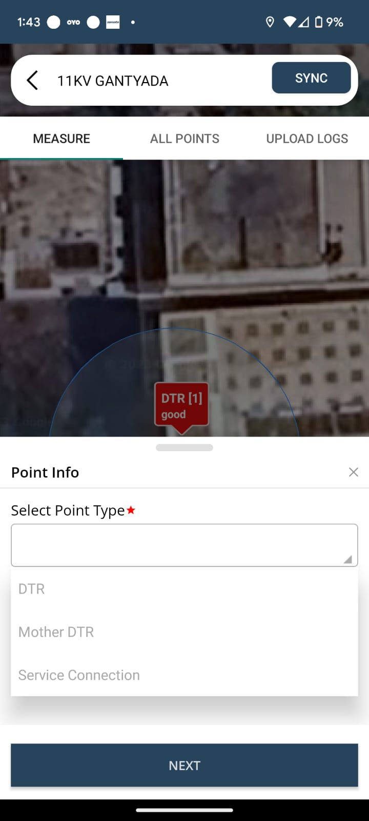
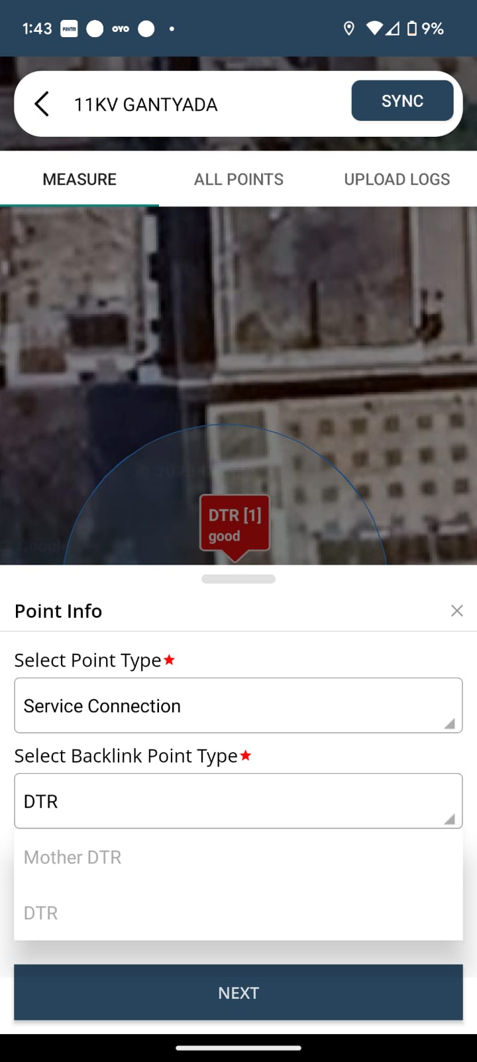
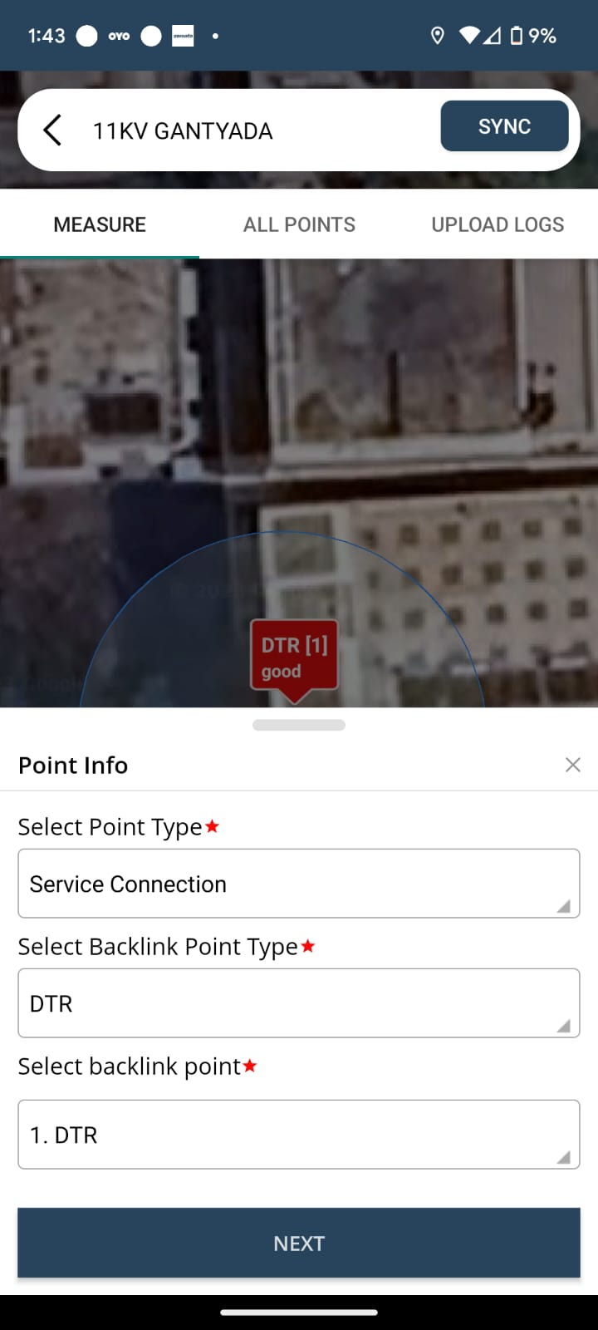
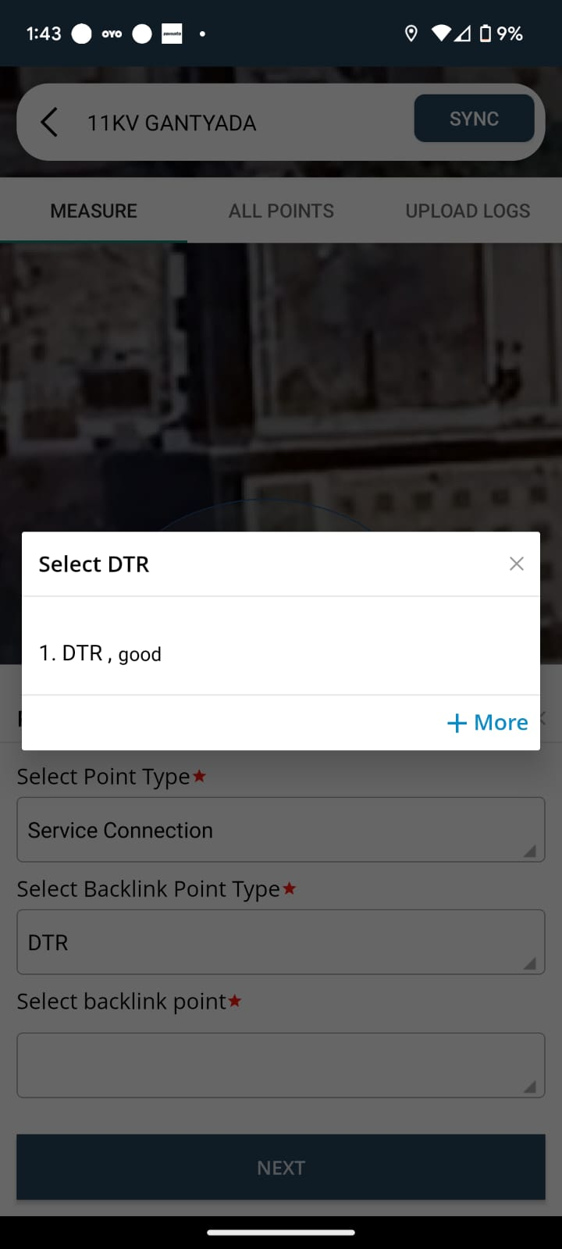
How to add Service Connection Point
Select Point type as Service Connection
Select Backlink Point as DTR
Check Backlink point DTR that is associated with the service (note: Check the point correctly to avoid accuracy issues)

Slide 12
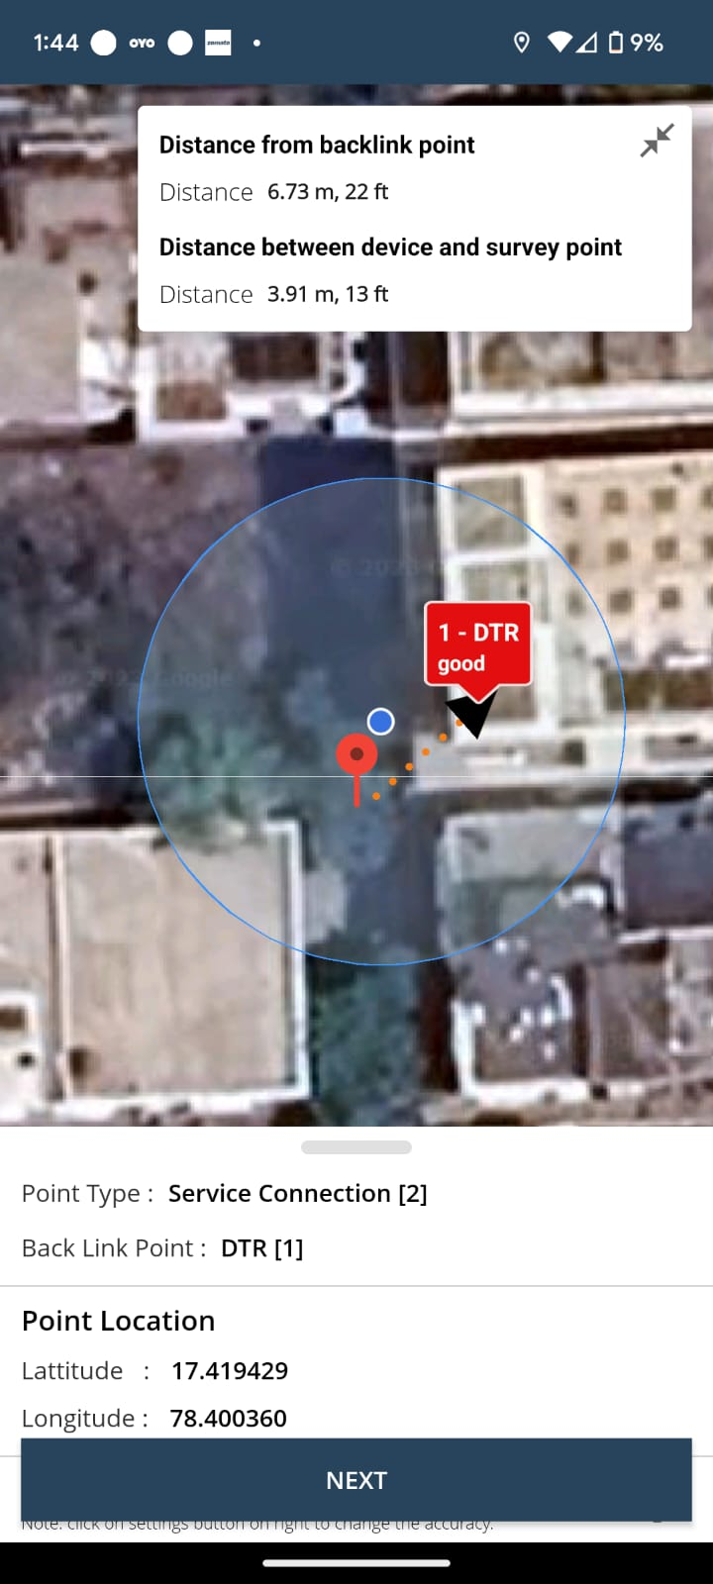
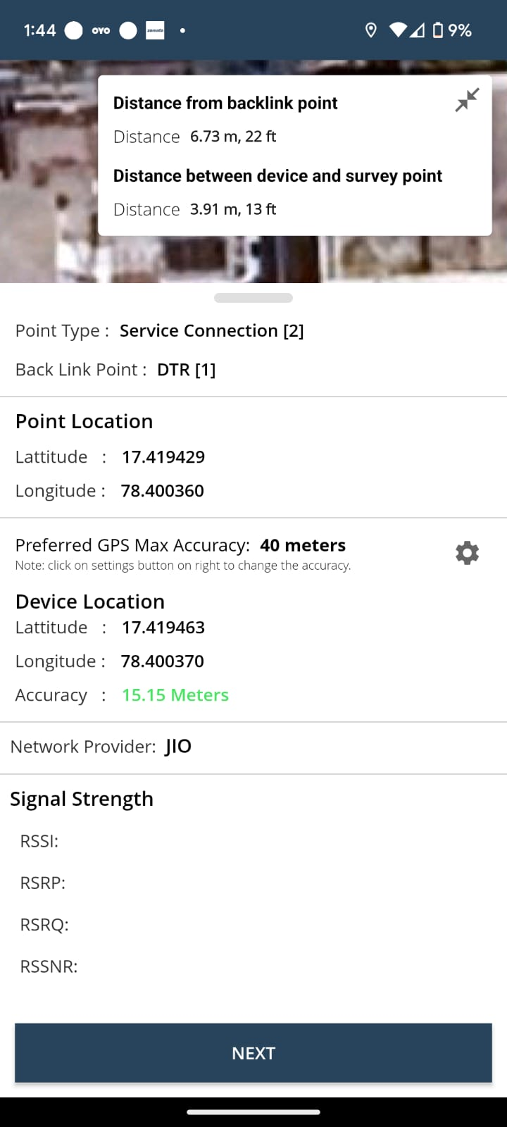
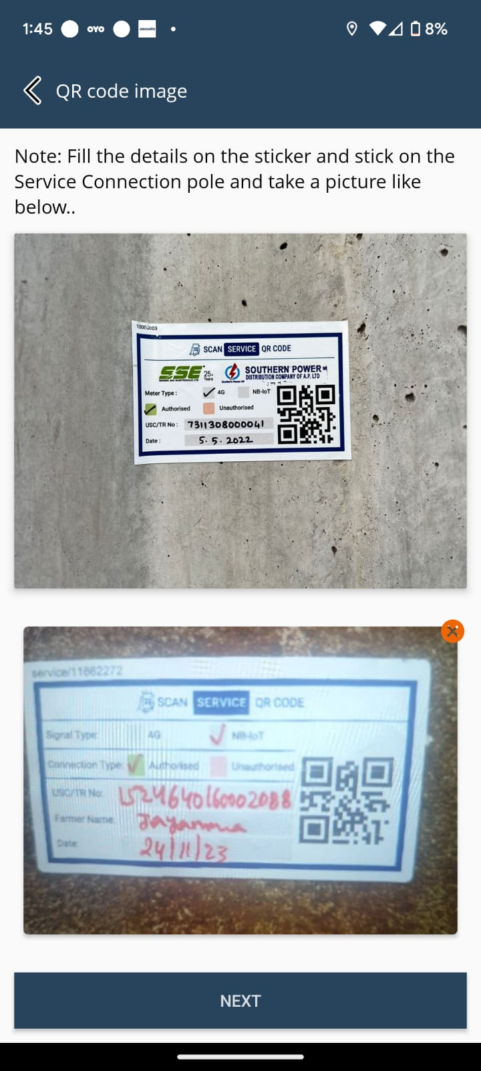
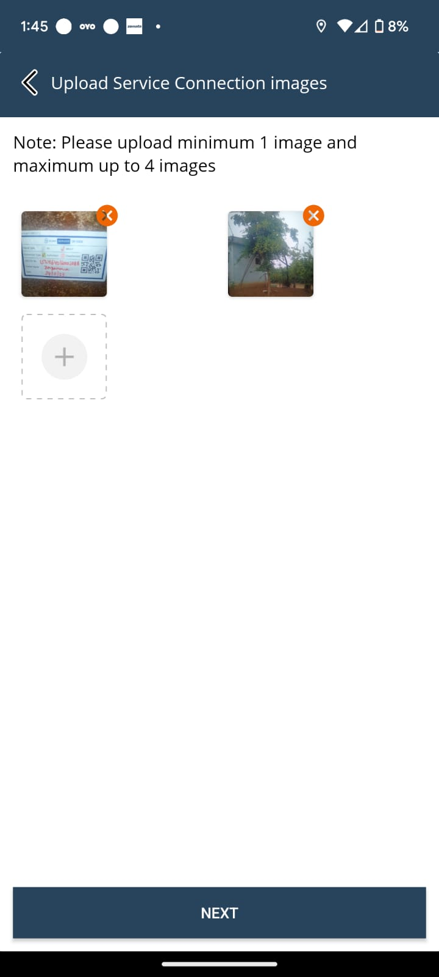
Service Connection Mapping with Images
Check the Service connection map view Location
Check the Accuracy below 40 meters
Check the Signal strength
Upload the image of Service connection Sticker
Fill the Details on Service QR Sticker and stick to the Pole & stick Weather protection seal above Service connection sticker.
Upload minimum 2 images Of Borewell pipes, Motor & Starter Panel.

Slide 13
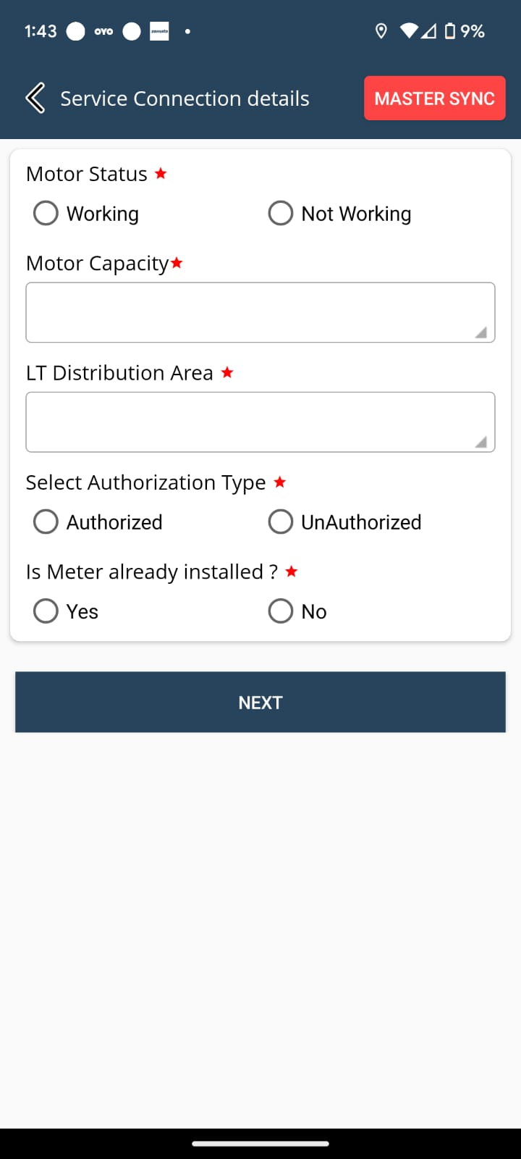
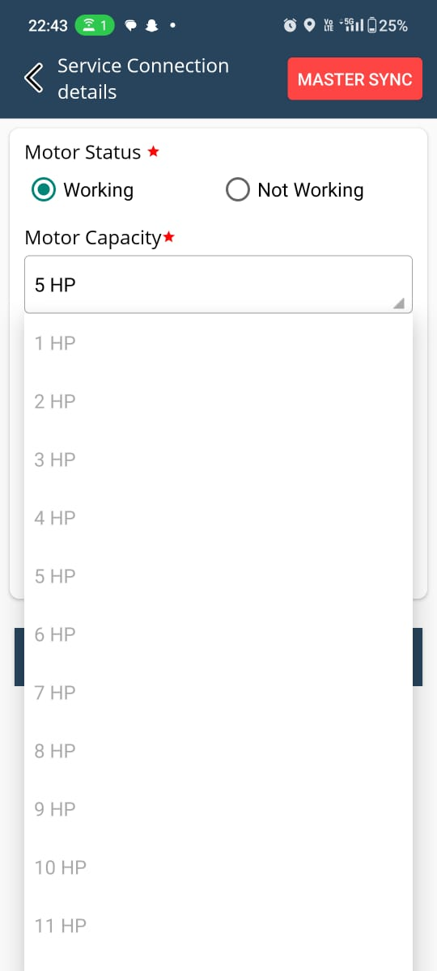
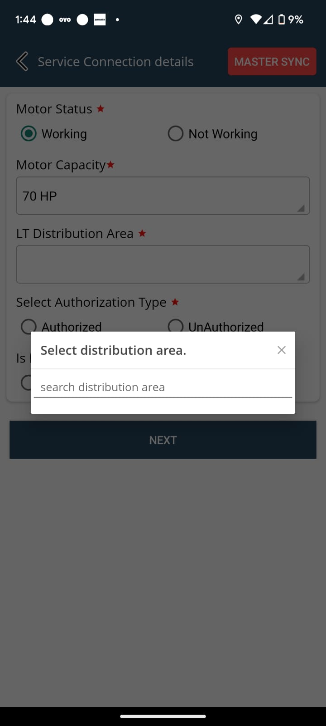
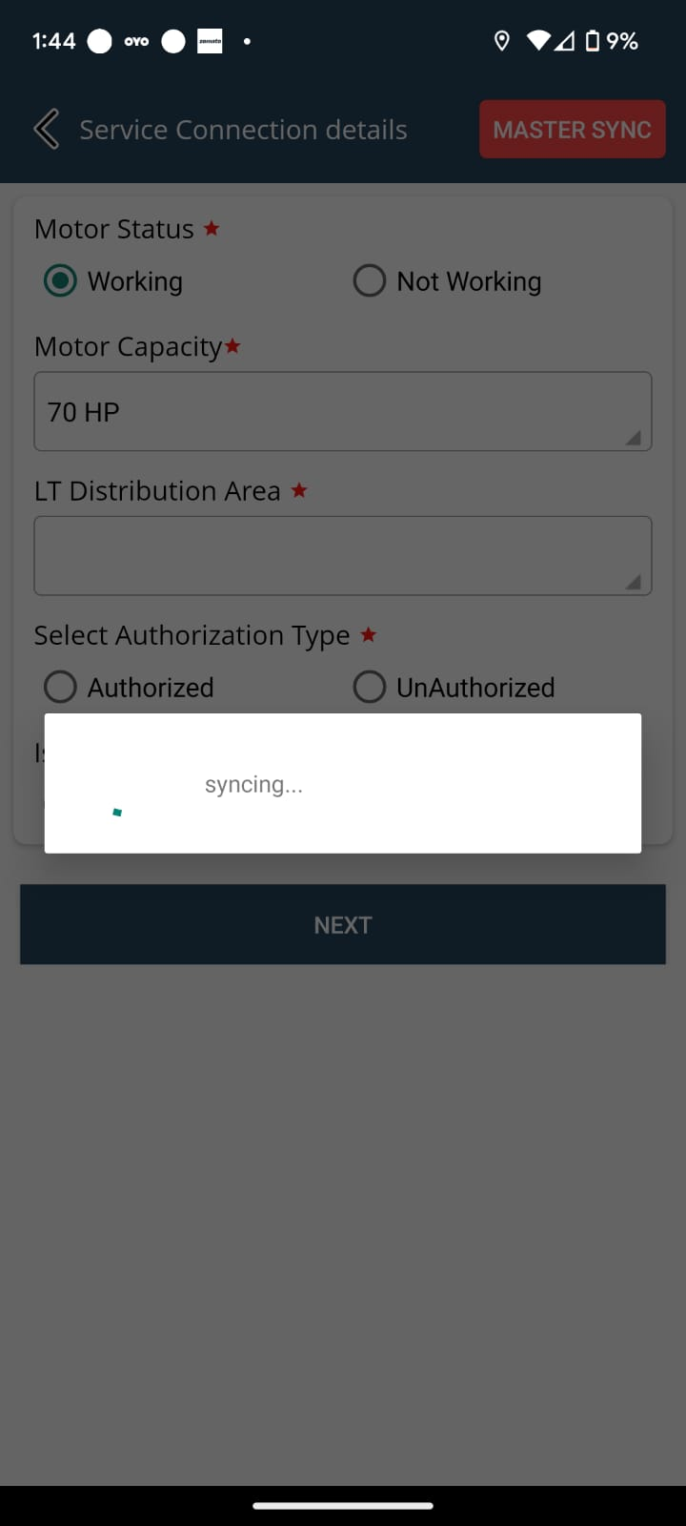
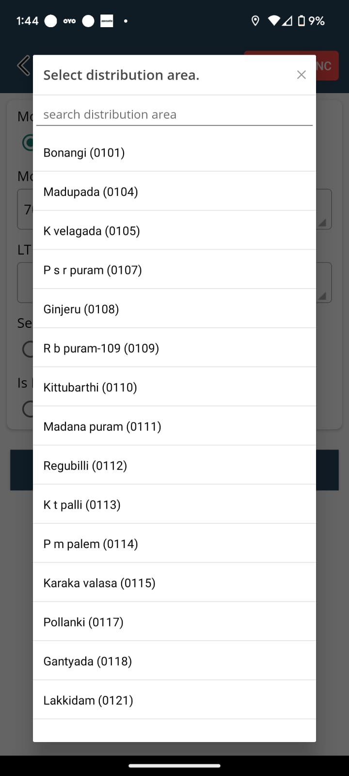
Service Connection Questionnaire
Select on the Motor Status
Select the Motor Capacity from the Dropdown list
User must Click On MASTER SYNC (top right) to view the LT distribution Area from the Dropdown list

Slide 14
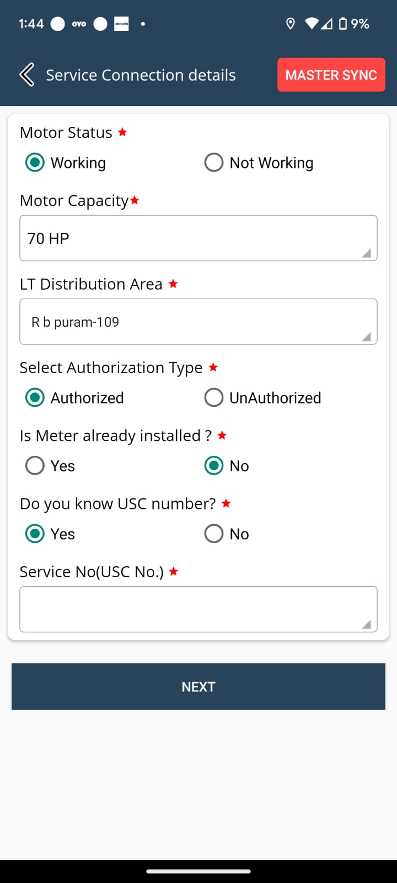
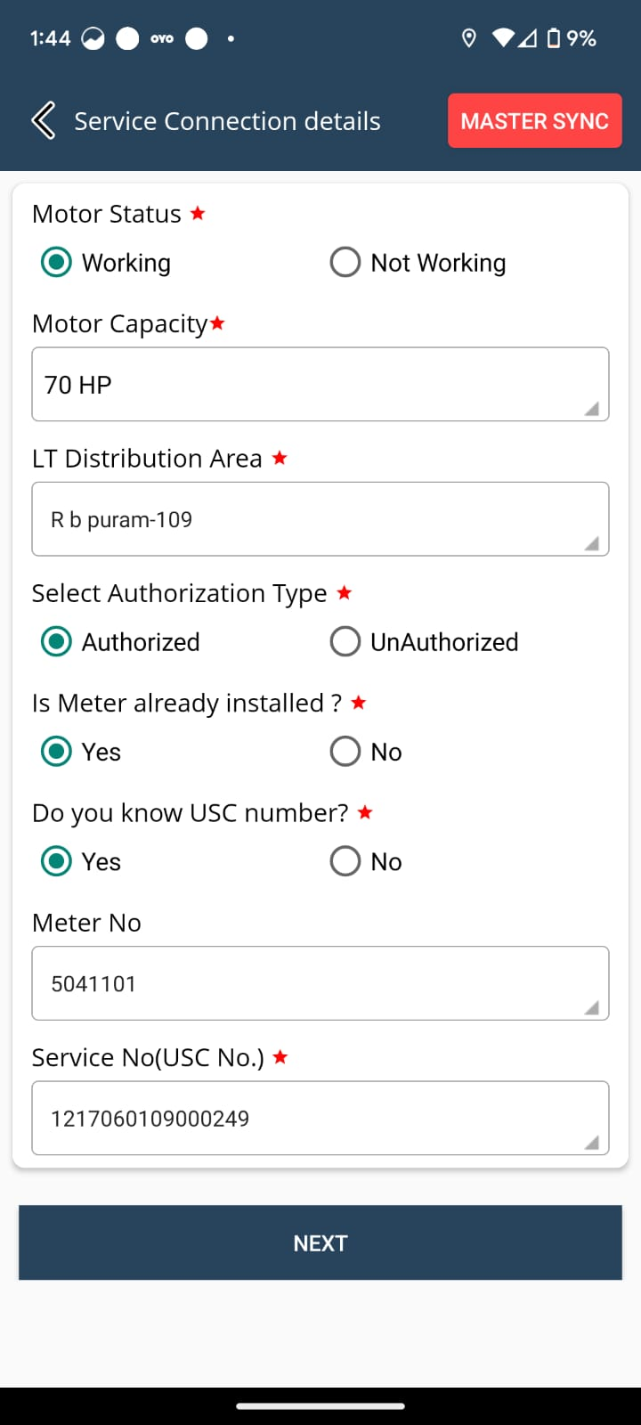
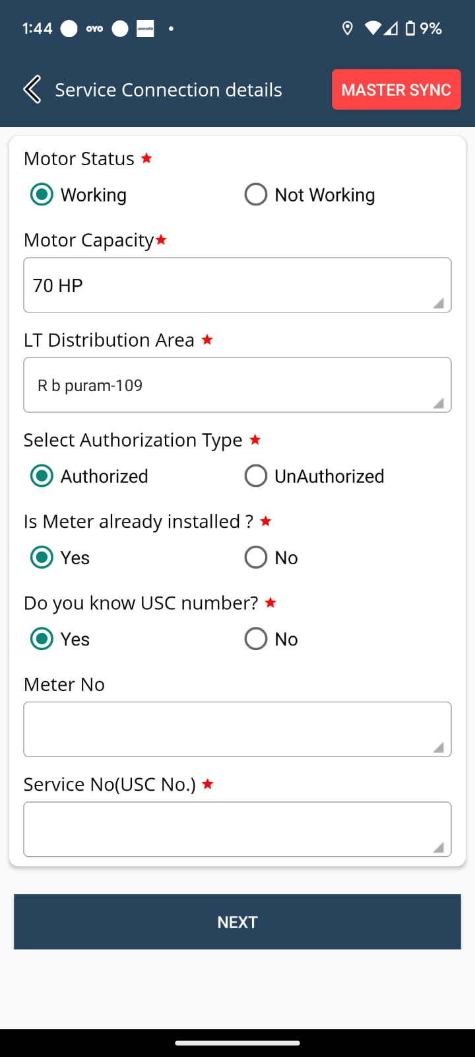
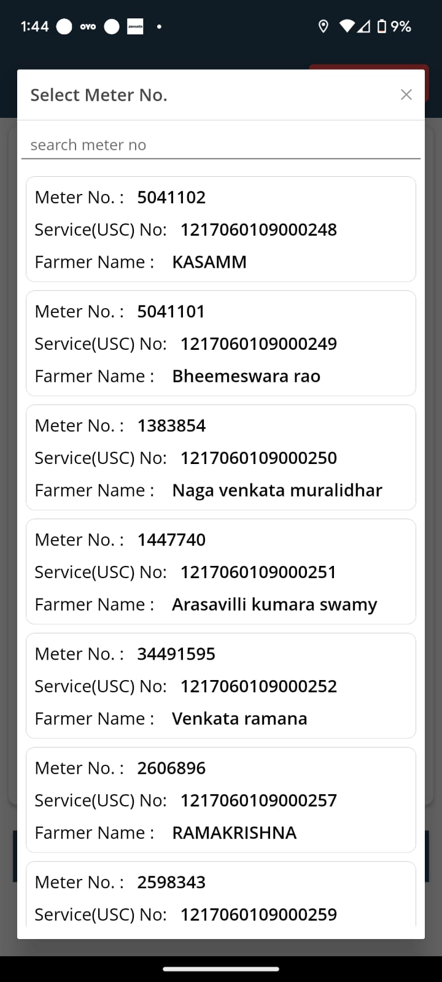
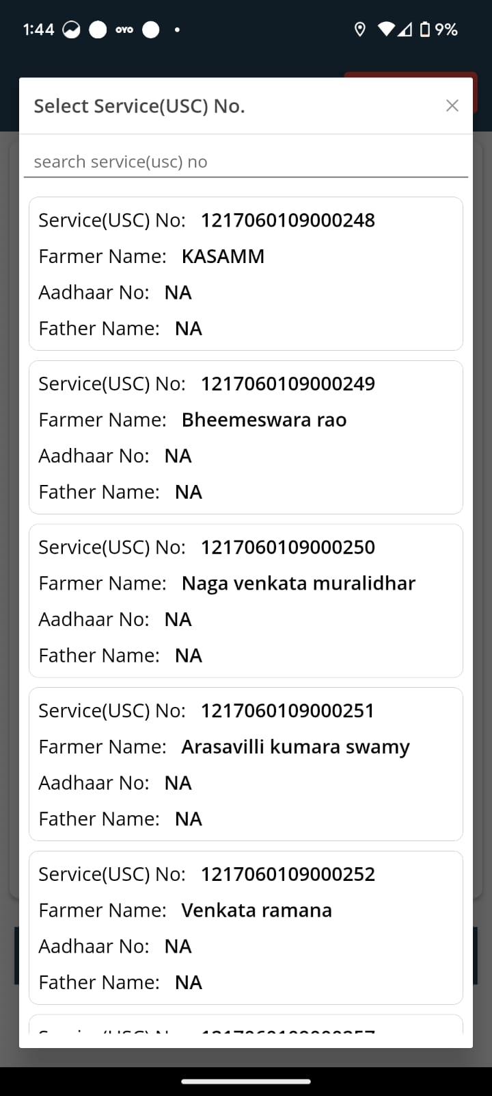
Service Connection Questionnaire
Select Authorization type
Select Yes/No for Is meter already installed ? and Do you know the USC number?
Here are the meter no. Details with linked USC numbers
Here is the dropdown menu of all the Sc numbers in the selected LT area

Slide 15
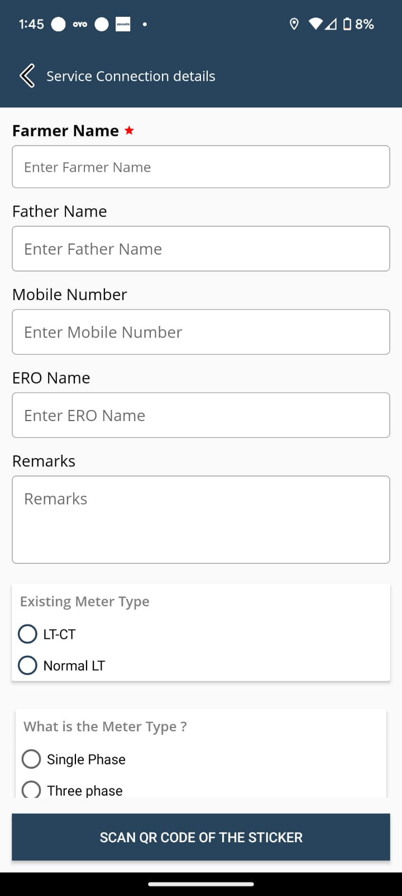
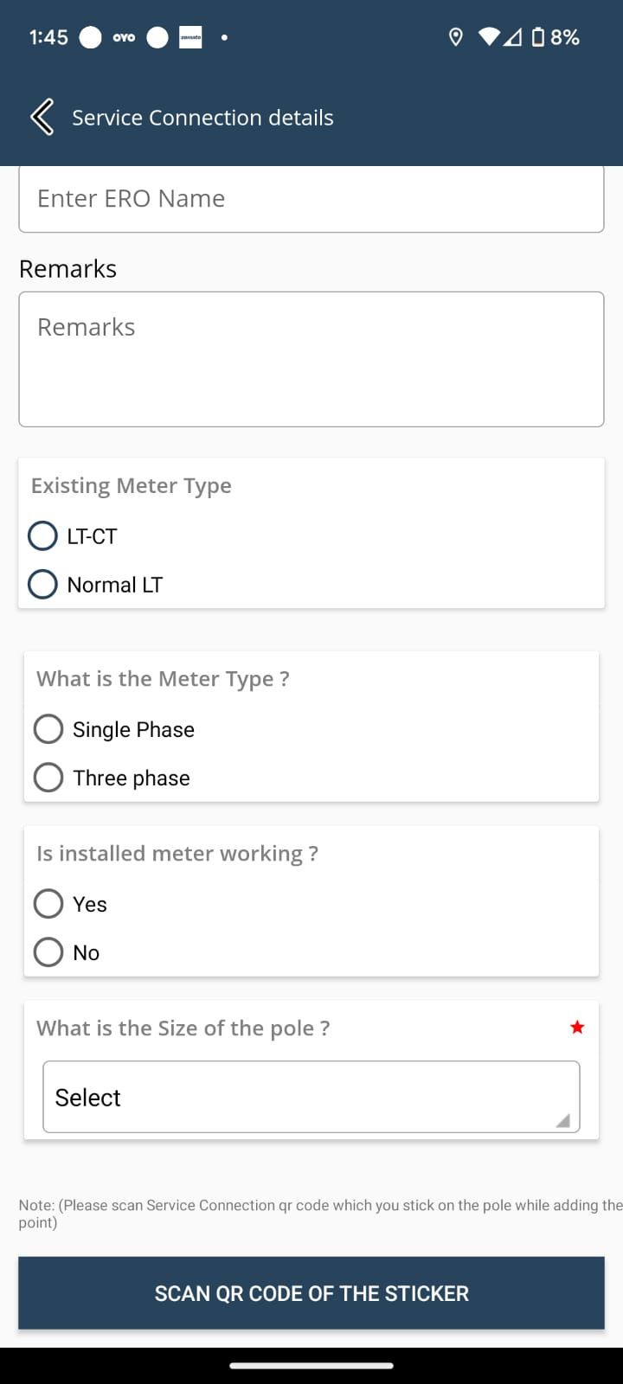
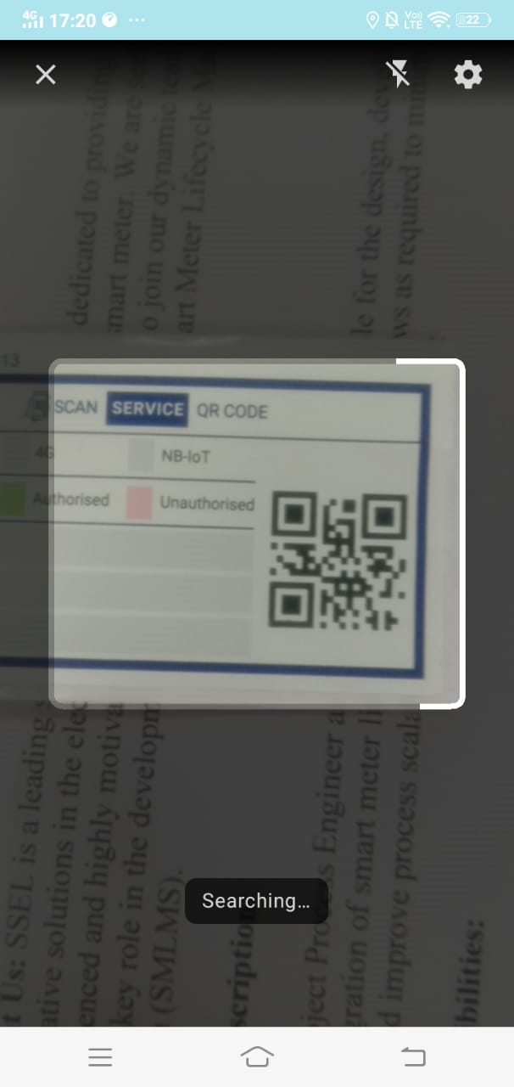
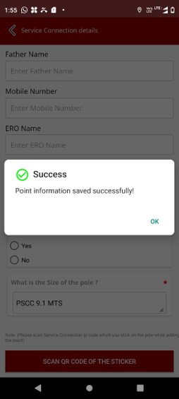
Service Connection Questionnaire
Verify the Details of Farmer and enter them in the boxes.
Select the Size of the Pole from the dropdown List.
If there is an LT or LT-CT meter present, the user must enter the details and capture the image
Scan the QR Code Of service connection
Point Information will be saved Successfully

Slide 16
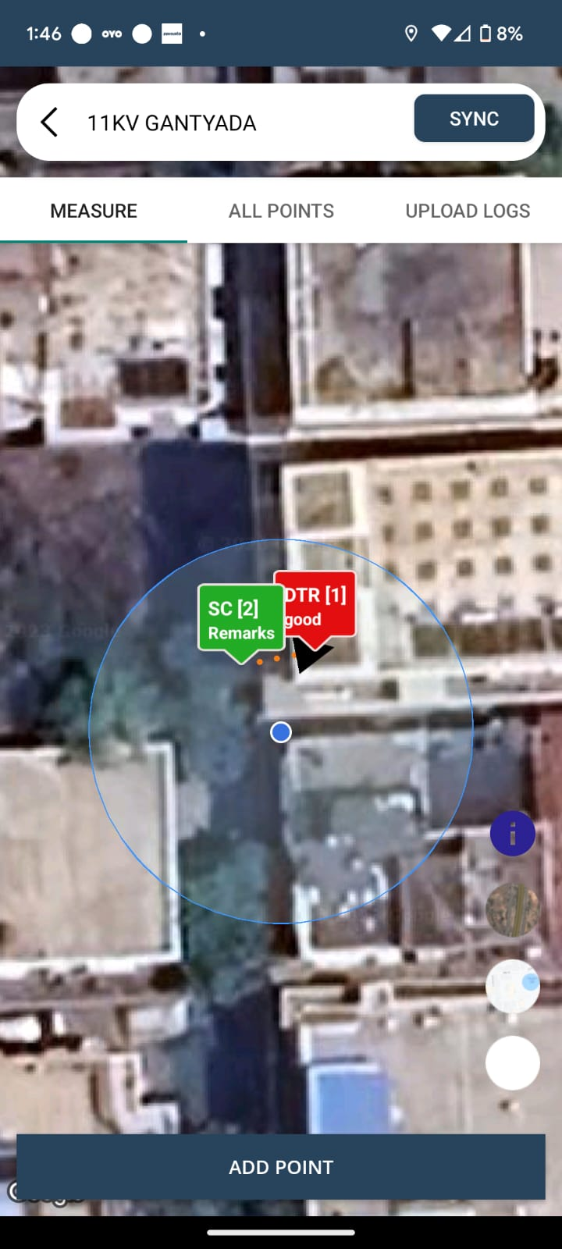

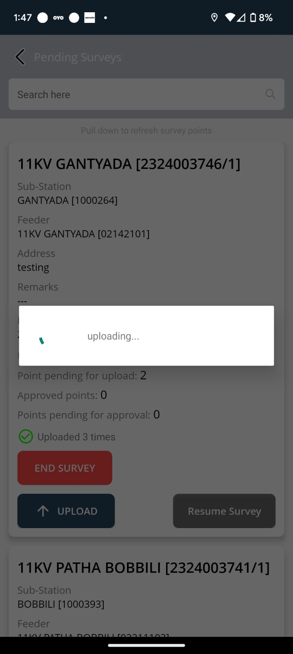

Check the Points Captured
Note : Don’t Click on End survey until feeder is completed.
Once the feeder is completed, you can end survey.
Upload the points Daily without any fail

Slide 17


Check the All-Uploaded Points while Adding the points

Slide 18

Thank you!!
Happy surveying!!

