Slide 1
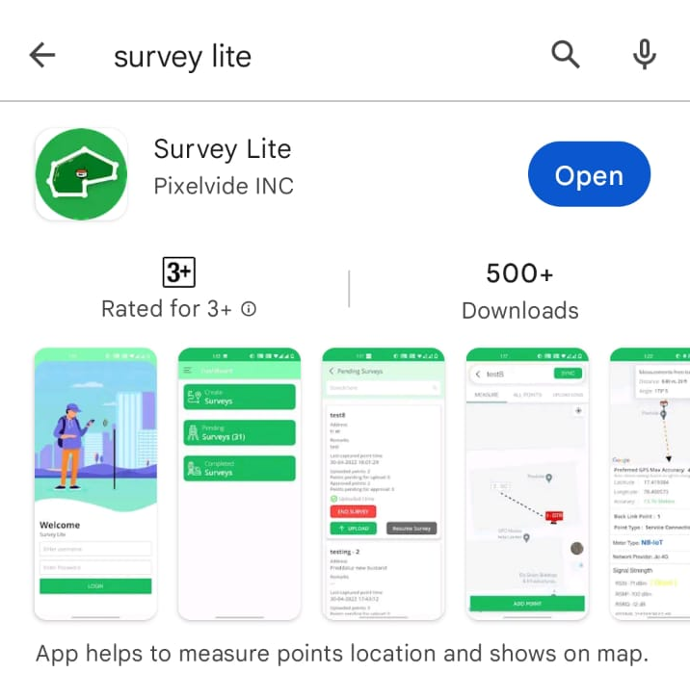
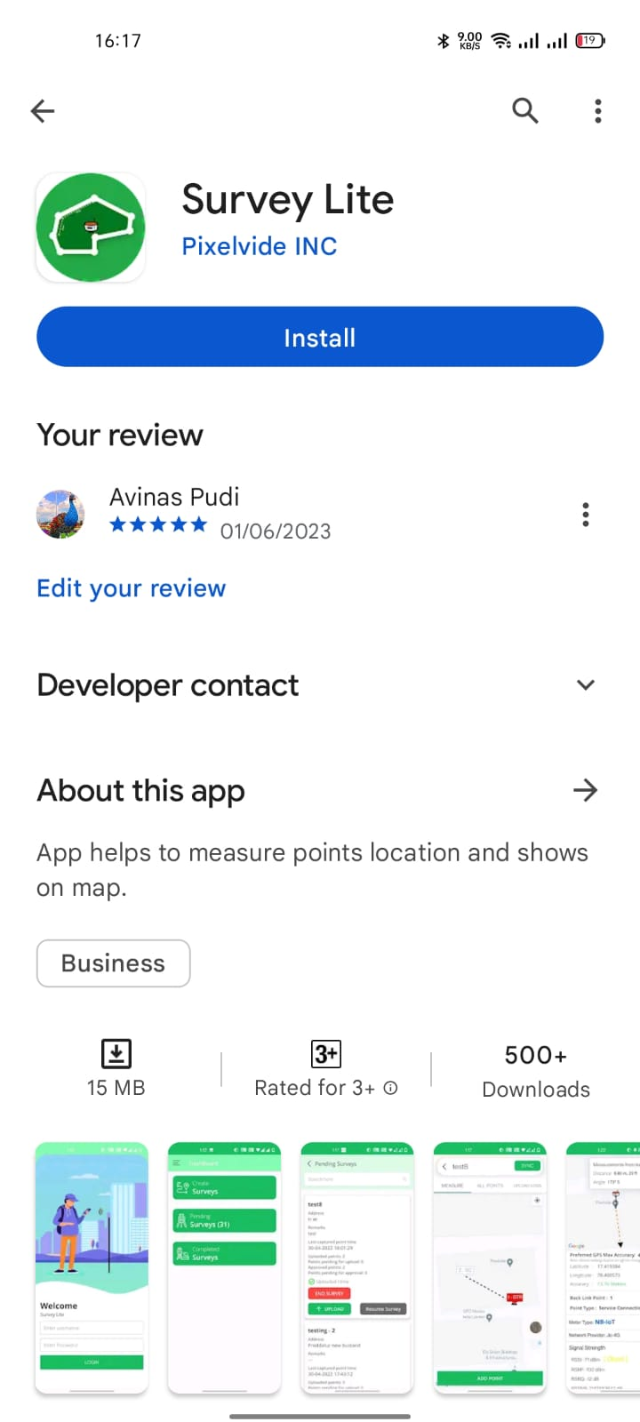
Open
Google Play store
Download Survey Lite App
Note : Allow all the Permissions while installing

Slide 2

Survey Lite App Login Page
Enter Your Username & Password
Provided to you

Slide 3
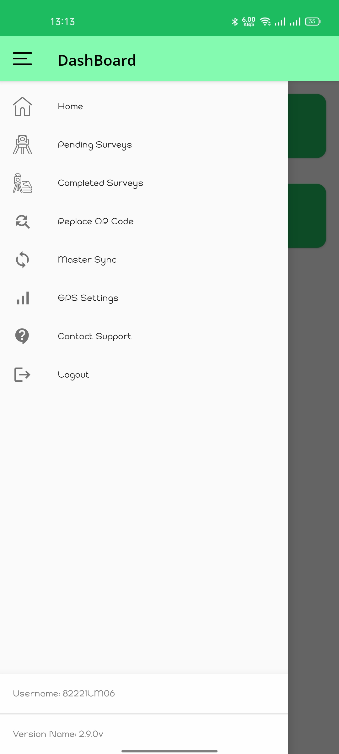
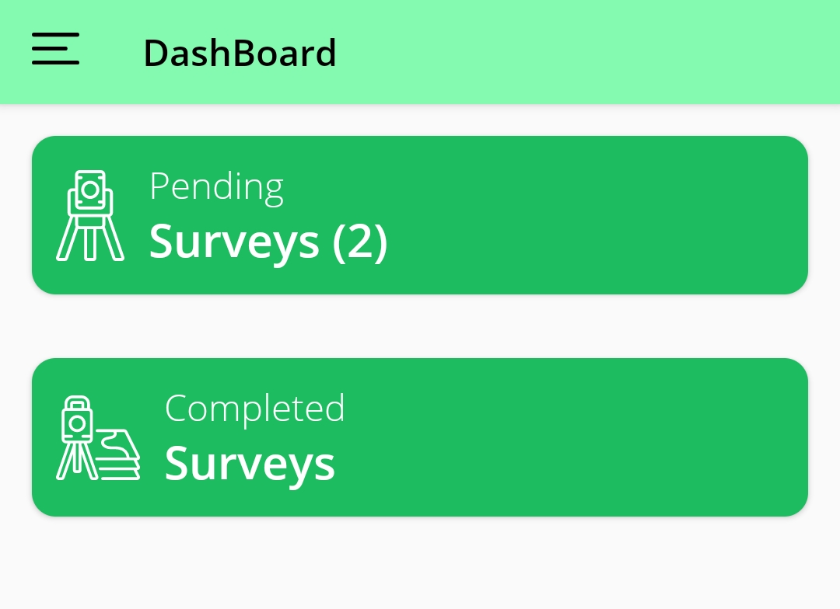
Dashboard Of Survey Lite App
After logging in you will get the Dashboard as Shown
Click on Pending Surveys

Slide 4
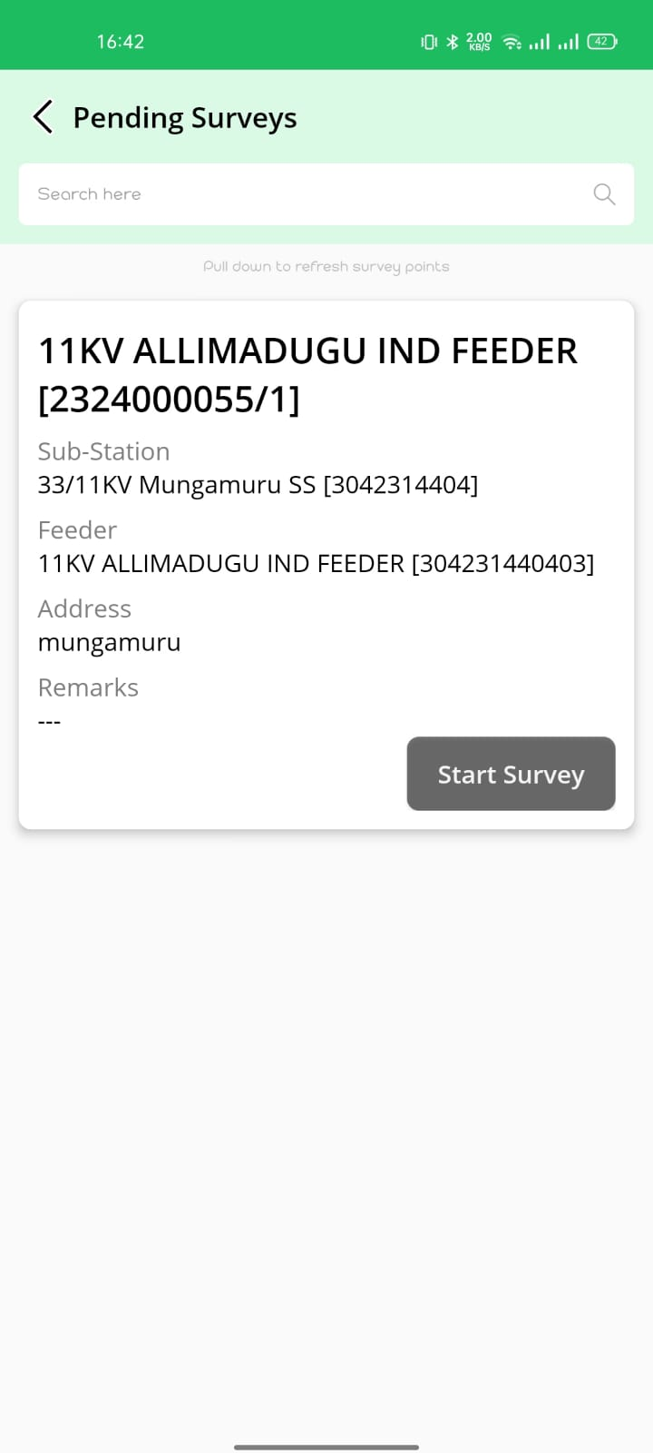
Pending surveys
In this page, you will find the list of feeders assigned by Section Admin
Click on Start Survey

Slide 5
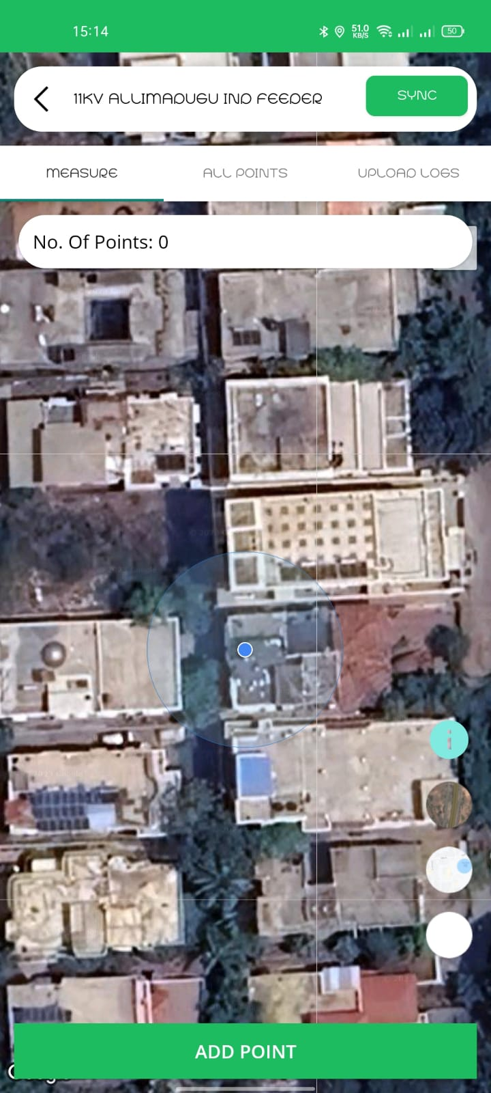
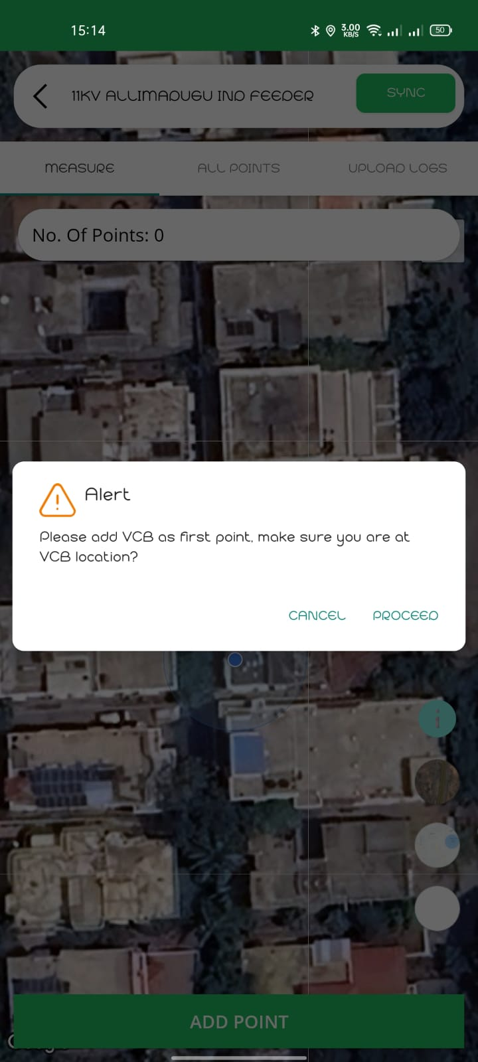
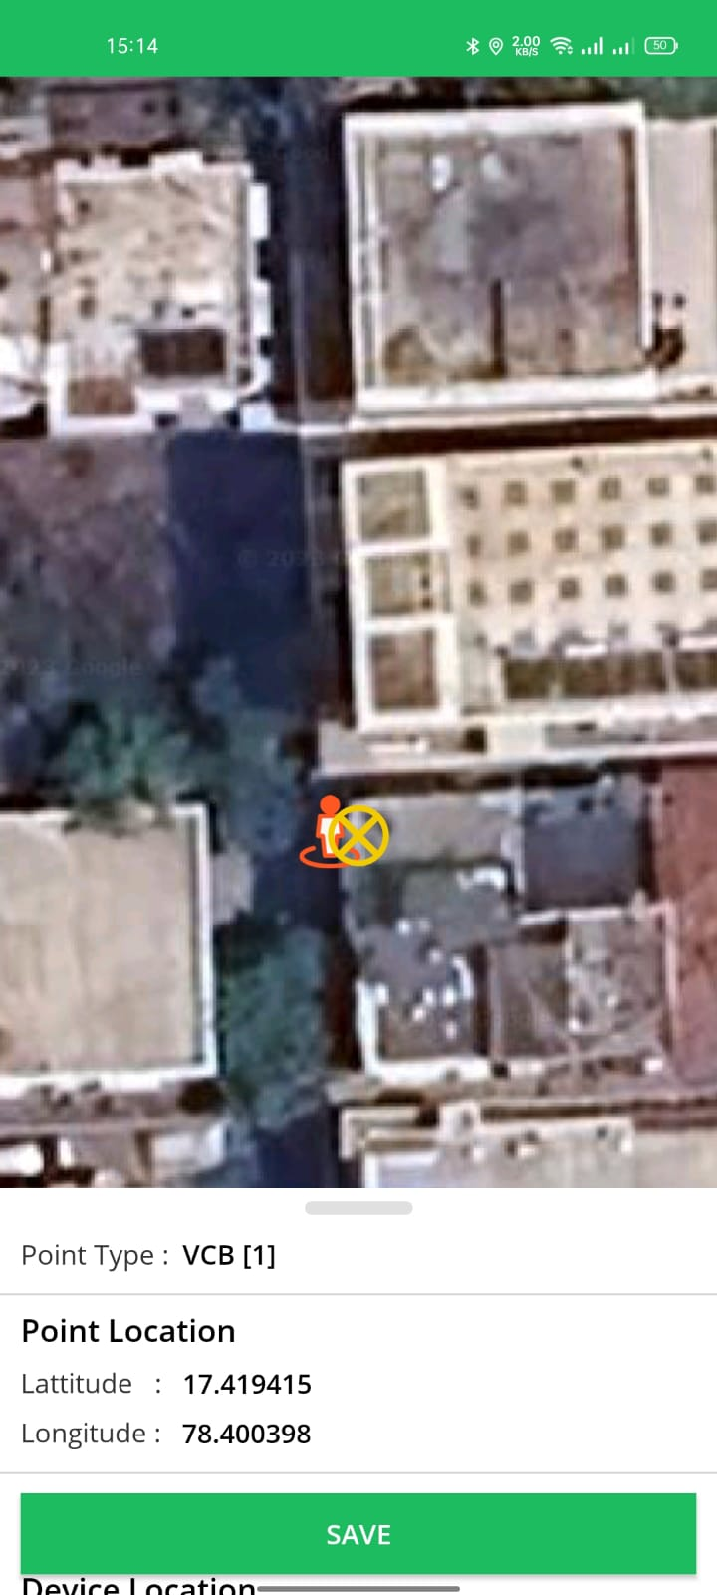
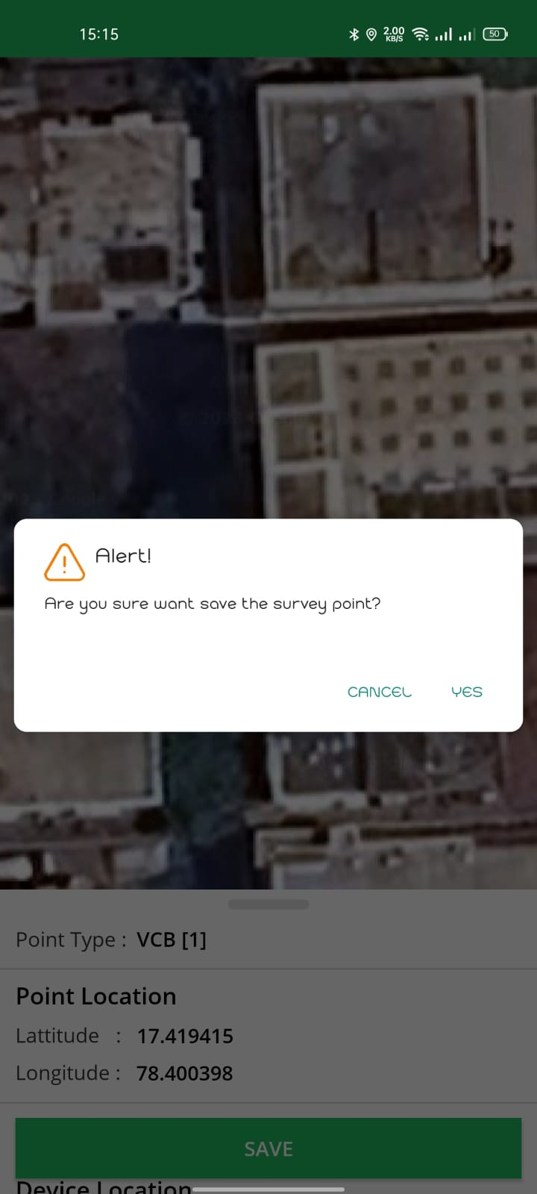
How to add VCB POINT
Click on Add Point Feeder VCB Point firstly
Click On Proceed
You can find the VCB point as mapped shown above
Click on ‘YES’ to save the survey VCB point
Point information will be saved Successfully

Slide 6
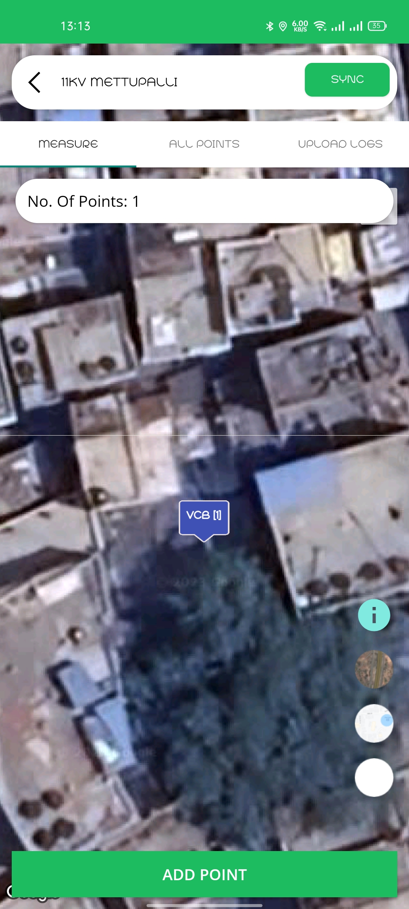
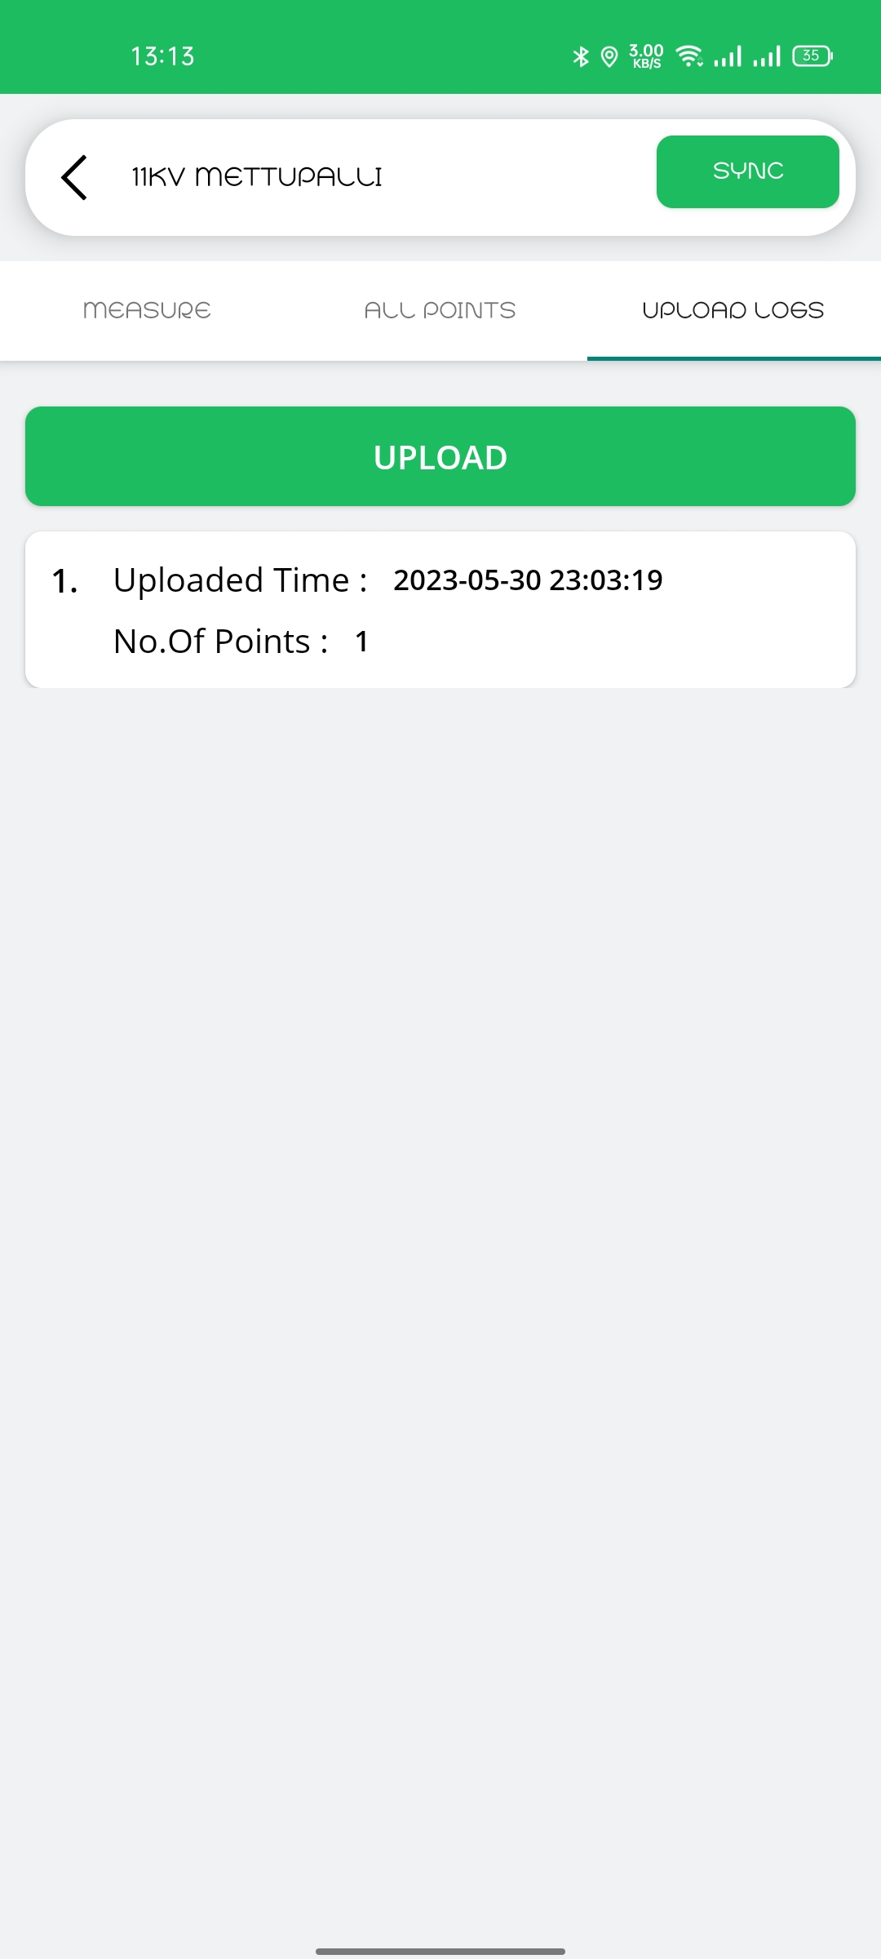
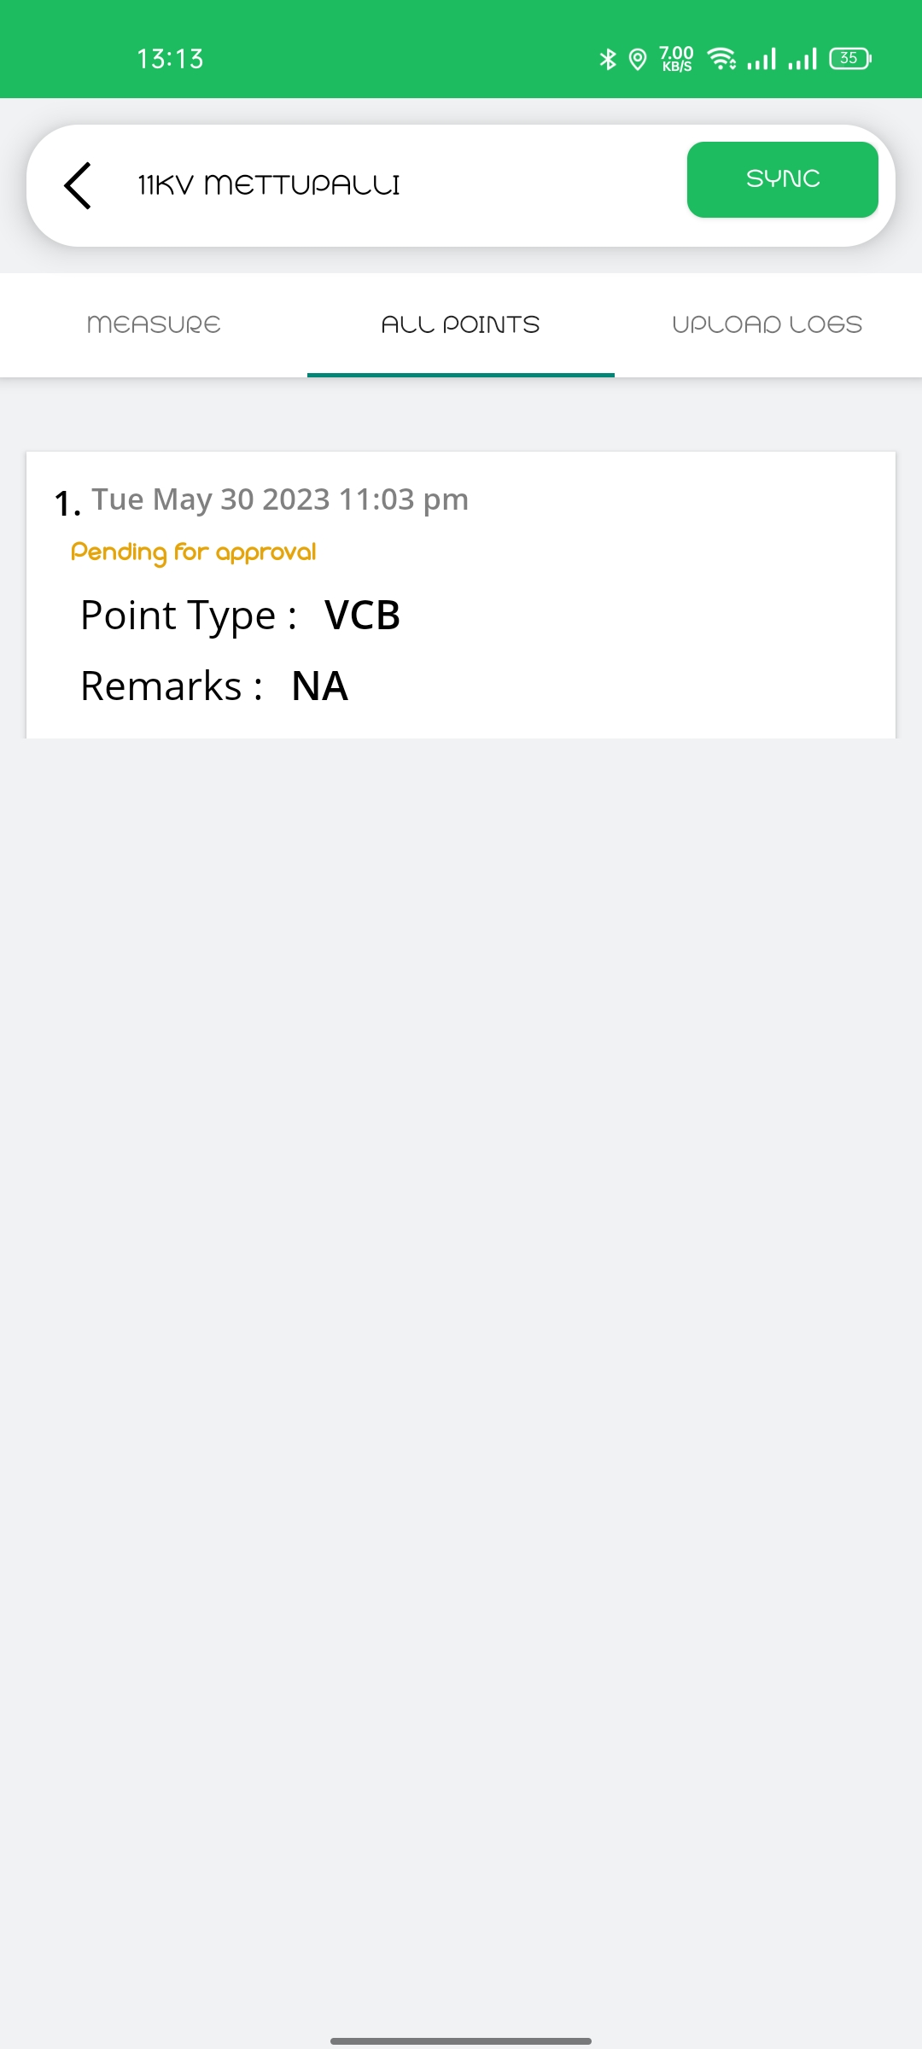
After Adding VCB Point
You can see the VCB point which is added

Slide 7
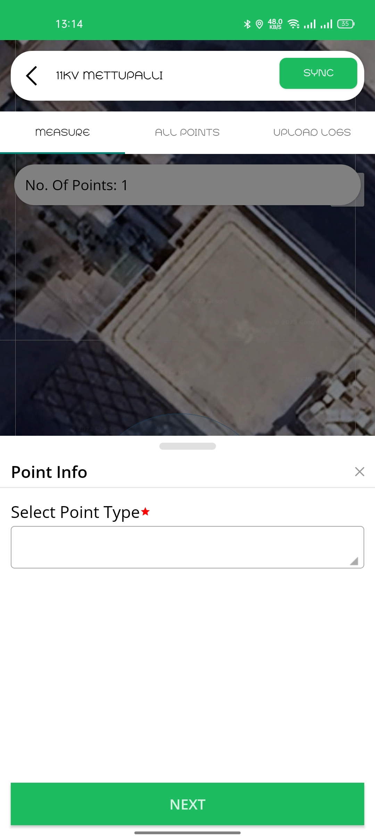
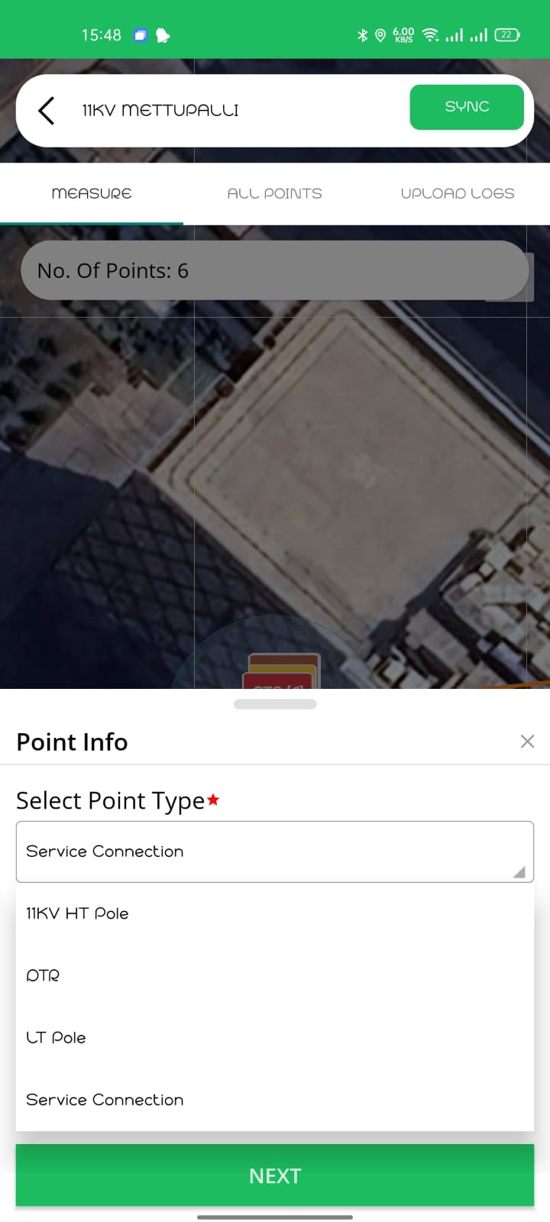
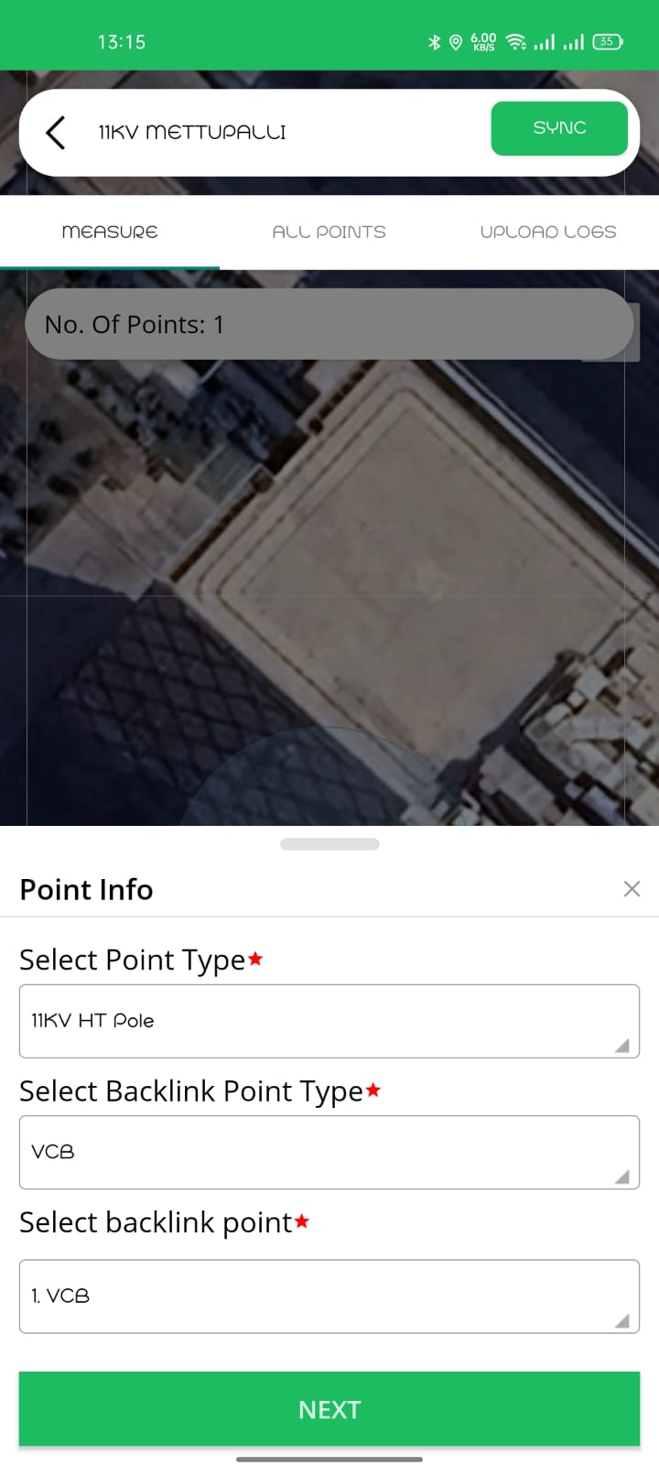
How to add HT POLE points
Click on Add Point
You will get dropdown of Point type
Select Point type as
11KV HT Pole
Select Backlink Point as VCB
(Vacuum Circuit Breaker)

Slide 8
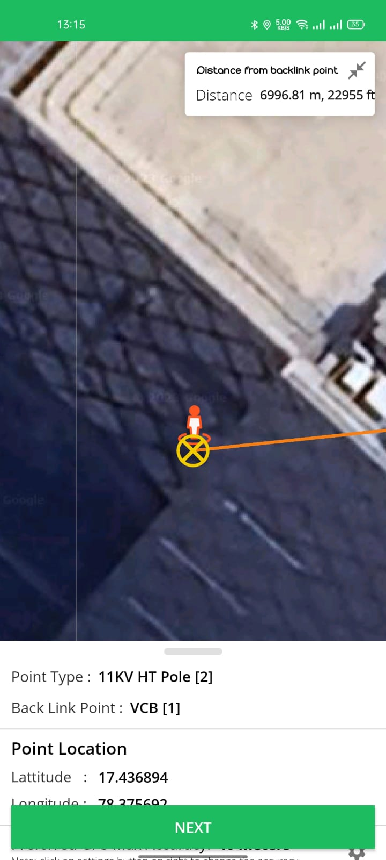
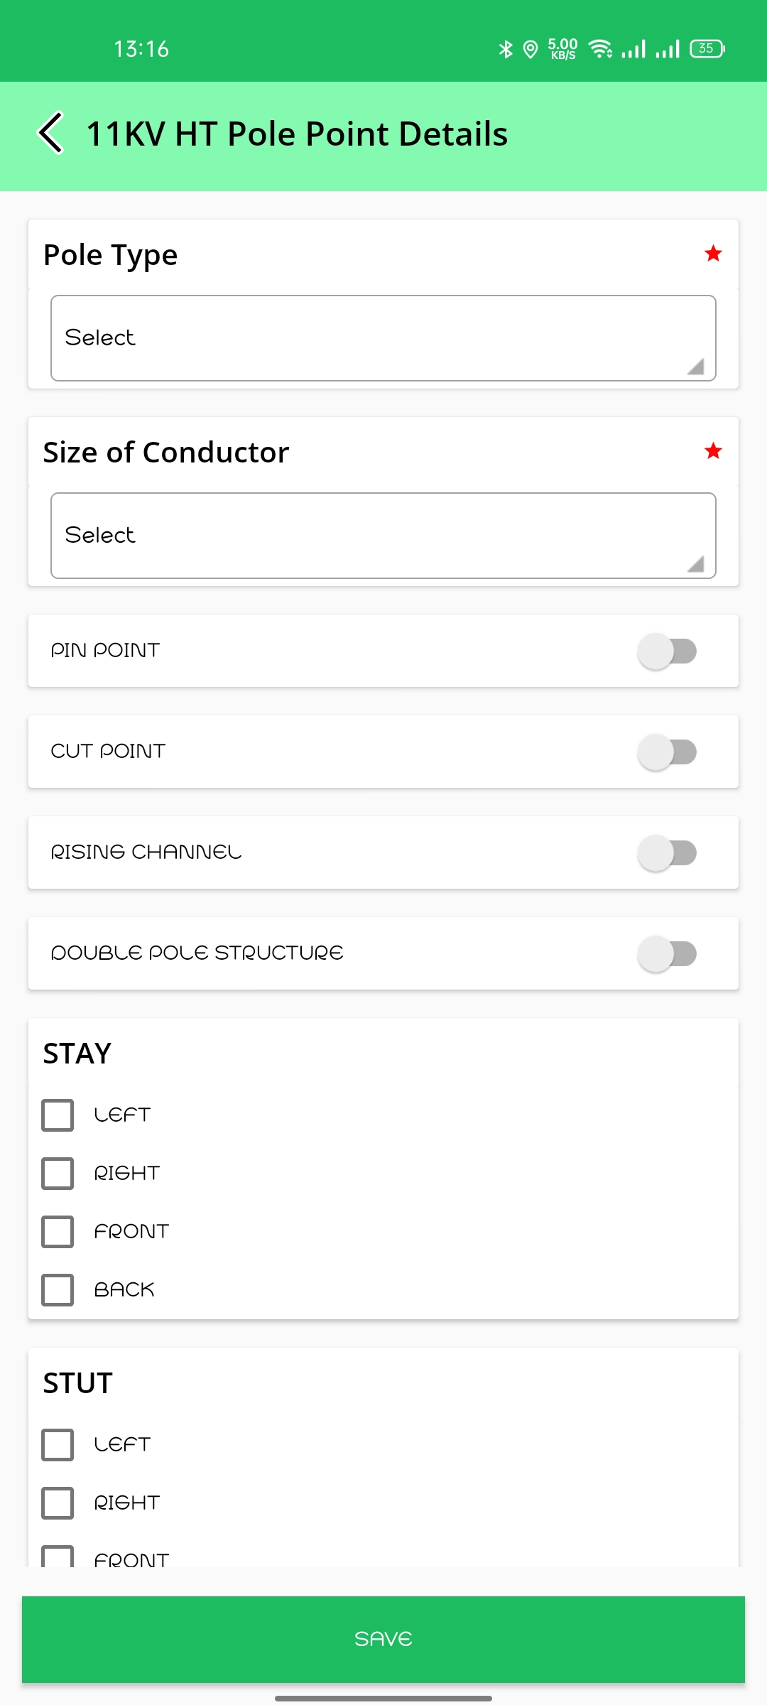
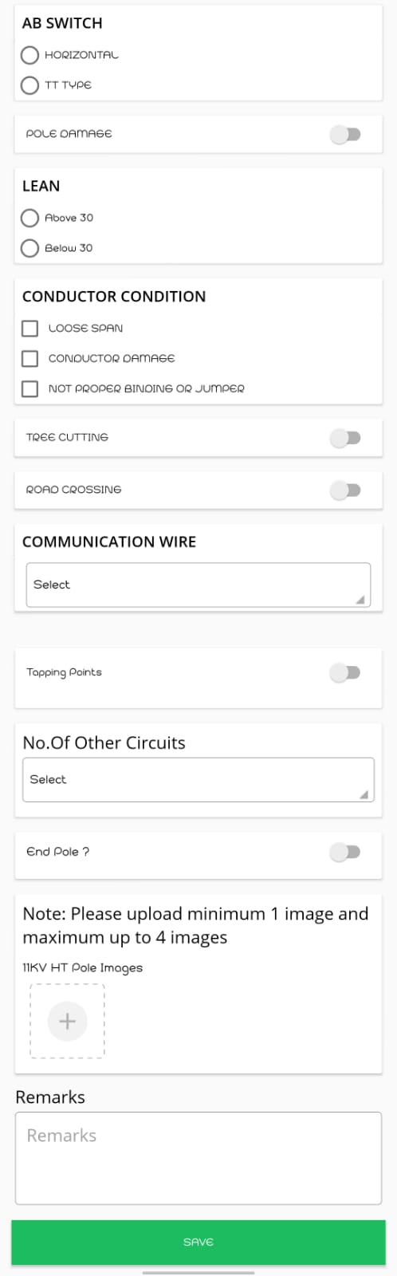
HT Pole Questionaries
Select 11KV HT Pole location as shown in Map View.
*Freezing point is mandatory
After Freezing HT POLE POINT you will find Questionaries.

Slide 9
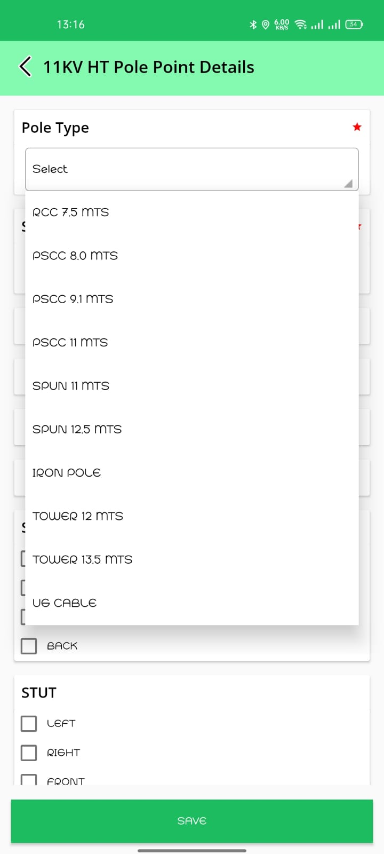
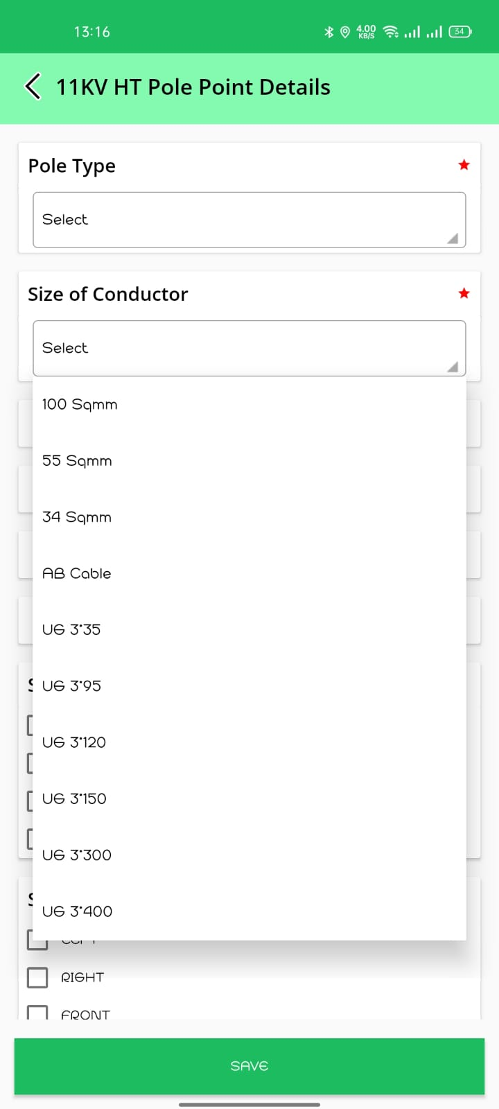
HT Pole Questionaries
Select Pole Type from the dropdown list
Click on Check Box, If Pole have any AB Switch
Click on Check Box, If there is any Lean
Click on Check Box according to conductor Condition
Click on Toggle Button, If any Tree Cutting or Road Crossing
Select Conductor size from the dropdown list
Click on Toggle Button, If the point type is Pin/ Cut/Rising channel/ Double structure
Click on Check Box, If there is any Stay or Stut

Slide 10
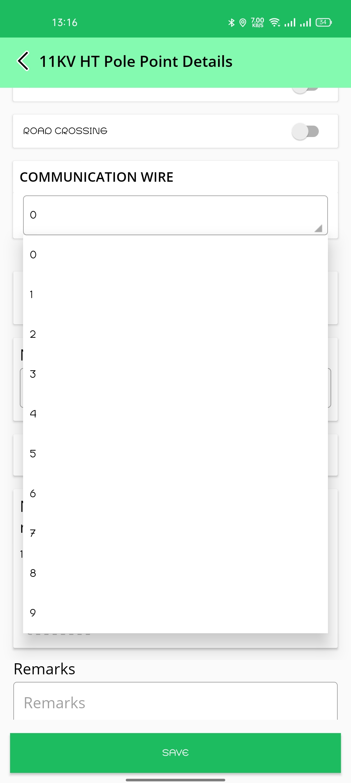
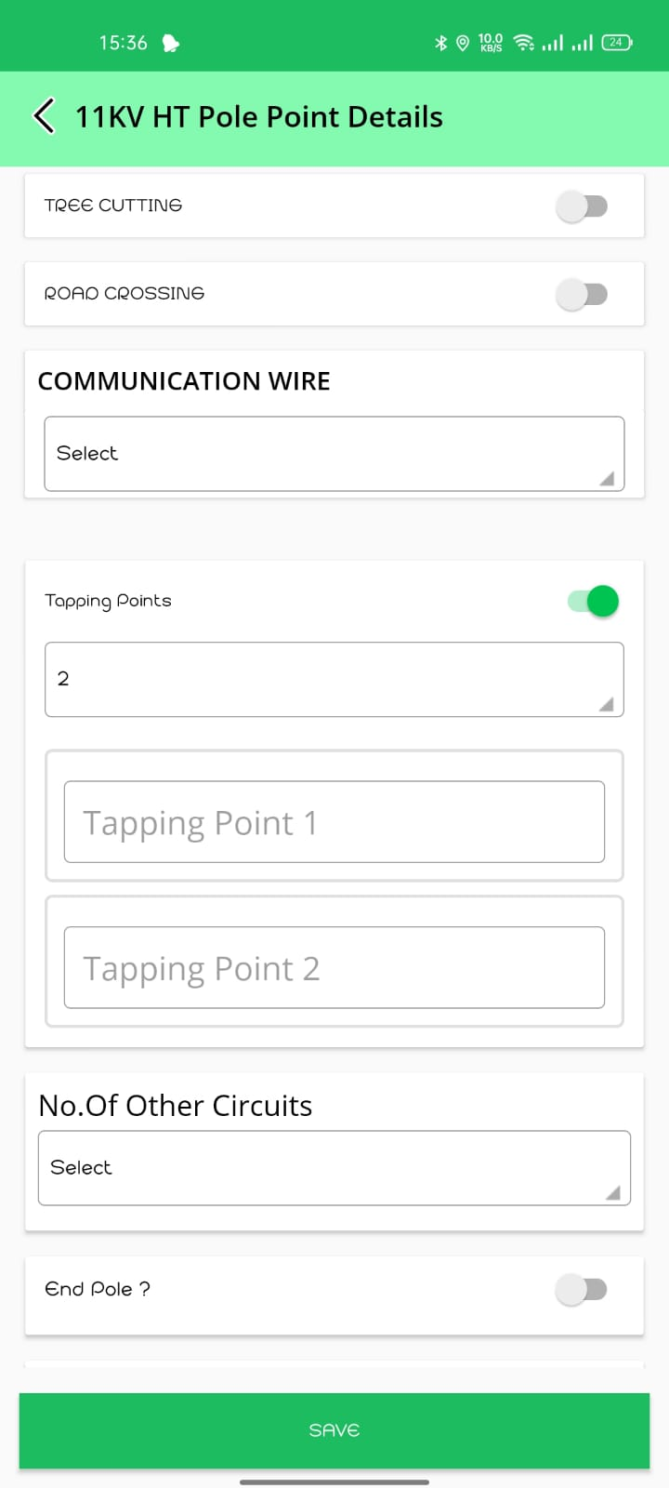
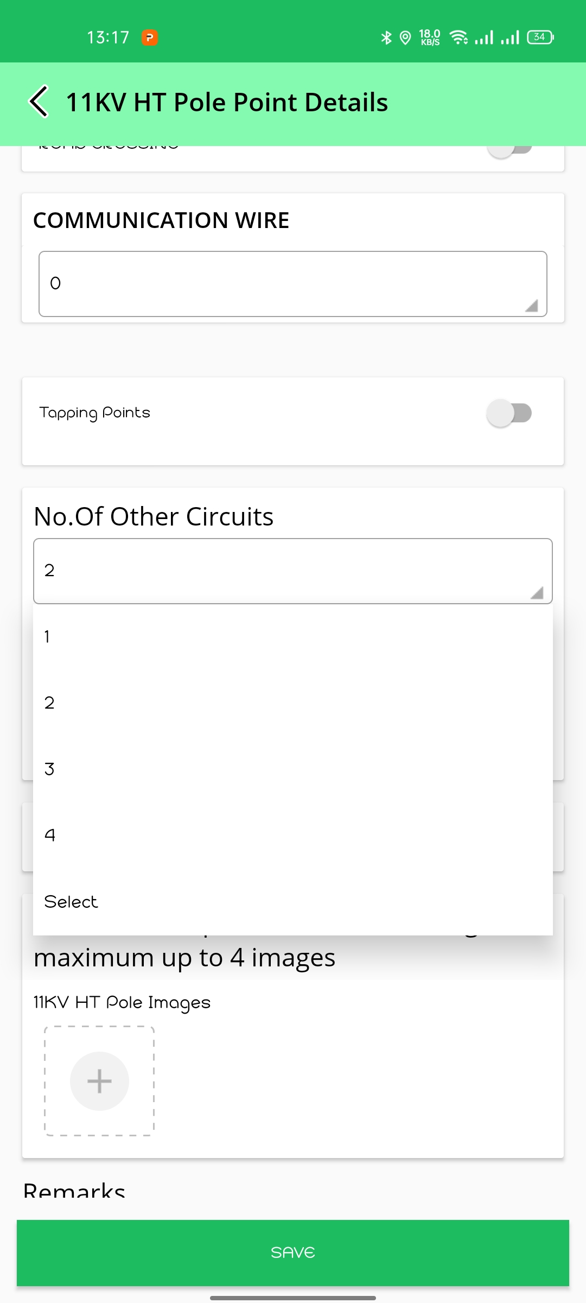
Click on +
Select the count of wires from the dropdown list, If there are any fiber/telecom wires on HT Pole
Click on Tapping points and Select the count of Tapping Points, If there is any Spur line
Mention the Remarks in Tapping Points.
Select the count of Circuits If there are any other circuits & Mention the details of KV
Click On the Toggle Button, if it’s the end point of 11kv line
Note : Don’t Click on End Pole Until the 11kv Line is Ended
Upload the Images Of HT Pole and mention if there any remarks.(Mandatory)

Slide 11
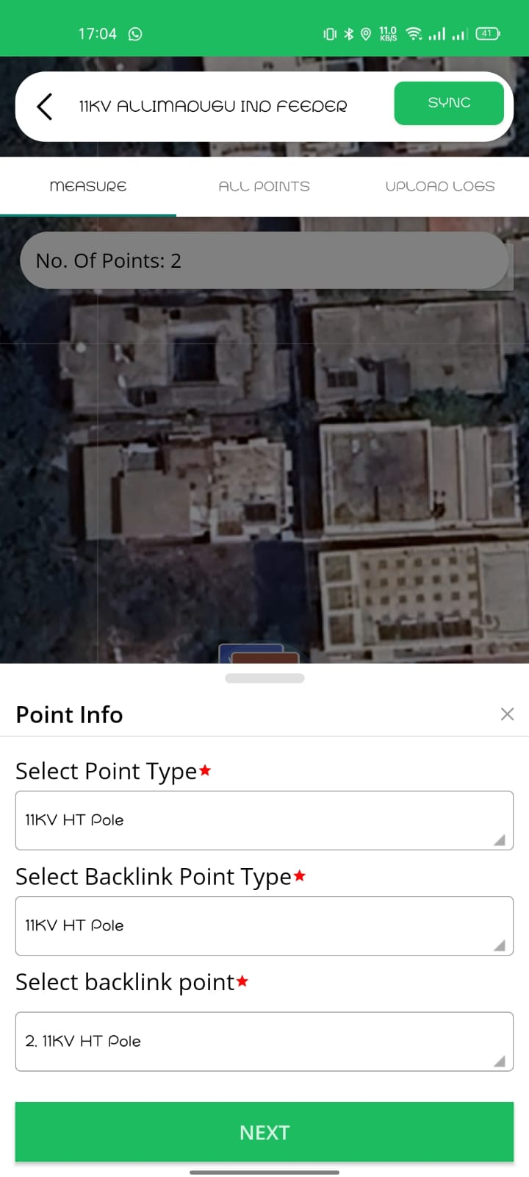
How to add Multiple HT POLE points
If there are multiple HT pole points, capture all the HT Poles.
For each HT pole point backlink point is previous HT pole point

Slide 12
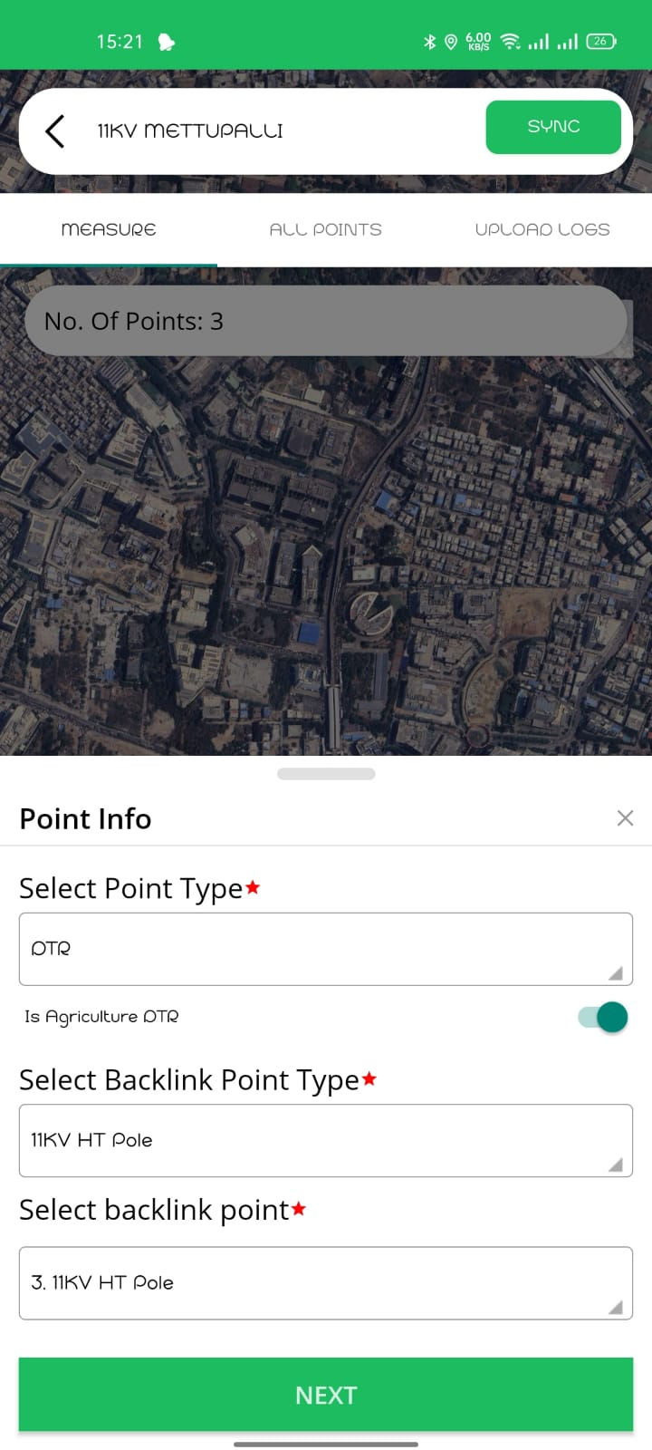
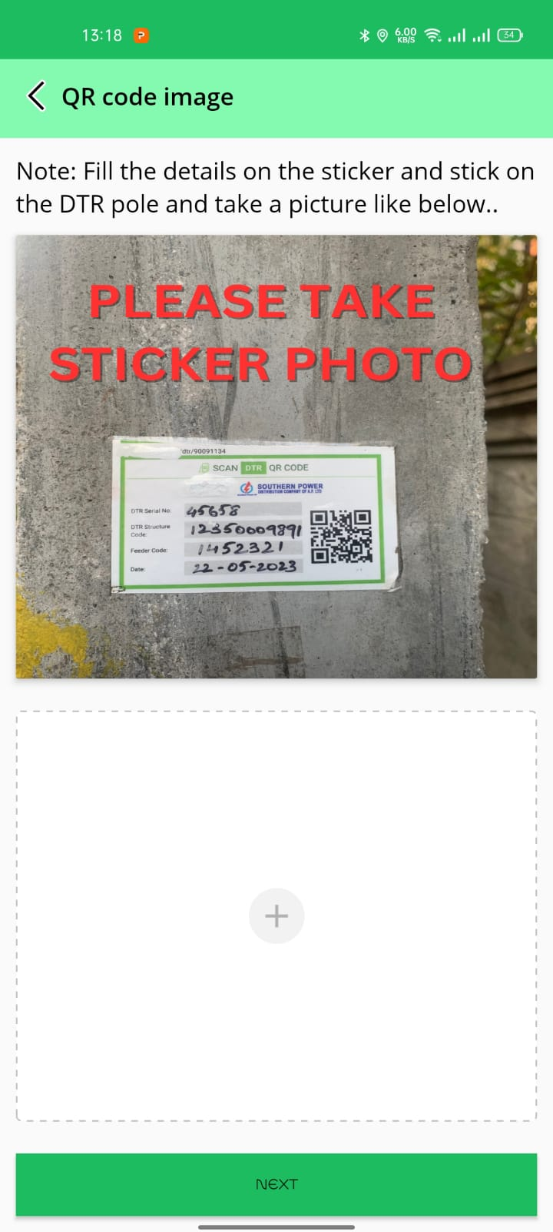
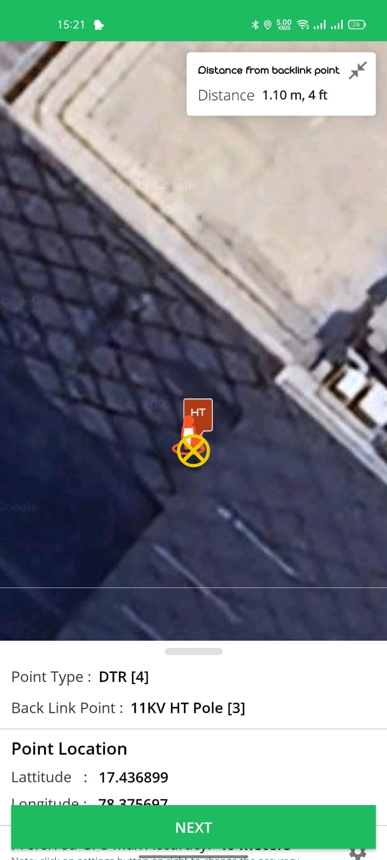
How to add DTR POINT
NOTE: If DTR is Mounted On HT Pole Or Beam, First Capture HT pole then Capture DTR Point & Back Link Point as same HT Pole
Click on +
Select the Point type as DTR
Select Back link point type HT POLE
Fill the Details on DTR Sticker and stick to the Pole & stick protective sticker above DTR sticker.
Upload the Image of DTR Sticker
Capture Location of DTR in Map View

Slide 13
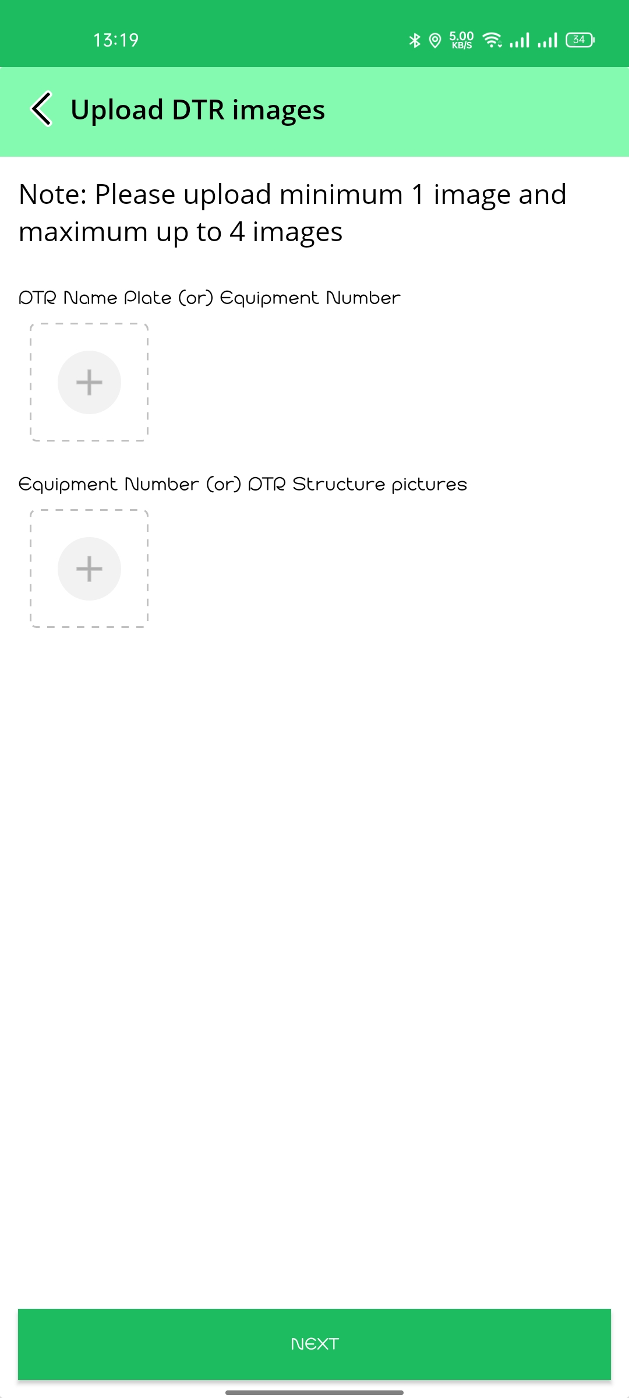
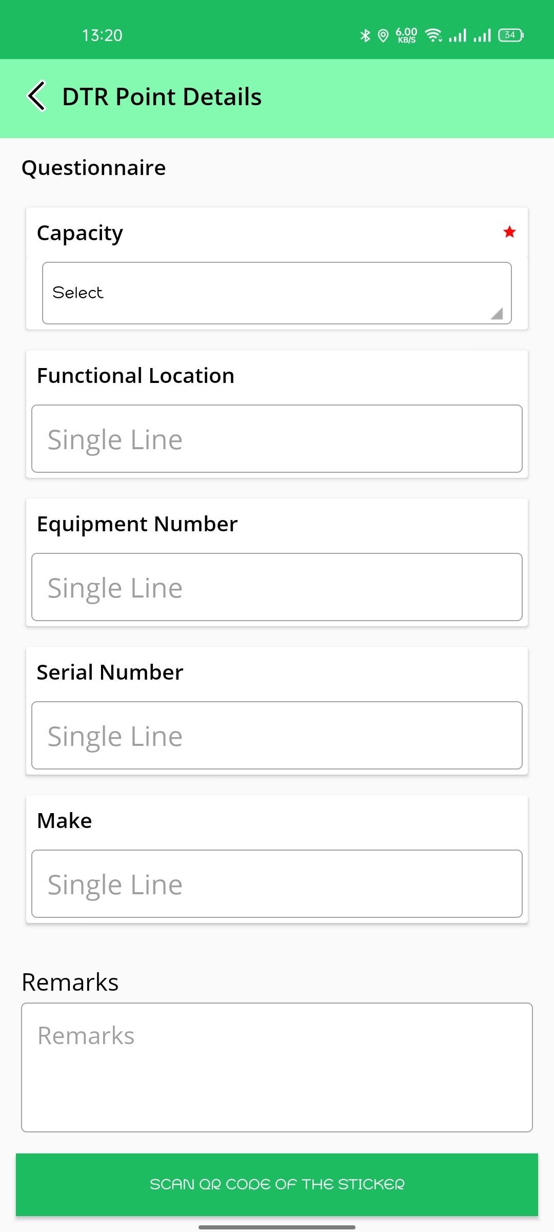
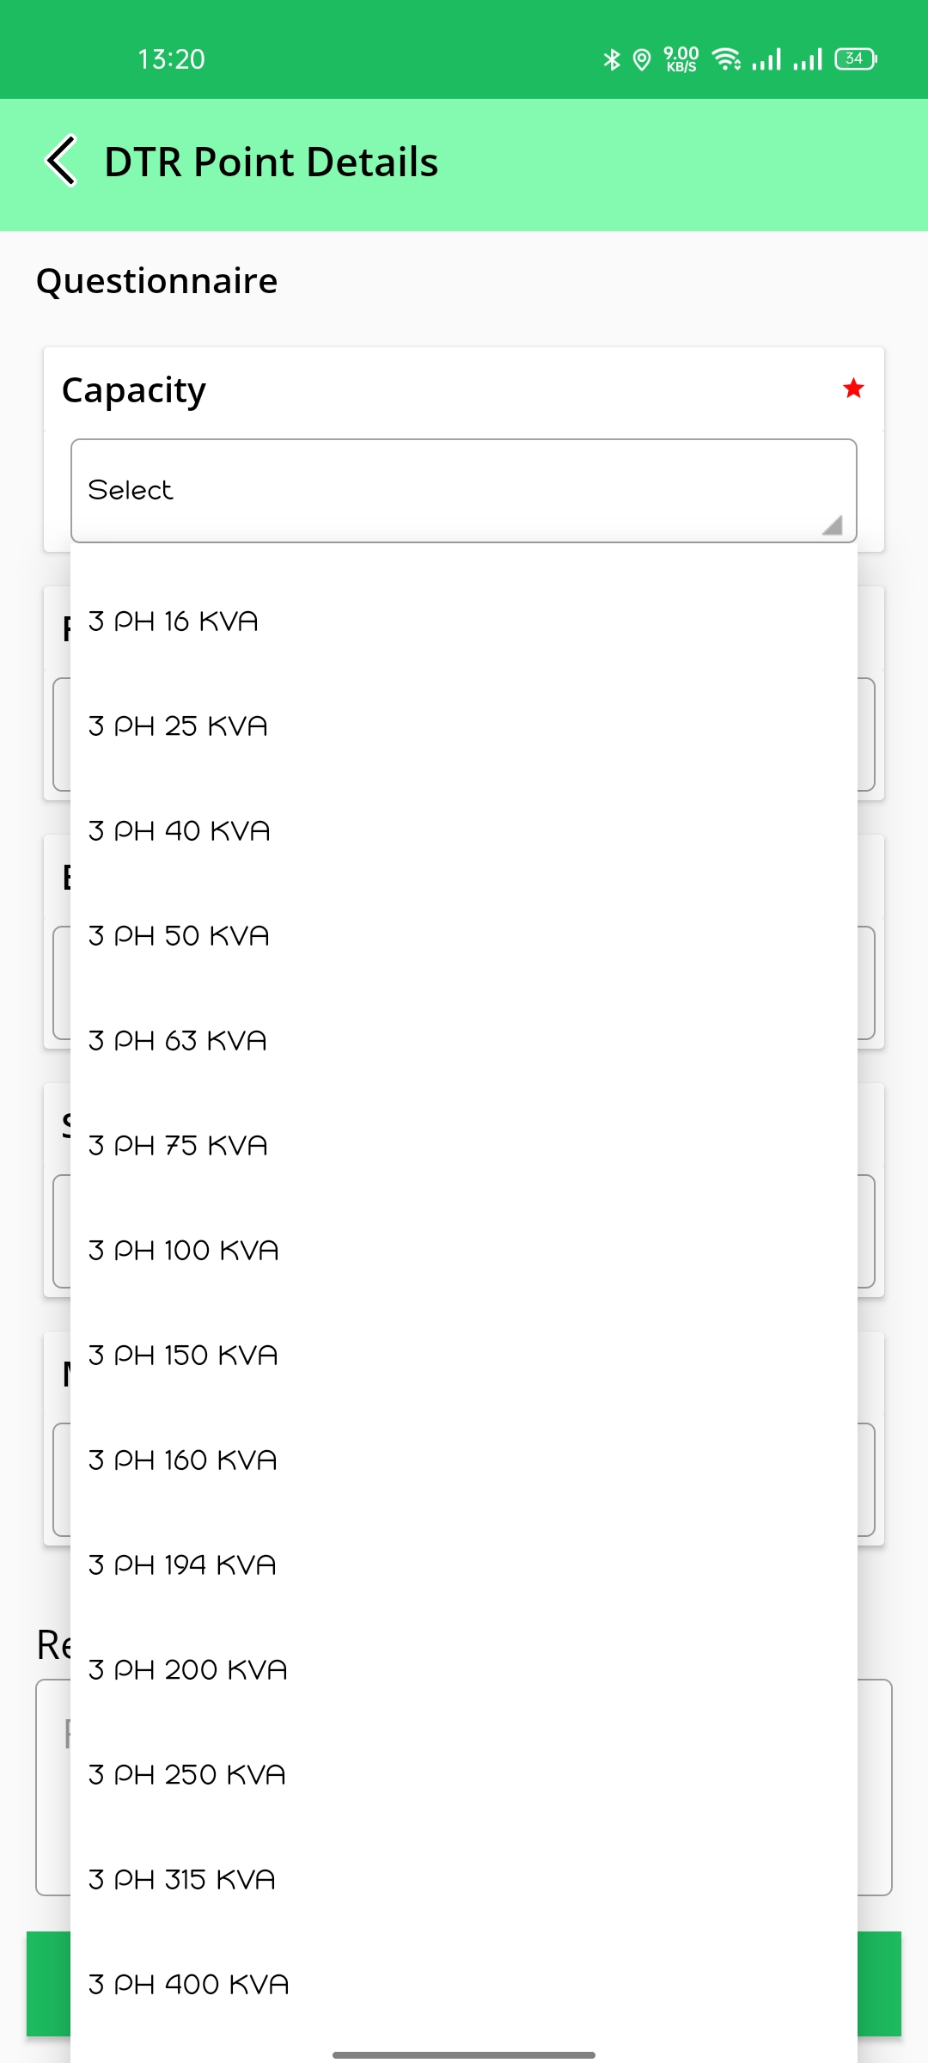
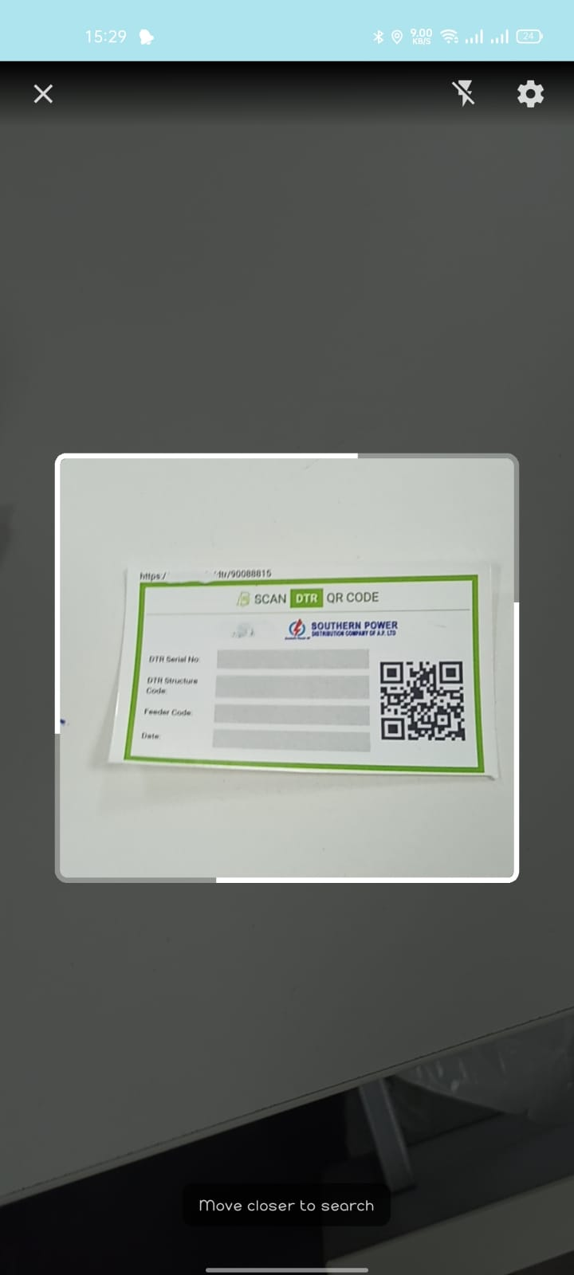
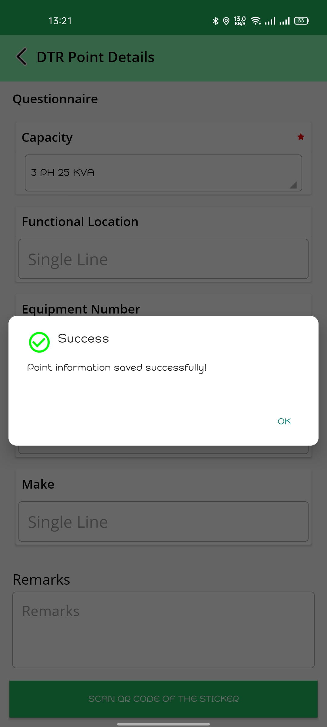
DTR POINT Questionaries
Upload the images of DTR Name Plate & Structure
Fill the DTR Point Details
Fill the Equipment Number
Fill the Serial No
Mention the Remarks
Select Capacity of DTR from the dropdown list
Scan the QR Code of DTR sticker which filled with DTR information
Once the DTR QR is scanned the DTR point information is saved successfully.

Slide 14
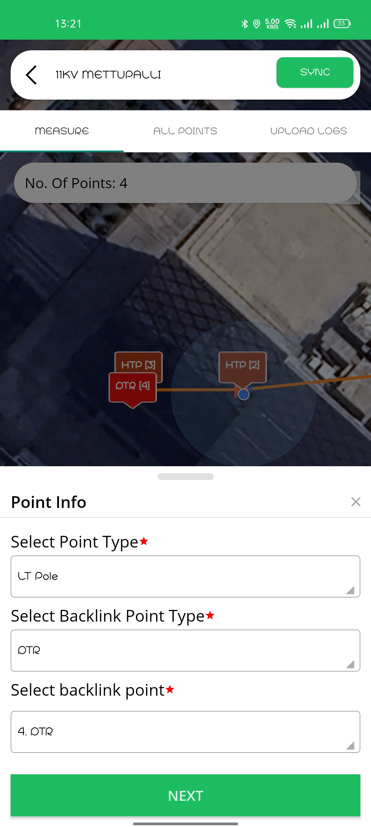
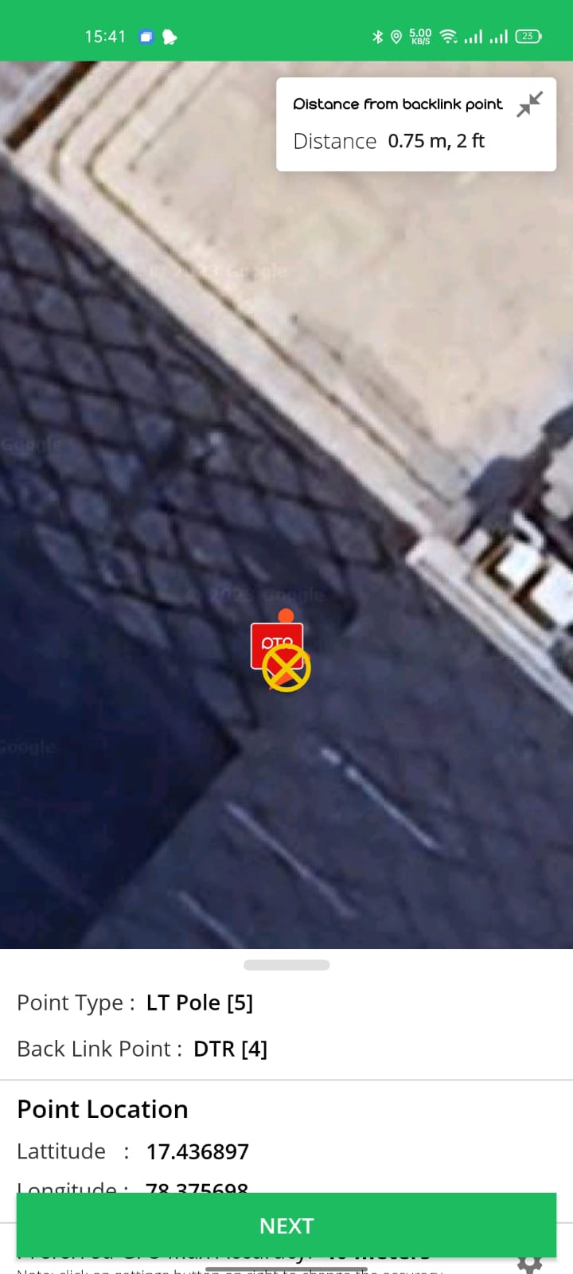
How to add LT POLE point
If there are any LT Poles between DTR & Service Connection all the LT Poles need to be captured same as HT Poles
Select Point type LT Pole
Select Back Link Point DTR

Slide 15
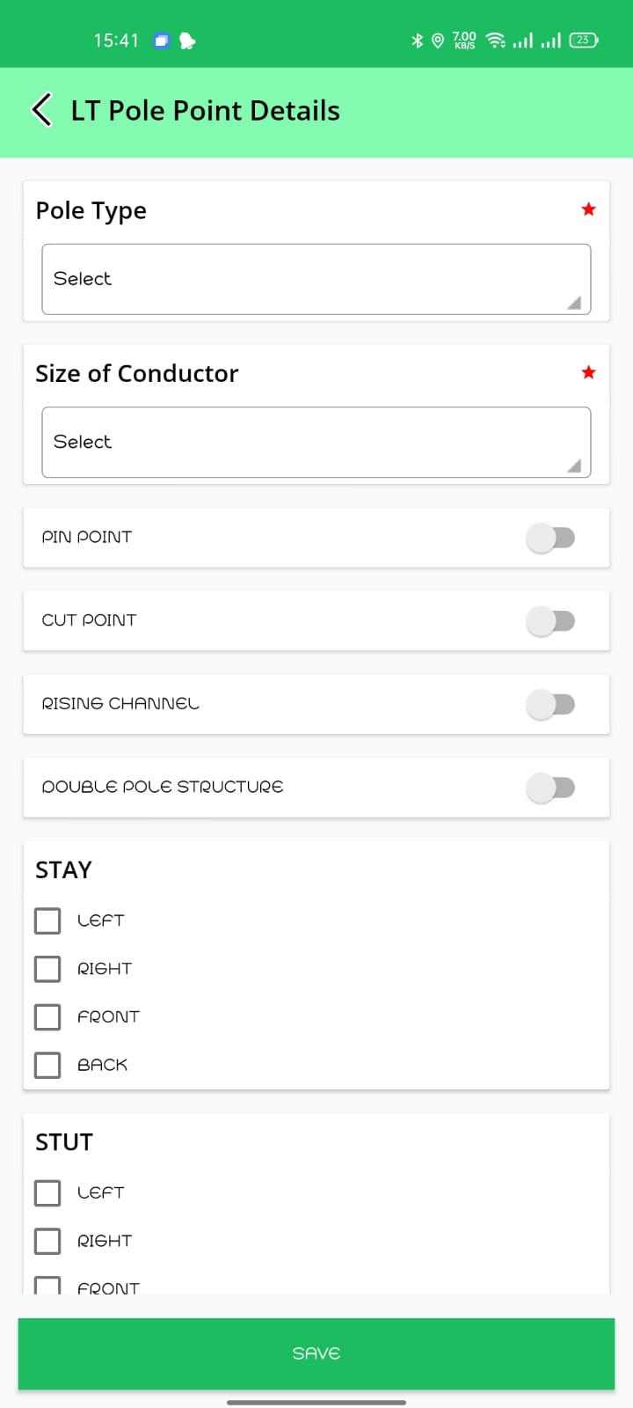
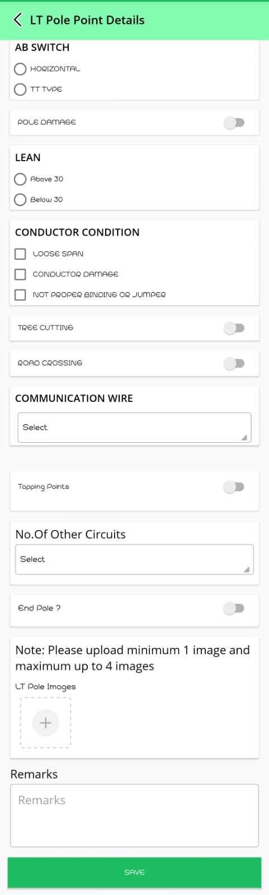
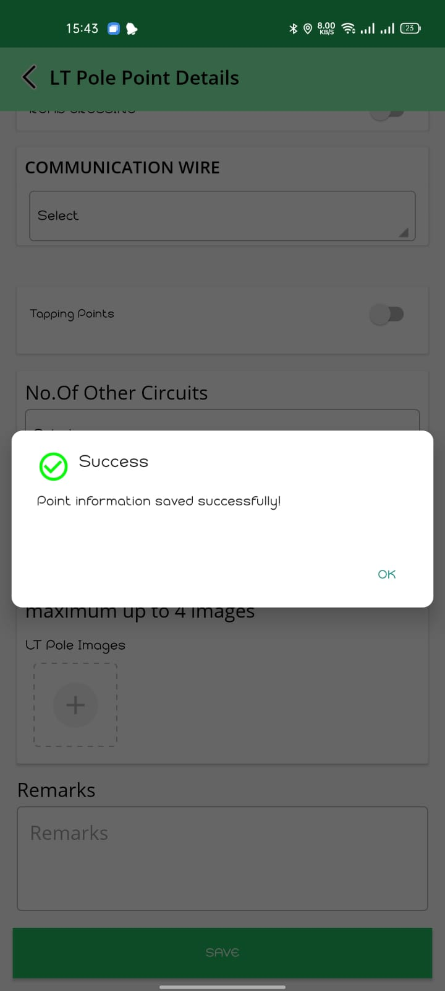
LT Pole Questionaries
Fill the Questionnaire of LT POLE and mention Remarks
Point Information will be saved Successfully.

Slide 16
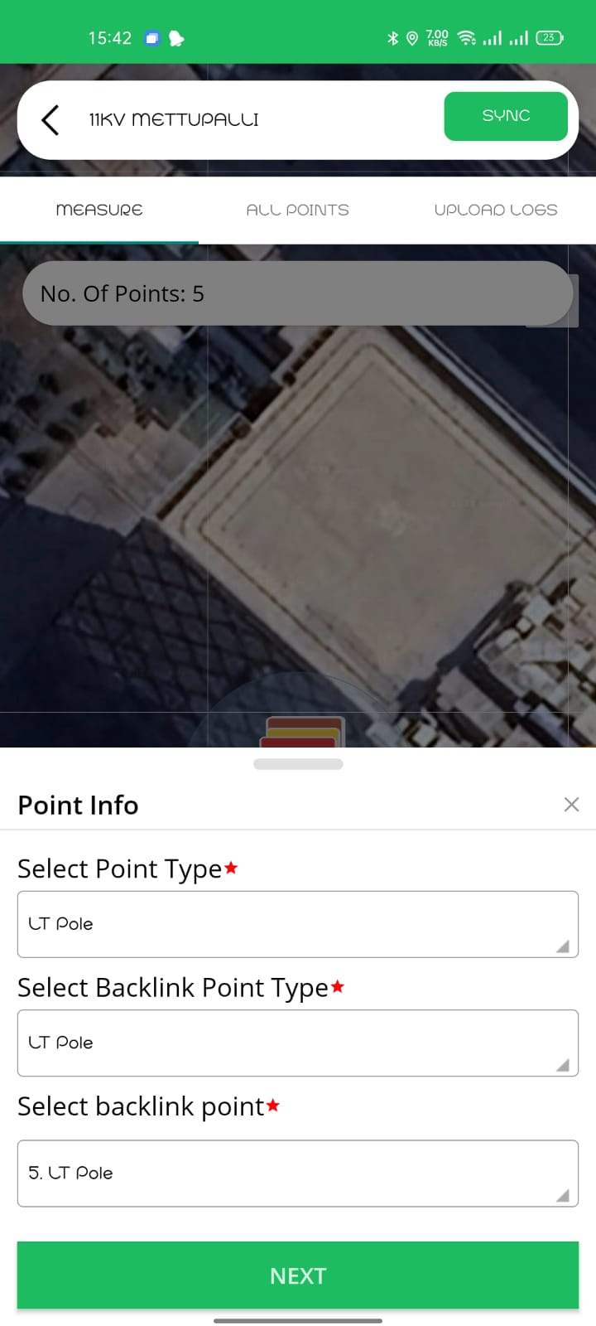
How to add Multiple LT POLE points
If there are multiple LT pole points between DTR and service connection , capture all the LT Poles.
For each LT pole point backlink point is previous LT pole point

Slide 17
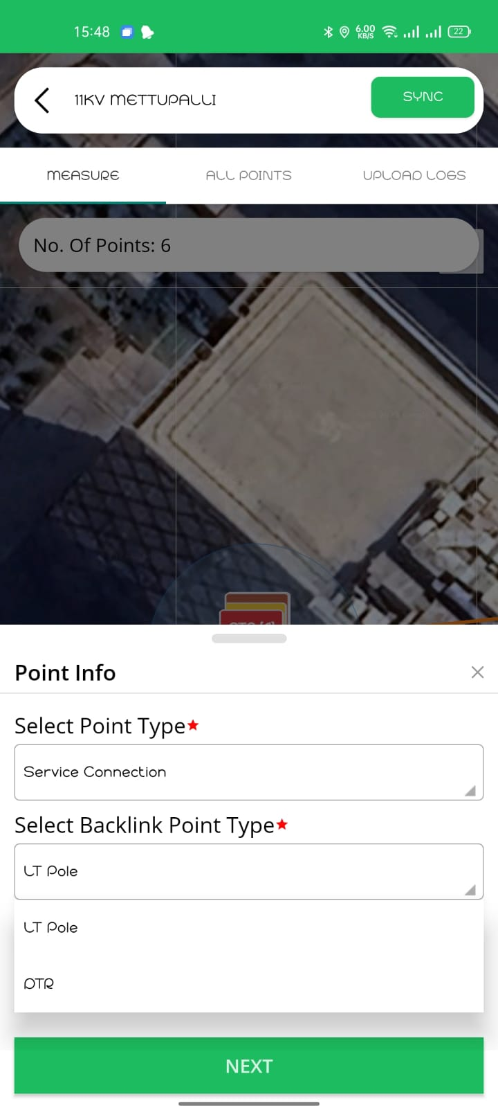
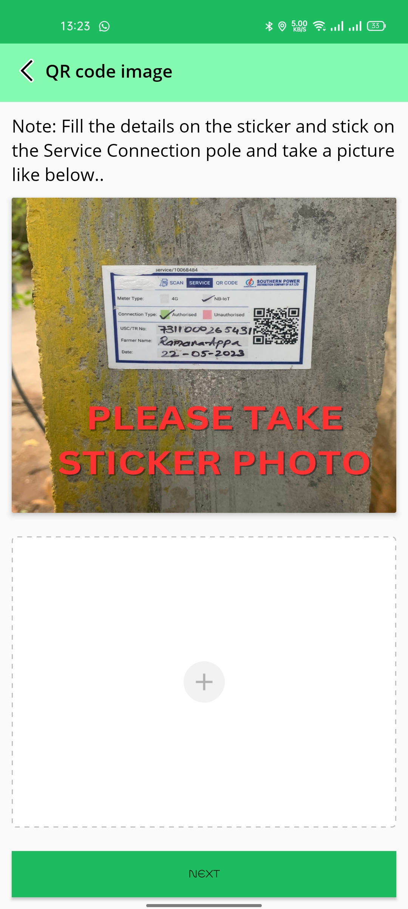
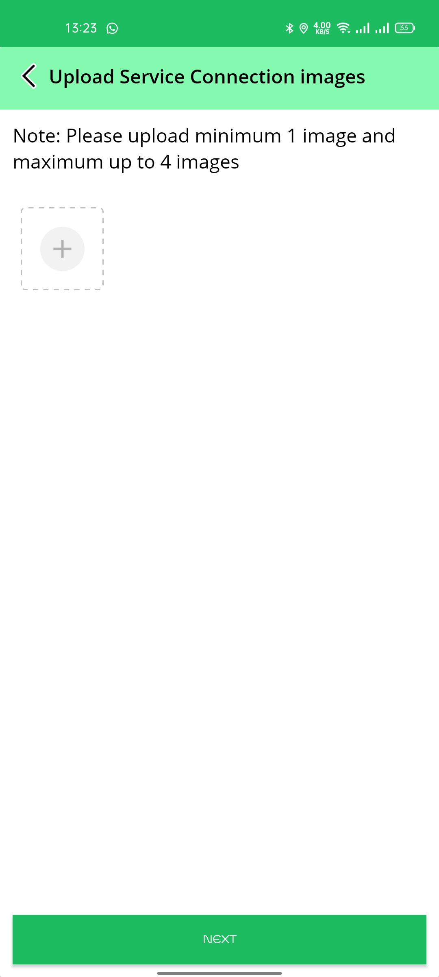
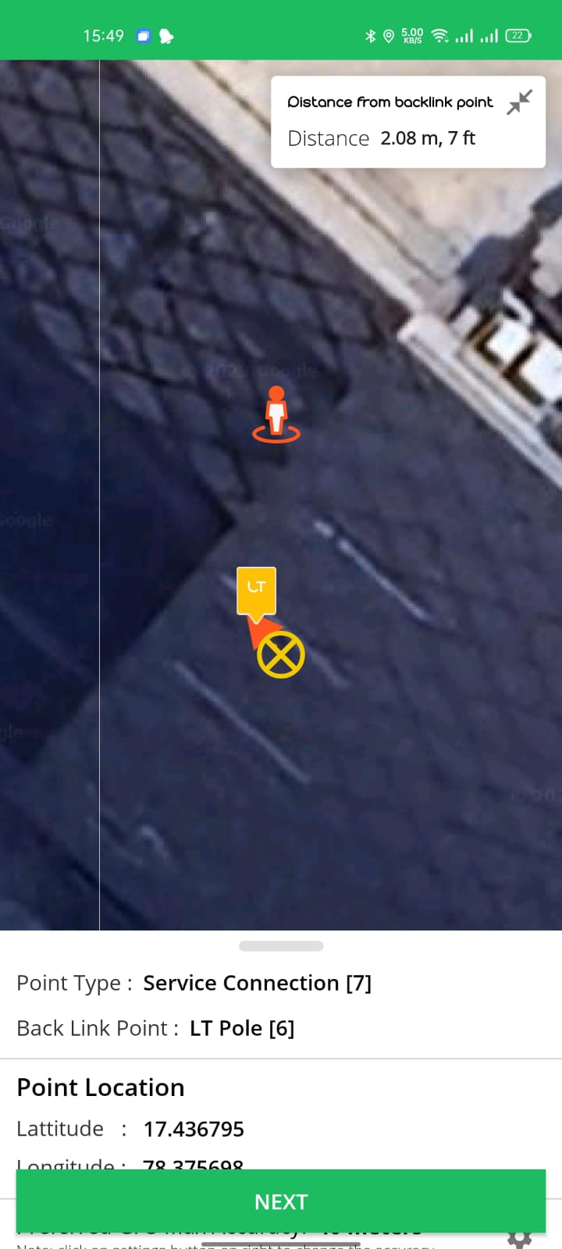
How to add Service Connection Point
Click On +
Select Point type as Service Connection
Select Backlink Point as LT Pole
Fill the Details of Consumer on Service connection Sticker and stick to the Pole & stick protective sticker on the service sticker.
Upload the image of Service connection Sticker
Upload minimum 2 images Of Borewell pipes, Motor & Starter Panel.

Slide 18
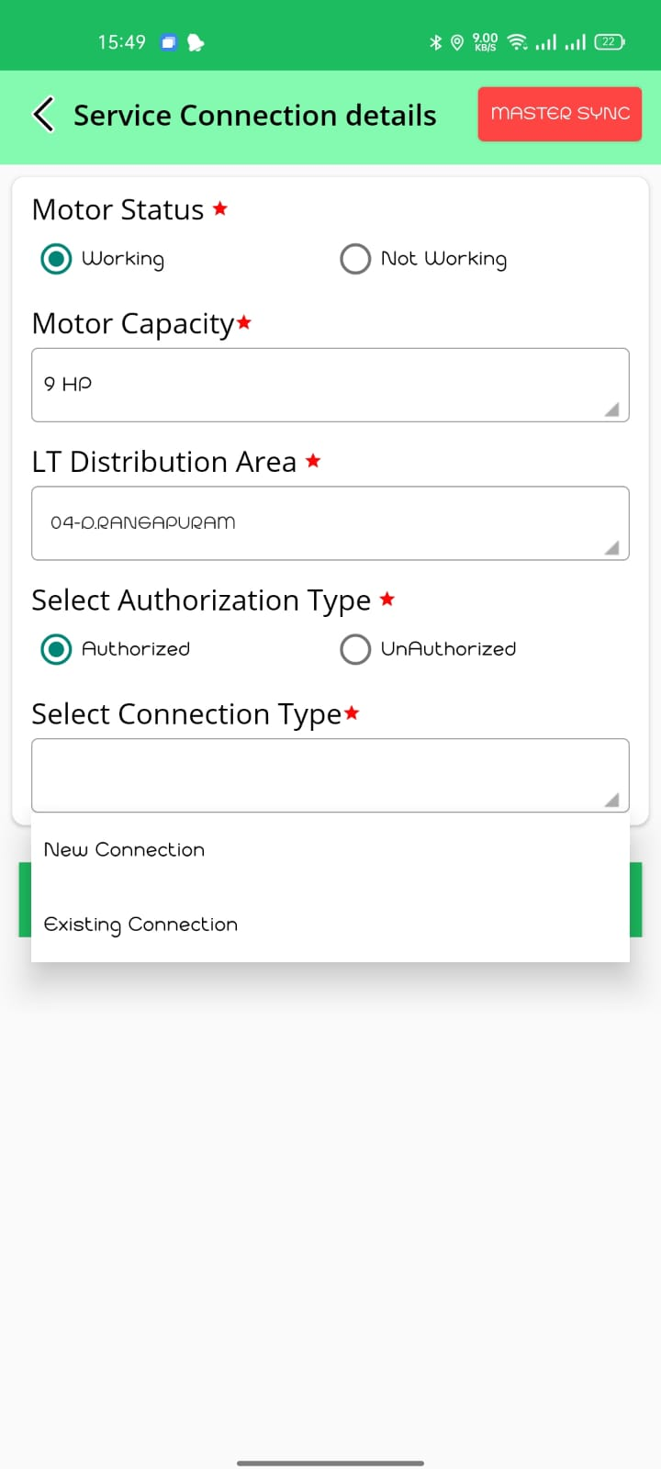
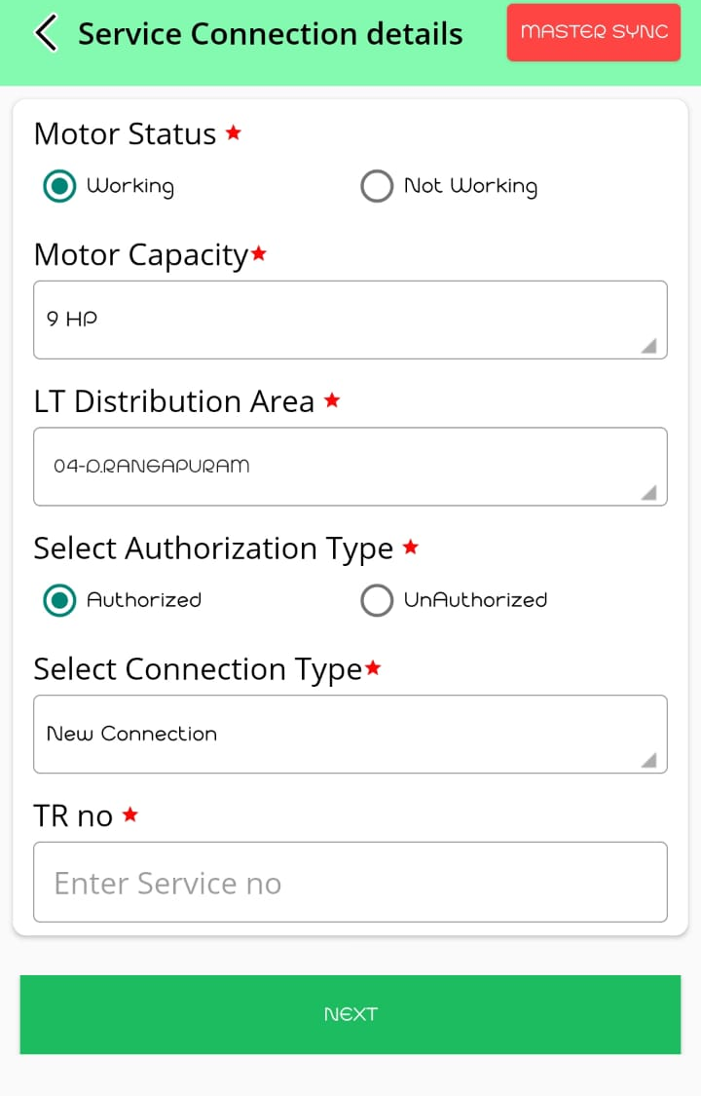
Service Connection Questionaries
Click on Master Sync you will get the LT Distribution Area Details
Select Check Box of Motor Condition Working Or Not Working
Select Motor capacity from the dropdown list
Select LT distribution area & Select Authorization Type from the dropdown list.
If Service Connection is Authorized Select Connection Type as New Connection Or Existing Connection
If service connection is a New Connection, Enter TR No. / Mobile Number/ Aadhar Number

Slide 19
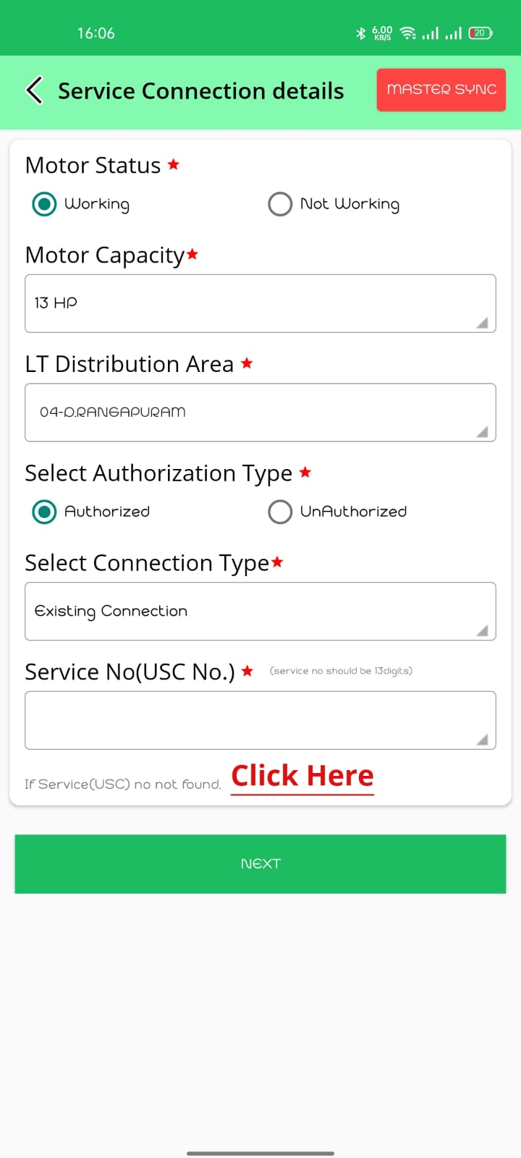
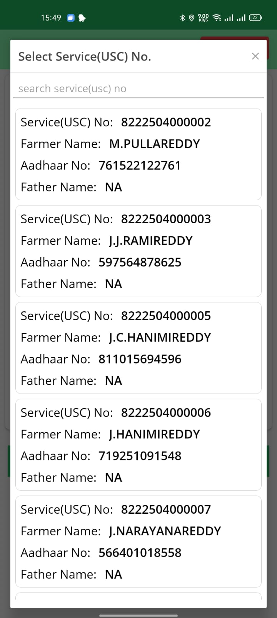






Existing Service Connection
If Connection is Existing Select USC No. from Dropdown List
If USC No. is Not found Please Contact Support team

Slide 20
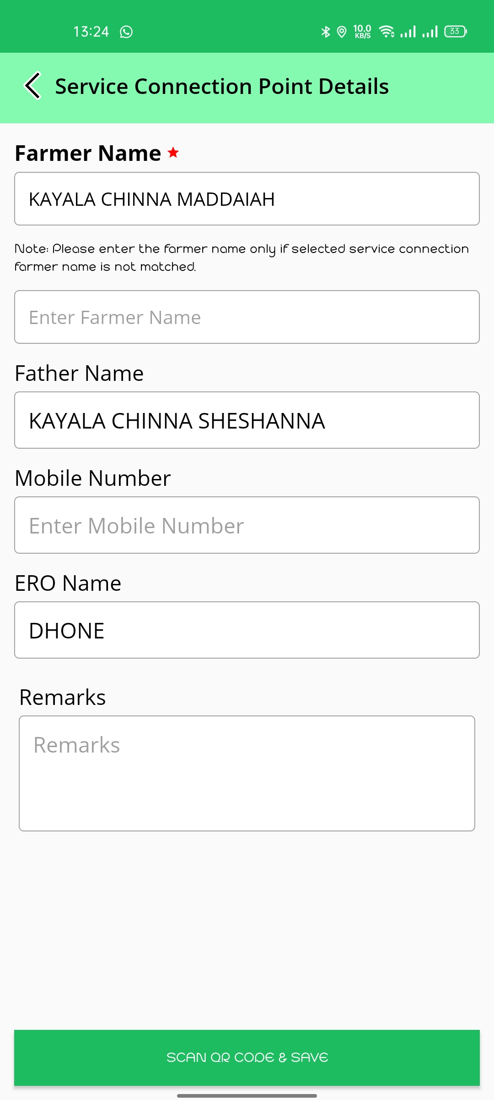
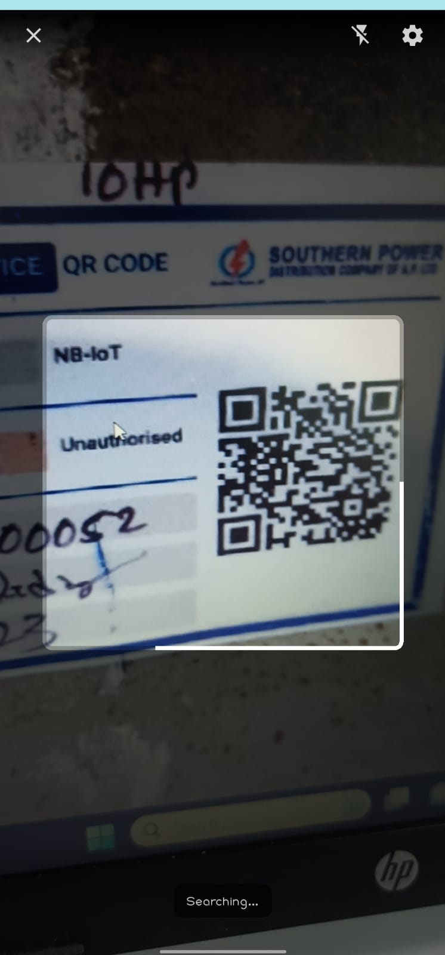
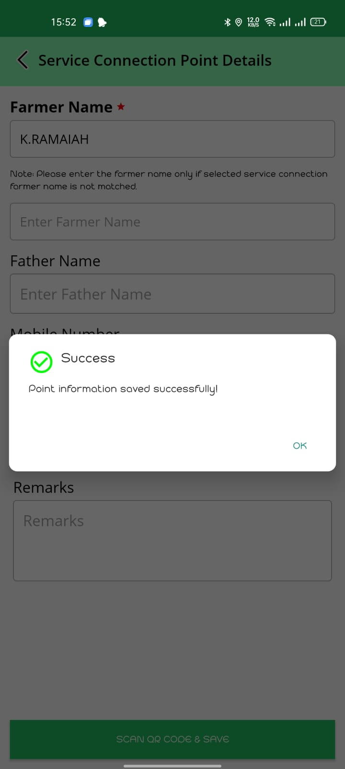
Verify the Details of Farmer
If the Farmer Name is wrong Enter Correct name
Scan the QR Code Of service connection
Point Information will be saved Successfully

Slide 21
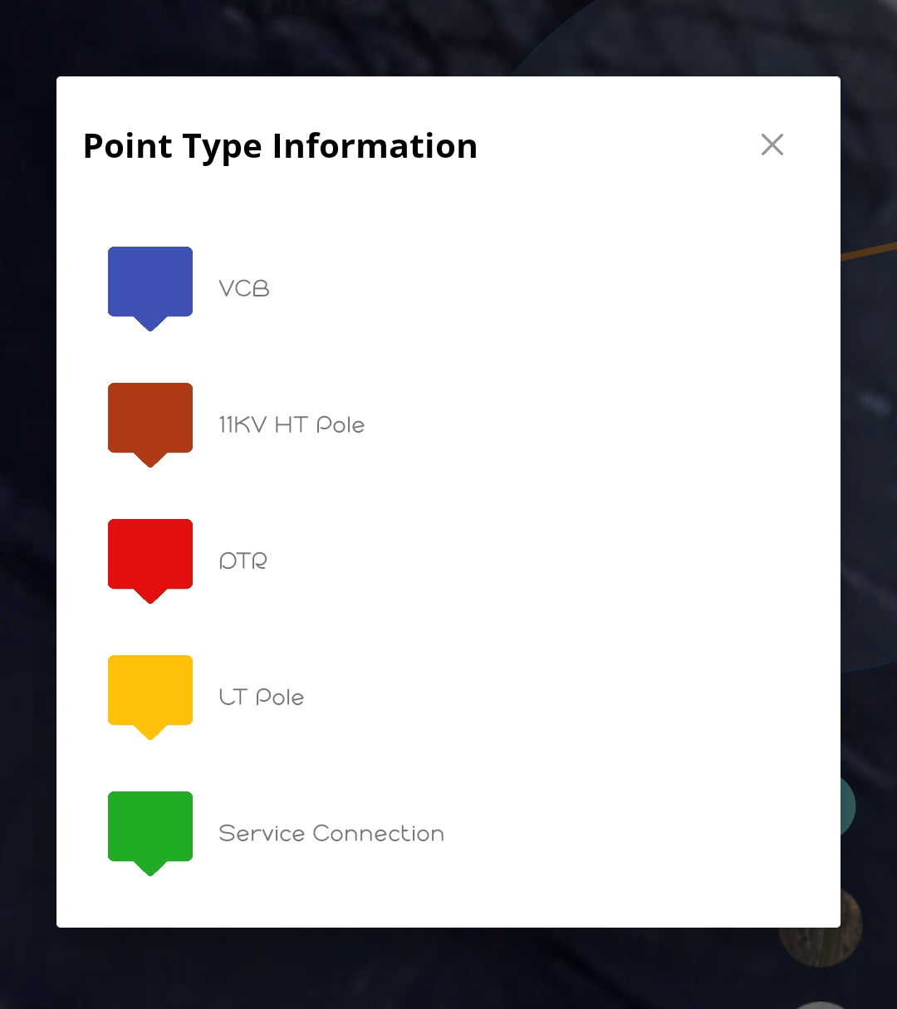


Slide 22



Check the Points Captured
Note : Don’t Click on End survey until feeder is completed.
Once the feeder is completed, you can end survey.
You can find the Uploaded Points, Points pending for Upload, Approved Points & Points pending for approval.
Click on UPLOAD, After Completing points
You Can find Points Captured of 11KV HT Pole, DTR, LT Pole &
Service connection
If the Mapped Points are entered Wrongly
You have the Option Delete Shown as Above

Slide 23

Thank you

